Slide 4
1 Corinthians 1
⁴ I give thanks to my God always for you because of the grace of God that was given you in Christ Jesus, ⁵ that in every way you were enriched in him in all speech and all knowledge— ⁶ even as the testimony about Christ was confirmed among you— ⁷ so that you are not lacking in any spiritual gift, as you wait for the revealing of our Lord Jesus Christ, ⁸ who will sustain you to the end, guiltless in the day of our Lord Jesus Christ.

Slide 5
⁹ God is faithful, by whom you were called into the fellowship of his Son, Jesus Christ our Lord.

Slide 6
UNITY MATTERS: dealing with division

Slide 7
¹⁰ I appeal to you, brothers,^{[a]} by the name of our Lord Jesus Christ, that all of you agree, and that there be no divisions among you, but that you be united in the same mind and the same judgement. ¹¹ For it has been reported to me by Chloe's people that there is quarrelling among you, my brothers. ¹² What I mean is that each one of you says, “I follow Paul”, or “I follow Apollos”, or “I follow Cephas”, or “I follow Christ.” ¹³ Is Christ divided? Was Paul crucified for you? Or were you baptized in the name of Paul? ¹⁴ I thank God that I baptized none of you except Crispus and Gaius, ¹⁵ so that no one may say that you were baptized in my name. ¹⁶ (I did baptize also the household of Stephanas. Beyond that, I do not know whether I baptized anyone else.) ¹⁷ For Christ did not send me to baptize but to preach the gospel, and not with words of eloquent wisdom, lest the cross of Christ be emptied of its power.

Slide 8
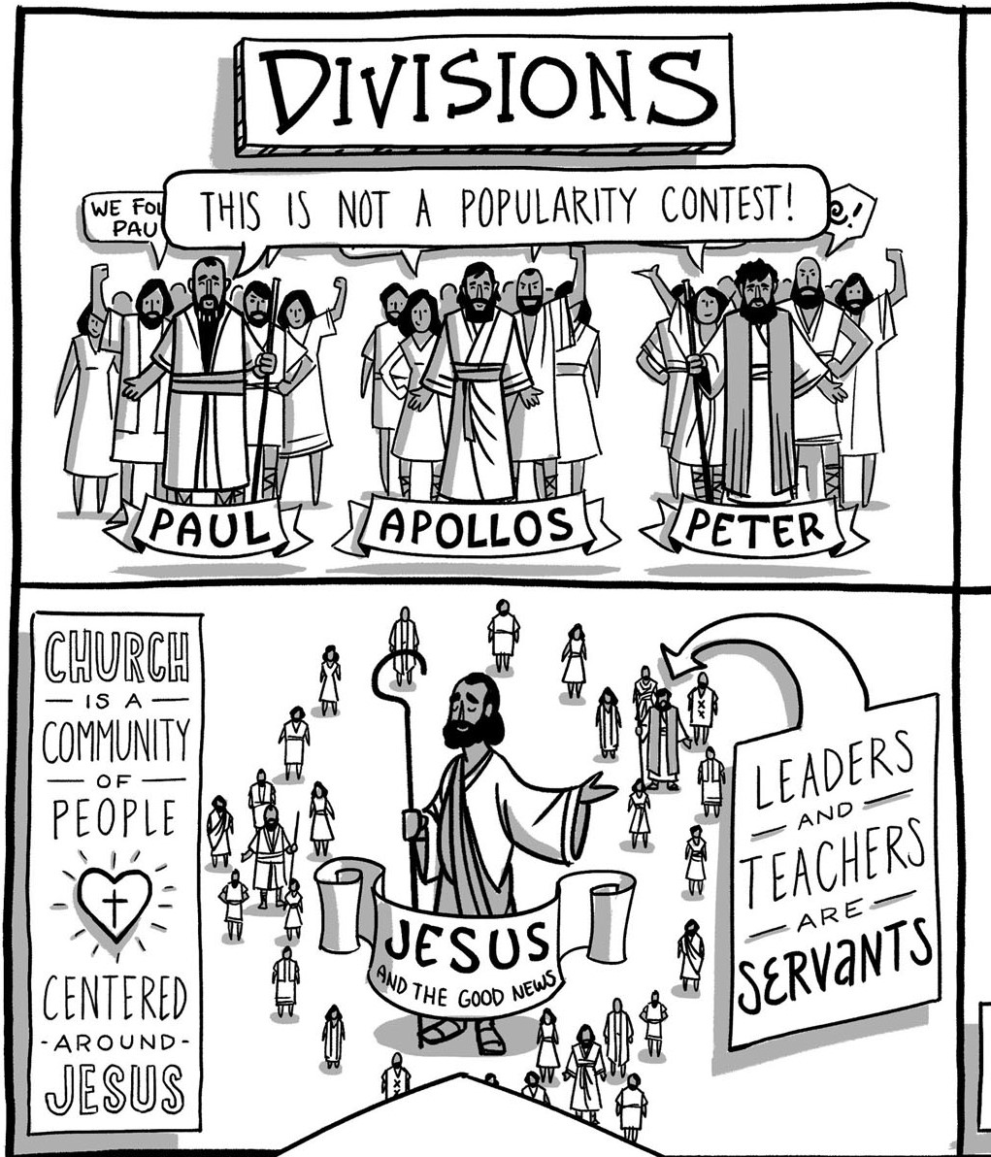

Slide 9
¹³ Is Christ divided?

Slide 10
¹³ Was Paul crucified for you? Or were you baptized in the name of Paul?

Slide 11
¹⁷ For Christ did not send me to baptize but to preach the gospel, and not with words of eloquent wisdom, lest the cross of Christ be emptied of its power.

Slide 12
Romans 3
²³ for all have sinned and fall short of the glory of God,
Romans 6
²³ For the wages of sin is death,

Slide 13
²³ For the wages of sin is death, but the free gift of God is eternal life in Christ Jesus our Lord.

Slide 14
John 3
¹⁶ “For God so loved the world,^{[i]} that he gave his only Son, that whoever believes in him should not perish but have eternal life.
Romans 10
¹³ For “everyone who calls on the name of the Lord will be saved.”

