Slide 3
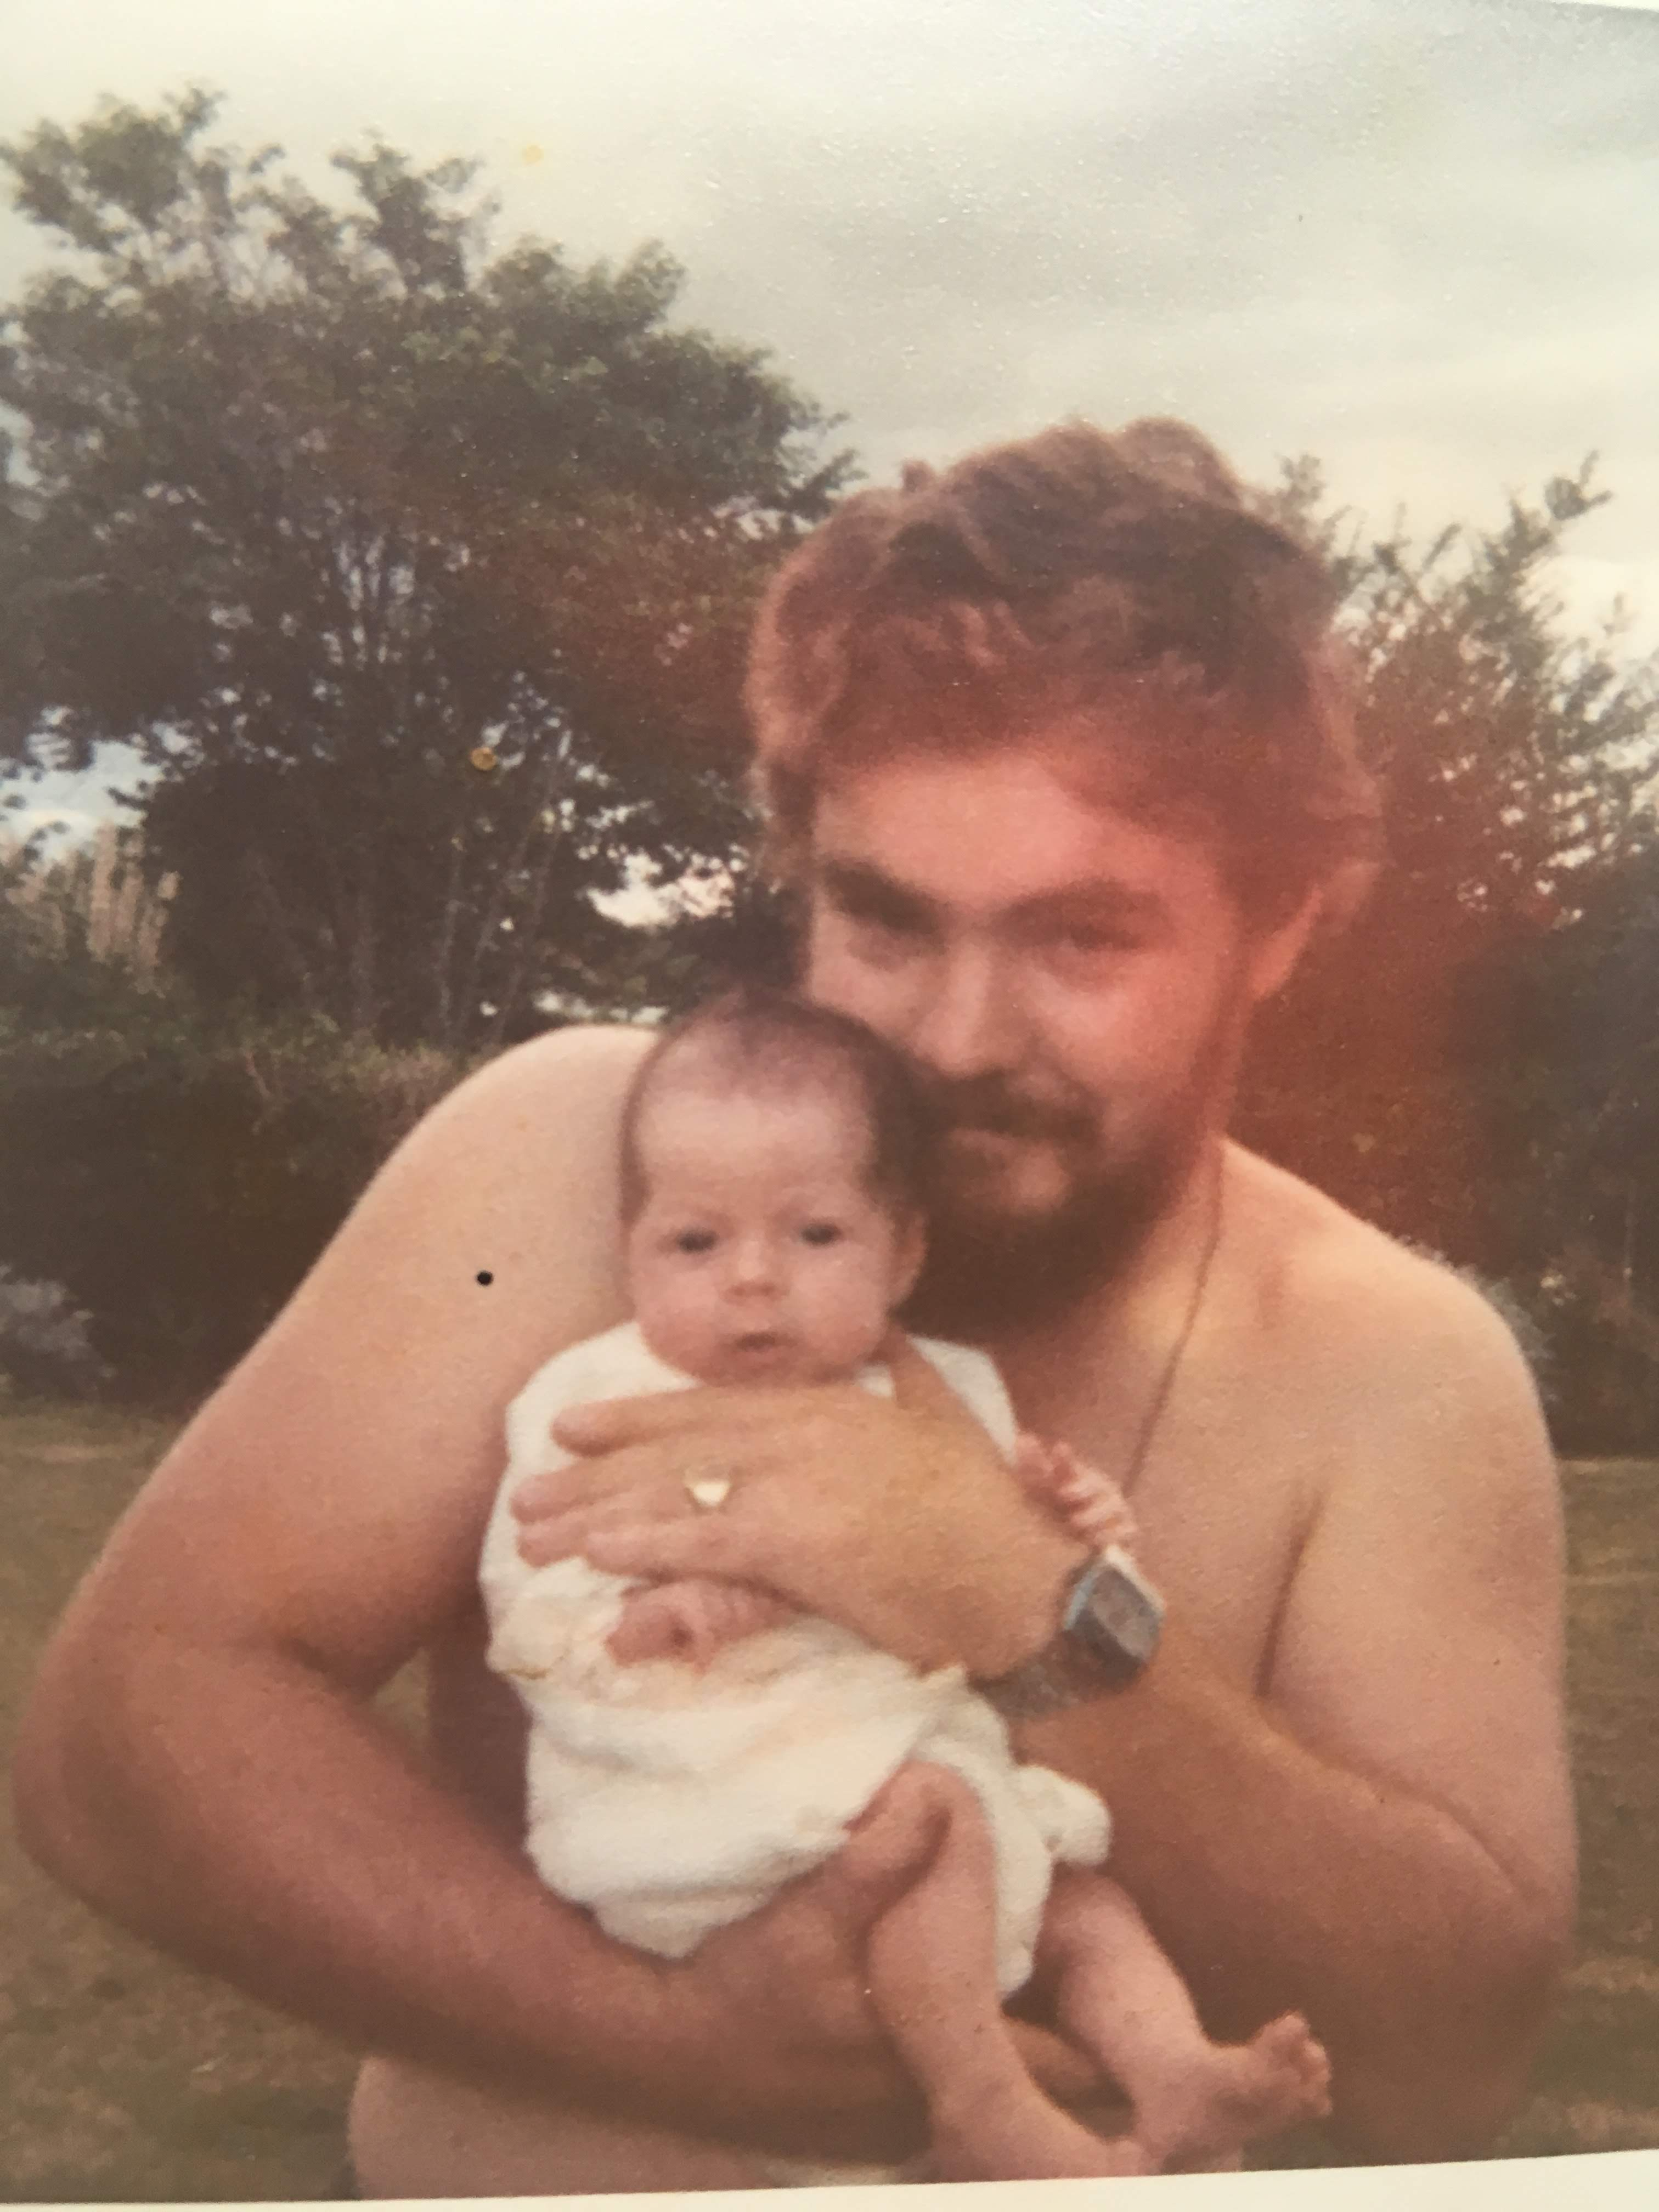

Slide 4
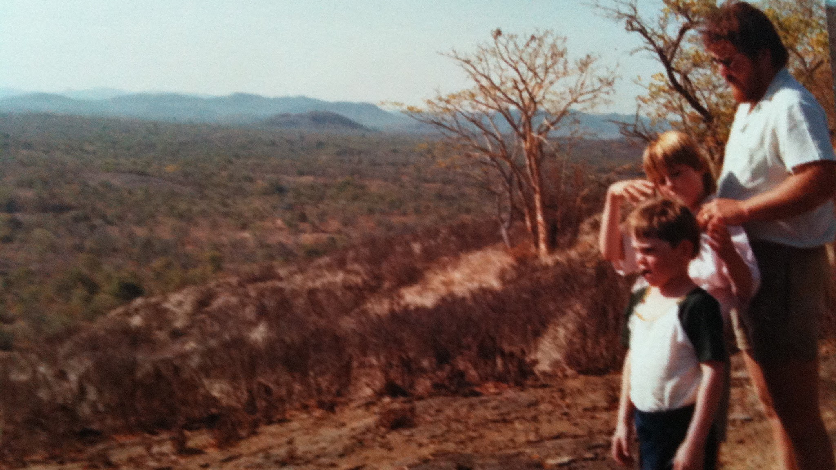

Slide 6
³ Then Elijah became afraid and immediately ran for his life. When he came to Beer-sheba that belonged to Judah, he left his servant there, ⁴ but he went on a day’s journey into the wilderness. He sat down under a broom tree and prayed that he might die. He said, “I have had enough! Lord, take my life, for I’m no better than my ancestors.” ⁵ Then he lay down and slept under the broom tree…
1 Kings 19v3-5 CSB

Slide 9
Look IN
Look OUT
Look UP

Slide 10
LOOK IN

Slide 11
LOOK IN
(beneath the surface)
Two key questions;
WHAT am I feeling/going on?
WHY am I feeling this?

Slide 12
⁶ Now these things took place as examples for us, that we might not desire evil as they did… ¹¹ Now these things happened to them as an example, but they were written down for our instruction...
1 Corinthians 10:6,11 ESV

Slide 13
LOOK IN
(beneath the surface)
Two key questions;
WHAT am I feeling/going on?
WHY am I feeling this?

Slide 14
LOOK IN
LOOK OUT (AROUND)
LOOK UP

Slide 15
LOOK OUT/AROUND
INVITE & INVEST in key relationships
Permission & Time

Slide 16
LOOK IN
LOOK OUT (AROUND)
LOOK UP

Slide 17
¹⁷ Therefore, if anyone is in Christ, he is a new creation. The old has passed away; behold, the new has come.
2 Corinthians 5:17 (ESV)

Slide 18
¹⁷ If by the one man’s trespass, death reigned through that one man, how much more will those who receive the overflow of grace and the gift of righteousness reign in life through the one man, Jesus Christ.
Romans 5:17 CSB
⁴ Therefore we were buried with him by baptism into death, in order that, just as Christ was raised from the dead by the glory of the Father, so we too may walk in newness of life.
Romans 6:4 CSB

Slide 19
¹³ Now may the God of hope fill you with all joy and peace as you believe so that you may overflow with hope by the power of the Holy Spirit.
Romans 15:13 CSB

Slide 20
⁶ do not be anxious about anything, but in everything by prayer and supplication with thanksgiving let your requests be made known to God. ⁷ And the peace of God, which surpasses all understanding, will guard your hearts and your minds in Christ Jesus.
Philippians 4:6-7 CSB

