Slide 1
‘For as he thinks in his heart, so is he.’
Proverbs 23:7 NKJV
² Do not be conformed to this age, but be transformed by the renewing of your mind, so that you may discern what is the good, pleasing, and perfect will of God.
Romans 12:2 CSB
Transformed = metamorphousthe (GK) = metamorphosis

Slide 3
#1
A Healthy
Mindset

Slide 5
³ Then Elijah became afraid and immediately ran for his life. When he came to Beer-sheba that belonged to Judah, he left his servant there, ⁴ but he went on a day’s journey into the wilderness. He sat down under a broom tree and prayed that he might die. He said, “I have had enough! Lord, take my life, for I’m no better than my ancestors.” ⁵ Then he lay down and slept under the broom tree…
1 Kings 19v3-5 CSB

Slide 6
⁵ ...Suddenly, an angel touched him. The angel told him, “Get up and eat.” ⁶ Then he looked, and there at his head was a loaf of bread baked over hot stones, and a jug of water. So he ate and drank and lay down again. ⁷ Then the angel of the Lord returned for a second time and touched him. He said, “Get up and eat, or the journey will be too much for you.” ⁸ So he got up, ate, and drank. Then on the strength from that food, he walked forty days and forty nights to Horeb, the mountain of God. ⁹ He entered a cave there and spent the night…
1 Kings 19v5-9 CSB

Slide 7
⁹ …Suddenly, the word of the Lord came to him, and he said to him, “What are you doing here, Elijah?” ¹⁰ He replied, “I have been very zealous for the Lord God of Armies, but the Israelites have abandoned your covenant, torn down your altars, and killed your prophets with the sword. I alone am left, and they are looking for me to take my life.”
1 Kings 19v9-10 CSB

Slide 8
When you find yourself in a WRONG MINDSET;
KNOW YOUR IDENTITY
KNOW WHERE YOU ARE – BE HONEST
KNOW YOU CAN CHANGE

Slide 9
HOW CAN I
CHANGE?

Slide 10
HOW CAN I CHANGE?
Recognise wrong thinking
² Do not be conformed to this age, but be transformed by the renewing of your mind, so that you may discern what is the good, pleasing, and perfect will of God.
Romans 12:2 CSB
Conformed = shaped/moulded

Slide 15
³ For although we live in the flesh (world), we do not wage war according to the flesh (as the world does), ⁴ since the weapons of our warfare are not of the flesh, but are powerful through God for the demolition of strongholds. We demolish arguments ⁵ and every proud thing that is raised up against the knowledge of God, and we take every thought captive to obey Christ.
2 Corinthians 10:3-5 CSB

Slide 16
HOW CAN I CHANGE?
Recognise wrong thinking
Replace wrong thinking with the truth that demolishes that stronghold

Slide 19
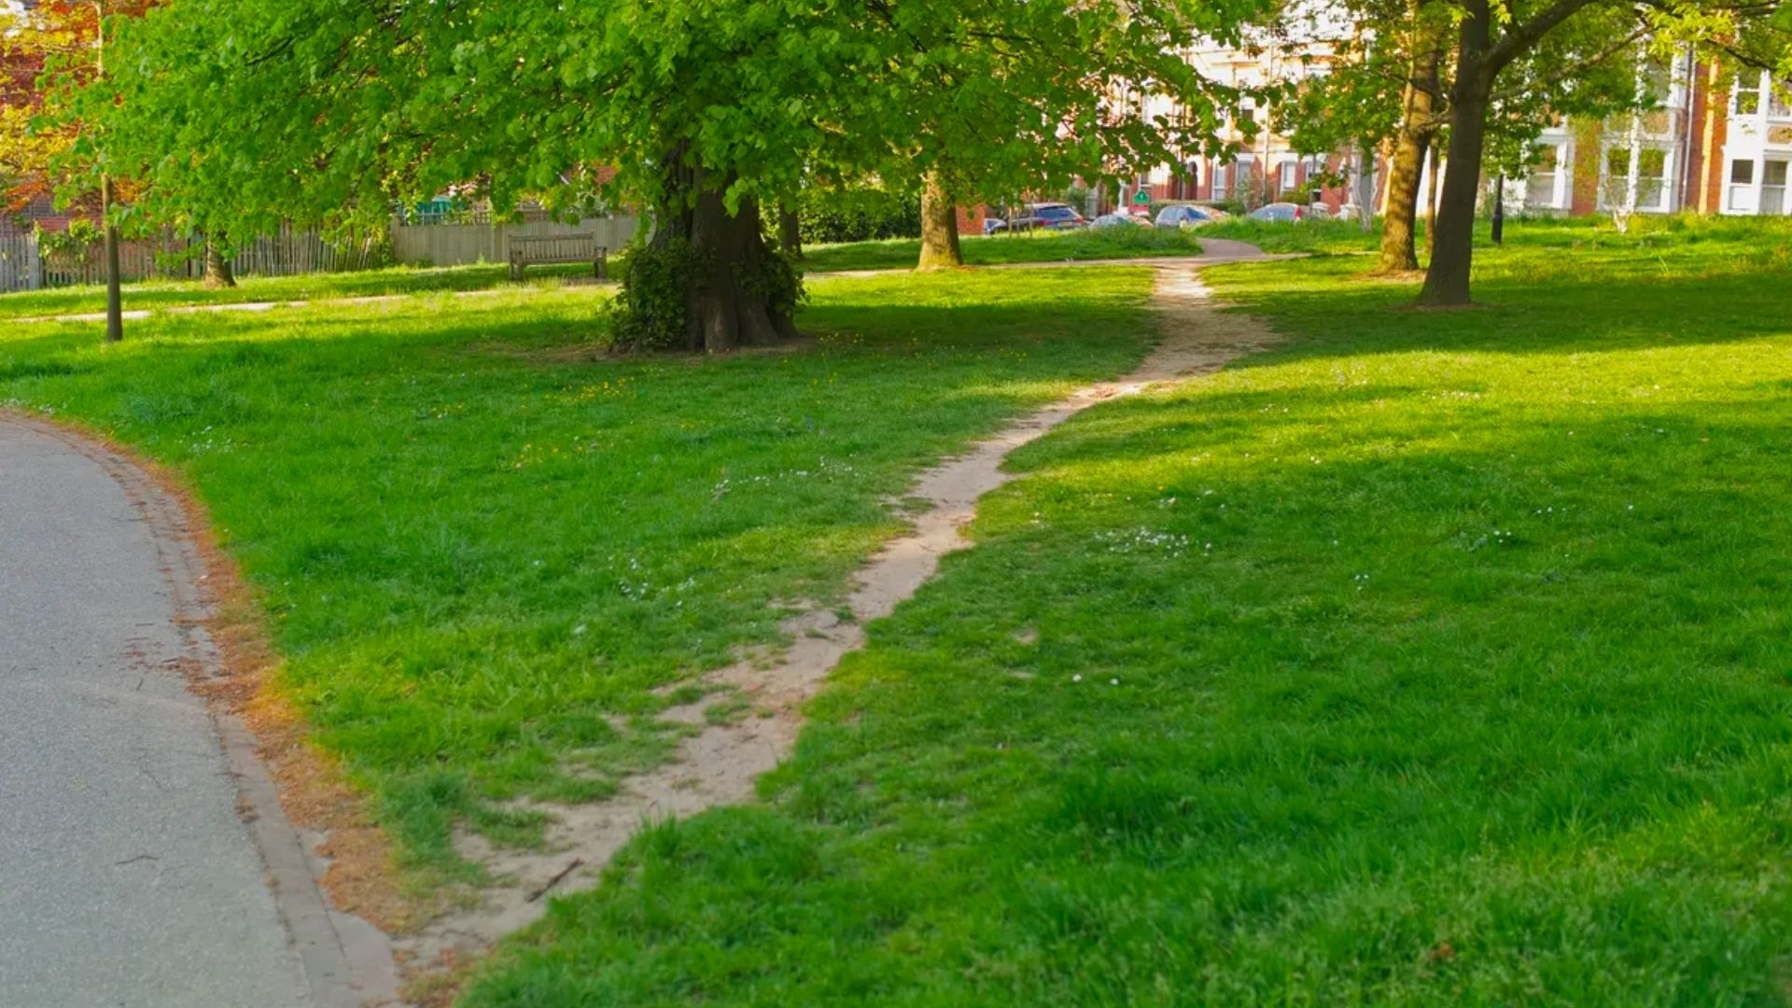

Slide 20
⁸ Finally, brothers and sisters, whatever is true, whatever is noble, whatever is right, whatever is pure, whatever is lovely, whatever is admirable—if anything is excellent or praiseworthy—think (dwell on) about such things.
Philippians 4:8 NIV
¹ So if you have been raised with Christ, seek the things above, where Christ is, seated at the right hand of God. ² Set your minds on things above, not on earthly things.
Colossians 3:2 CSB

Slide 21
³ For although we live in the flesh (world), we do not wage war according to the flesh (as the world does), ⁴ since the weapons of our warfare are not of the flesh, but are powerful through God for the demolition of strongholds. We demolish arguments ⁵ and every proud thing that is raised up against the knowledge of God, and we take every thought captive to obey Christ.
2 Corinthians 10:3-5 CSB

Slide 23
NOTES / EXTRAS

Slide 24
¹⁸ There is no fear in love; instead, perfect love drives out fear, because fear involves punishment. So the one who fears is not complete in love.
1 John 4:18 CSB

Slide 25
³² You will know the truth, and the truth will set you free.”
John 8:32 CSB

Slide 26
¹² For our struggle is not against flesh and blood, but against the rulers, against the authorities, against the cosmic powers of this darkness, against evil, spiritual forces in the heavens. ¹³ For this reason take up the full armour of God, so that you may be able to resist in the evil day, and having prepared everything, to take your stand. ¹⁴ Stand, therefore, with truth like a belt around your waist, righteousness like armour on your chest, ¹⁵ and your feet sandaled with readiness for the gospel of peace. ¹⁶ In every situation take up the shield of faith with which you can extinguish all the flaming arrows of the evil one. ¹⁷ Take the helmet of salvation and the sword of the Spirit—which is the word of God. ¹⁸ Pray at all times in the Spirit with every prayer and request, and stay alert with all perseverance and intercession for all the saints.
Ephesians 6:12-18 CSB

Slide 27
"Don't repress it; confess it! Don't conceal it; reveal it. Revealing your healing is the beginning of healing."
– Purpose-Driven Life, p. 213

