Slide 3
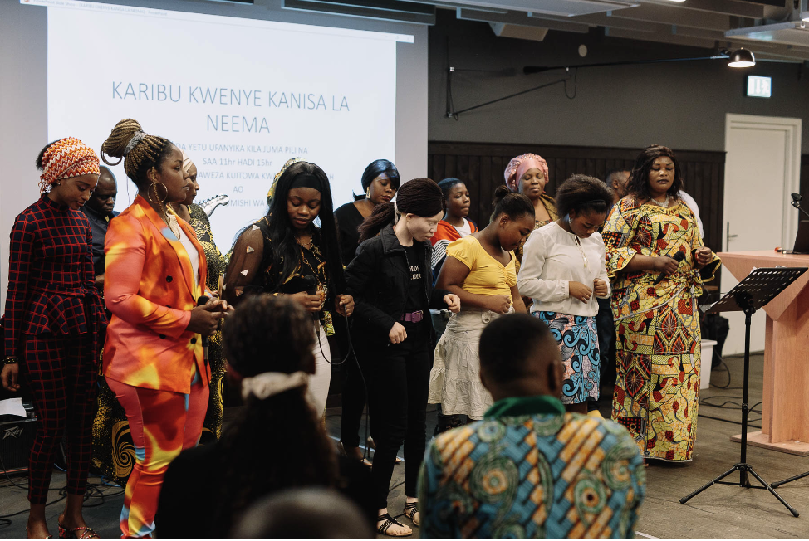
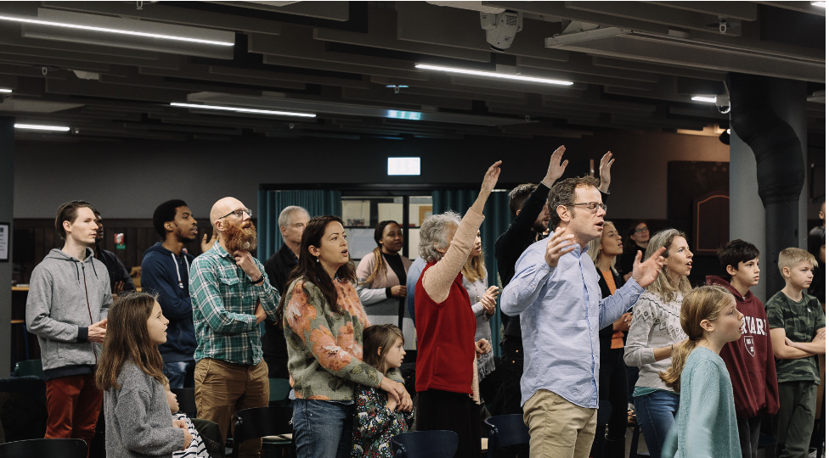
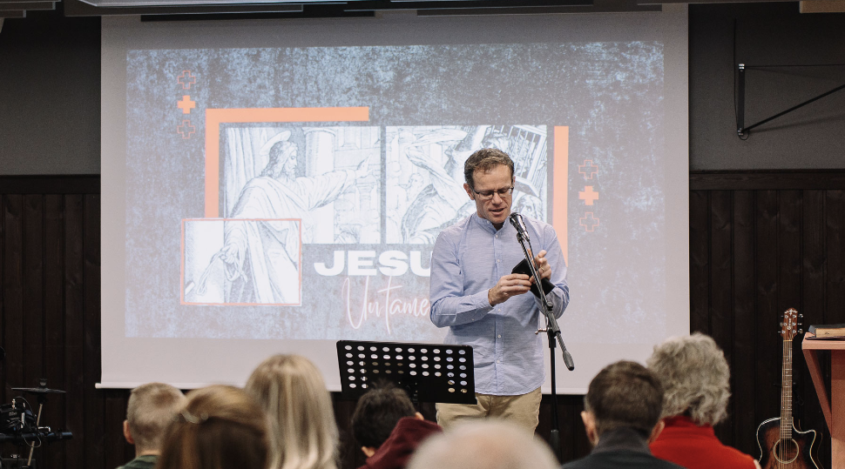

Slide 7
WHO
ARE SUNDAYS
FOR?

Slide 10
³⁷ Jesus replied: “‘Love the Lord your God with all your heart and with all your soul and with all your mind.’ ³⁸ This is the first and greatest commandment. ³⁹ And the second is like it: ‘Love your neighbour as yourself.’
Matthew 22v37-39
^{LOVE GOD / LOVE OTHERS}

Slide 11
¹⁹ Therefore, brothers and sisters, since we have confidence to enter the Most Holy Place by the blood of Jesus…let us draw near to God with a sincere heart and with the full assurance that faith brings… ²⁴ And let us consider how we may spur one another on toward love and good deeds, ²⁵ not giving up meeting together, as some are in the habit of doing, but encouraging one another - and all the more as you see the Day approaching.
Hebrews 10

Slide 14
²⁶ What then shall we say, brothers and sisters? When you come together, each of you has a hymn, or a word of instruction, a revelation, a tongue or an interpretation. Everything must be done so that the church may be built up.
1 Corinthians 14

Slide 15
¹ Now about the gifts of the Spirit, brothers and sisters, I do not want you to be uninformed
1 Corinthians 12
¹⁴ Pursue love, and earnestly desire the spiritual gifts,
1 Corinthians 14

Slide 16
¹² So it is with you. Since you are eager for gifts of the Spirit, try to excel in those that build up the church…¹³ For this reason the one who speaks in a tongue should pray that they may interpret what they say. ¹⁴ For if I pray in a tongue, my spirit prays, but my mind is unfruitful. ¹⁵ So what shall I do?
1 Corinthians 14

Slide 17
¹⁵ I will pray with my spirit, but I will also pray with my understanding; I will sing with my spirit, but I will also sing with my understanding. ¹⁶ Otherwise when you are praising God in the Spirit, how can someone else, who is now put in the position of an enquirer, say ‘Amen’ to your thanksgiving, since they do not know what you are saying? ¹⁷ You are giving thanks well enough, but no one else is edified.
1 Corinthians 14

Slide 18
³⁹ Therefore, my brothers and sisters, be eager to prophesy, and do not forbid speaking in tongues. ⁴⁰ But everything should be done in a fitting and orderly way.
1 Corinthians 14

