Slide 3
Do not forget!
¹ Bless the Lord, O my soul, and all that is within me, bless his holy name! ² Bless the Lord, O my soul, and forget not all his benefits..

Slide 4
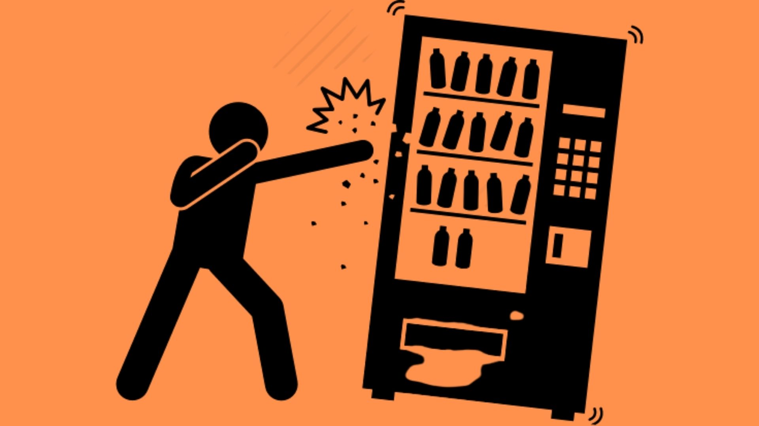

Slide 5
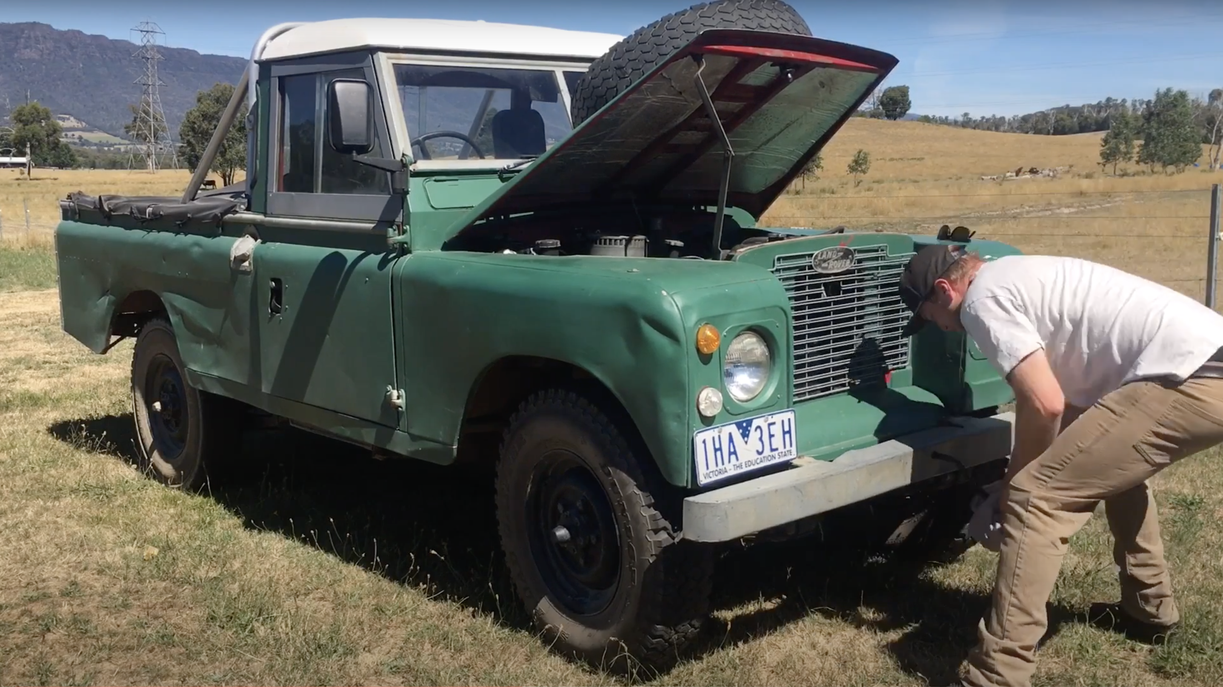

Slide 6
Here is how to work the Gospel into one’s own heart until it transforms. It happens through inward dialogue, speaking directly and forcefully to your own heart (”my soul”) rather than just listening to it. Biblical meditation, unlike the popular varieties, is not a relaxation technique for emptying the mind but rather one that fills it with truth, using thought and memory to set your heart on fire
Tim Keller

Slide 7
Do not forget!
¹ Bless the Lord, O my soul, and all that is within me, bless his holy name! ² Bless the Lord, O my soul, and forget not all his benefits..

Slide 8
Forgiveness & Fulness
³ who forgives all your iniquity, who heals all your diseases, ⁴ who redeems your life from the pit, who crowns you with steadfast love and mercy, ⁵ who satisfies you with good so that your youth is renewed like the eagle’s.

Slide 9
Forgiveness & Fulness
Faithfulness

Slide 10
¹⁰ He does not deal with us according to our sins, nor repay us according to our iniquities. ¹¹ For as high as the heavens are above the earth, so great is his steadfast (faithful) love toward those who fear him; ¹² as far as the east is from the west, so far does he remove our transgressions from us.

Slide 11
Forgiveness & Fulness
Faithfulness
Fathering

Slide 12
¹³ As a father shows compassion to his children, so the Lord shows compassion to those who fear him. ¹⁴ For he knows our frame; he remembers that we are dust.

Slide 13
Forgiveness & Fulness
Faithfulness
Fathering
Future

Slide 14
¹⁵ As for man, his days are like grass; he flourishes like a flower of the field; ¹⁶ for the wind passes over it, and it is gone, and its place knows it no more. ¹⁷ But the steadfast love of the Lord is from everlasting to everlasting on those who fear him, and his righteousness to children’s children, ¹⁸ to those who keep his covenant and remember to do his commandments. ¹⁹ The Lord has established his throne in the heavens, and his kingdom rules over all.

Slide 15
Forgiveness & Fulness
Faithfulness
Fathering
Future
Forgetfulness – Do not forget!

Slide 16
Do not forget!
¹ Bless the Lord, O my soul, and all that is within me, bless his holy name! ² Bless the Lord, O my soul, and forget not all his benefits..

Slide 17
Forgiveness & Fulness
Faithfulness
Fathering
Future
Forgetfulness – Do not forget!

Slide 18
¹ Bless the Lord, O my soul, and all that is within me, bless his holy name! ² Bless the Lord, O my soul, and forget not all his benefits, ³ who forgives all your iniquity, who heals all your diseases, ⁴ who redeems your life from the pit, who crowns you with steadfast love and mercy, ⁵ who satisfies you with good so that your youth is renewed like the eagle’s.
Psalm 103:1-5 ESV

Slide 19
⁶ The Lord works righteousness and justice for all who are oppressed. ⁷ He made known his ways to Moses, his acts to the people of Israel. ⁸ The Lord is merciful and gracious, slow to anger and abounding in steadfast love. ⁹ He will not always chide, nor will he keep his anger forever. ¹⁰ He does not deal with us according to our sins, nor repay us according to our iniquities.
Psalm 103:6-10 ESV

Slide 20
¹¹ For as high as the heavens are above the earth, so great is his steadfast love toward those who fear him; ¹² as far as the east is from the west, so far does he remove our transgressions from us. ¹³ As a father shows compassion to his children, so the Lord shows compassion to those who fear him. ¹⁴ For he knows our frame; he remembers that we are dust.
Psalm 103:11-14 ESV

Slide 21
¹⁵ As for man, his days are like grass; he flourishes like a flower of the field; ¹⁶ for the wind passes over it, and it is gone, and its place knows it no more. ¹⁷ But the steadfast love of the Lord is from everlasting to everlasting on those who fear him, and his righteousness to children’s children, ¹⁸ to those who keep his covenant and remember to do his commandments.
Psalm 103:15-18 ESV

