Slide 1
Living as a new testament church!
Fullness of Life in the holy spirit!

Slide 2
“Men of Israel, hear these words: Jesus of Nazareth, a man attested to you by God with mighty works and wonders and signs that God did through him in your midst, as you yourselves know— this Jesus, delivered up according to the definite plan and foreknowledge of God, you crucified and killed by the hands of lawless men. God raised him up, loosing the pangs of death, because it was not possible for him to be held by it. Acts 2:22-24
Jesus Christ is Alive!

Slide 3
This Jesus God raised up, and of that we all are witnesses. Being therefore exalted at the right hand of God, and having received from the Father the promise of the Holy Spirit, he has poured out this that you yourselves are seeing and hearing. ³⁴ For David did not ascend into the heavens, but he himself says, “‘The Lord said to my Lord, “Sit at my right hand, until I make your enemies your footstool.”’ Let all the house of Israel therefore know for certain that God has made him both Lord and Christ, this Jesus whom you crucified.”
Jesus Baptises in the Holy Spirit!

Slide 4
Now when they heard this they were cut to the heart, and said to Peter and the rest of the apostles, “Brothers, what shall we do?” And Peter said to them, “Repent and be baptised every one of you in the name of Jesus Christ for the forgiveness of your sins, and you will receive the gift of the Holy Spirit. For the promise is for you and for your children and for all who are far off, everyone whom the Lord our God calls to himself.” And with many other words he bore witness and continued to exhort them, saying, “Save yourselves from this crooked generation.” So those who received his word were baptised, and there were added that day about three thousand souls. Acts 2:32-41
“I Will Build My Church!” – Jesus

Slide 5
1. A Change of Direction
Repentance means to turn around and go in a different direction.
“We all like sheep, have gone astray, each of us has turned to his own way; and the Lord has laid on him the iniquity of us all.”
Isa. 53:6
You turn around to live for Him in response to what the Holy Spirit shows you abut Him and what He has accomplished. Repentance is a continuing part of our lives even after we come to believe in Him.

Slide 6
2. A Change of Behaviour
Baptism in water is an outward demonstration of an inward change.
“Do you not know that all of us who have been baptised into Christ Jesus were baptised into his death? We were buried therefore with him by baptism into death, in order that, just as Christ was raised from the dead by the glory of the Father, we too might walk in newness of life.” Romans 6:3-4

Slide 7
2. A Change of Behaviour
Why Should We Be Baptised?
It is part of the ‘Great Commission’. Matthew 28:19
It was the practice of the early church. Acts 2:38
We have come to know Christ and we want to lovingly obey Him.

Slide 8
2. A Change of Behaviour
How Should We Be Baptised?
By total immersion!
“Then both Philip and the eunuch went down into the water and Philip baptised him. When they came up out of the water ….” Acts 8:38,39

Slide 9
3. A Change of Empowerment
Various phrases are used for the same experience: baptism in the Holy Spirit, filled with the Holy Spirit, receiving the Holy Spirit, the Holy Spirit coming upon or endued with power from on high.
The baptism in the Holy Spirit is not the same as believing in Jesus.
You can have the Spirit of God living in you (a Christian) and still not be baptised in the Holy Spirit. This encounter is for all who belong to Christ.

Slide 10
3. A Change of Empowerment
Case 1: Philip in Samaria Acts 8:4-19
Believed v12 → Baptised in Water v12 → Received the HS→ v17
Case 2: Saul of Tarsus Acts 9:17-19
Brother v17 → Filled with the HS Vs 17,18 → Baptised in Water v18
Case 3: Disciples at Ephesus Acts 19:1-7
Believed Vs 4,5 → Baptised in Water v5 → HS came upon them v6

Slide 11
3. A Change of Empowerment
The baptism in the HS is always experiential. The NT believers knew they had received because there was clear evidence that was seen/heard. What type of evidence is seen/heard?
Acts 2 → Speaking in Tongues.
Acts 8 → No specifics but evidence clearly seen by Simon.
Acts 9 → Healing & “I thank God that I speak in tongues more than all of you.” 1 Cor. 14:18
Acts 10 → Speaking in Tongues & Prophecy.
Acts 19 → Speaking in Tongues & Prophecy.

Slide 12
4. A Change of Family
“Added to their number that day” Acts 2:41
It is an integral part of God’s plan for you that you live your Christian life within the context of a community of believers.
The Christian life is never meant to be lived in isolation.
Isolating yourself from other believers won’t help. Through the rough and the smooth we are called to help one another grow.

Slide 13
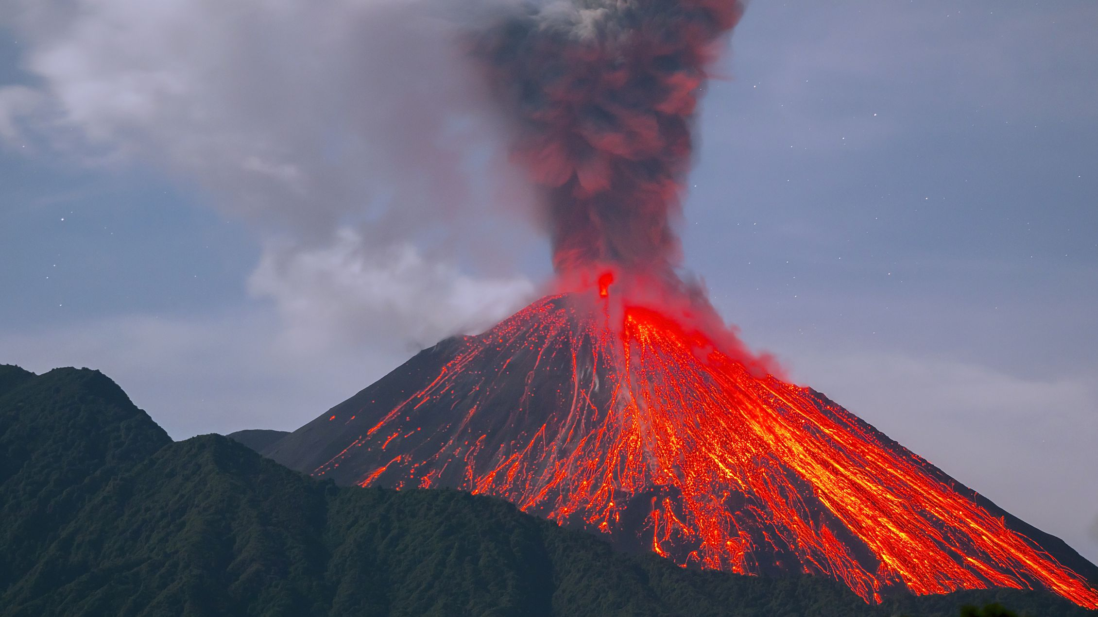
An Eruption of Praise!

