Slide 2
JONAH AND GOD’S GRACE

Slide 3
The Story
God’s request to preach
Jonah’s reaction to protest
God’s response to pursue

Slide 4
The Storm
The storm’s perplexity
The sailors’ panic
The solution proposed
The Sovereign’s provision

Slide 5
¹ From inside the fish Jonah prayed to the Lord his God. ² He said:
“In my distress I called to the Lord, and he answered me. From the depths of the grave I called for help, and you listened to my cry. ³ You hurled me into the depths, into the very heart of the seas, and the currents swirled about me; all your waves and breakers swept over me.

Slide 6
⁴ I said, ‘I have been banished from your sight; yet I will look again toward your holy temple.’ ⁵ The engulfing waters threatened me, the deep surrounded me; seaweed was wrapped around my head. ⁶ To the roots of the mountains I sank down; the earth beneath barred me in forever. But you, Lord my God, brought my life up from the pit.

Slide 7
⁷ “When my life was ebbing away, I remembered you, Lord, and my prayer rose to you, to your holy temple.
⁸ “Those who cling to worthless idols forfeit the grace that could be theirs. ⁹ But I, with a song of thanksgiving will sacrifice to you. What I have vowed I will make good. ‘Salvation comes from the Lord.’”
¹⁰ And the Lord commanded the fish, and it vomited Jonah onto dry land. Jonah 2 (NIV)

Slide 8
A Time of Contemplation
Jonah:
Considered GOD afresh
Called on GOD afresh
Committed to GOD afresh
Celebrated in GOD afresh

Slide 9
Jonah Considered God & His Temple Afresh
v.4 “… I will look again towards Your holy temple.”
Meaning:
to take a fresh lingering look
to gaze, not just a glance
to consider afresh the Jerusalem temple
to ponder again on the Mercy Seat

Slide 10
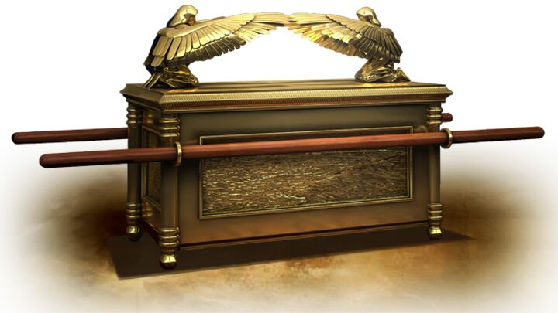
God’s Provision to meet with Him

Slide 11
Understanding Grace
Favour given to an undeserving person, by someone who is not obligated to do so.
To be let into a place we don’t deserve by an unobligated person.
Examples: Jacob (Exod.33); & the prodigal son (Luke 15)

Slide 12
Jonah’s Issue
Prov.4 v.23 (NKJ) out of the heart spring the issues of life
God’s grace hadn’t fully impacted Jonah’s heart
Jonah hadn’t fully grasped the amazing grace of God

Slide 13
Jonah Called on God Afresh
v.2 “… From the depths of the grave I called for help, and You listened to my cry.”
“… since we have a great high priest … Let us approach God’s throne of grace with confidence, so that we may receive mercy and find grace to help us in our time of need.” Hebs.4 v14 – 16

Slide 14
Jonah made a fresh Commitment to God
Recognising that salvation comes from the Lord, Jonah vowed afresh to make good on his calling as God’s prophet - v.9

Slide 15
Jonah Celebrated in God Afresh
Jonah vowed to sacrifice with a song of thanksgiving – v.9
Paul urges us: “… give thanks IN all circumstances, …” 1 Thess.5 v.18
God responded and commanded the fish to release Jonah – v.10

Slide 16
If you understand & have grasped the grace of God, it will be evident in your thankfulness to the Lord.
Like Jonah, we are all ‘a work in progress’ – Jonah 4 v.1 – 2 and God will complete His work in us - Phil.1 v.6

