Slide 1
Notes:
https://jdgreear.com/blog/every-nation-tribe-and-tongue-in-our-own-backyard/#_ftn1

Slide 3
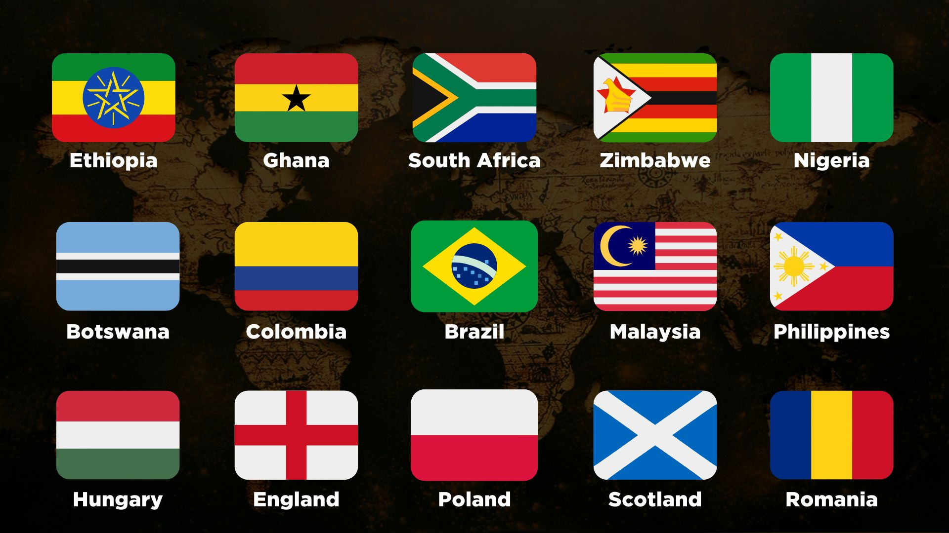

Slide 4
Notes:
https://jdgreear.com/blog/every-nation-tribe-and-tongue-in-our-own-backyard/#_ftn1

Slide 5
⁹ “Worthy are you to take the scroll and to open its seals, for you were slain, and by your blood you ransomed people for God from every tribe and language and people and nation
Revelation 5:9 ESV

Slide 6
⁹ After this I looked, and behold, a great multitude that no one could number, from every nation, from all tribes and peoples and languages, standing before the throne and before the Lamb, clothed in white robes, with palm branches in their hands, ¹⁰ and crying out with a loud voice, “Salvation belongs to our God who sits on the throne, and to the Lamb!”
Revelation 7:9 ESV

Slide 7
²⁴ After sending them out, the Lord God stationed mighty cherubim to the east of the Garden of Eden. And he placed a flaming sword that flashed back and forth to guard the way to the tree of life.
Genesis 3:24 NLT

Slide 9
³³ Hang the curtain under the clasps and bring the ark of the testimony there behind the curtain, so the curtain will make a separation for you between the holy place and the most holy place. ³⁴ Put the mercy seat on the ark of the testimony in the most holy place.
Exodus 26:33-34 ESV

Slide 12
⁹ After this I looked, and behold, a great multitude that no one could number, from every nation, from all tribes and peoples and languages, standing before the throne and before the Lamb, clothed in white robes, with palm branches in their hands, ¹⁰ and crying out with a loud voice, “Salvation belongs to our God who sits on the throne, and to the Lamb!”
Revelation 7:9 ESV

Slide 13
³⁷ Jesus let out a loud cry and breathed his last. ³⁸ Then the curtain of the temple was torn in two from top to bottom.
Mark 15:37 CSB

Slide 14
¹⁹ Then God's temple in heaven was opened, and the ark of his covenant was seen within his temple.
Revelation 11:19 ESV

Slide 15
¹¹ Don’t forget that you Gentiles used to be outsiders. You were called “uncircumcised heathens” by the Jews, who were proud of their circumcision, even though it affected only their bodies and not their hearts. ¹² In those days you were living apart from Christ. You were excluded from citizenship among the people of Israel, and you did not know the covenant promises God had made to them. You lived in this world without God and without hope.
Ephesians 2:11-22 NLT

Slide 16
¹³ But now you have been united with Christ Jesus. Once you were far away from God, but now you have been brought near to him through the blood of Christ. ¹⁴ For Christ himself has brought peace to us. He united Jews and Gentiles into one people when, in his own body on the cross, he broke down the wall of hostility that separated us.
Ephesians 2:11-22 NLT

Slide 17
¹⁵ He did this by ending the system of law with its commandments and regulations. He made peace between Jews and Gentiles by creating in himself one new people from the two groups. ¹⁶ Together as one body, Christ reconciled both groups to God by means of his death on the cross, and our hostility toward each other was put to death.
Ephesians 2:11-22 NLT

Slide 18
¹⁷ He brought this Good News of peace to you Gentiles who were far away from him, and peace to the Jews who were near. ¹⁸ Now all of us can come to the Father through the same Holy Spirit because of what Christ has done for us.
Ephesians 2:11-22 NLT

Slide 19
¹⁹ So now you Gentiles are no longer strangers and foreigners. You are citizens along with all of God’s holy people. You are members of God’s family. ²⁰ Together, we are his house, built on the foundation of the apostles and the prophets. And the cornerstone is Christ Jesus himself. ²¹ We are carefully joined together in him, becoming a holy temple for the Lord. ²² Through him you Gentiles are also being made part of this dwelling where God lives by his Spirit.
Ephesians 2:11-22 NLT

Slide 20
⁶ And this is God’s plan: Both Gentiles and Jews who believe the Good News share equally in the riches inherited by God’s children. Both are part of the same body, and both enjoy the promise of blessings because they belong to Christ Jesus.
Ephesians 3:6 NLT

Slide 21
¹⁰ God’s purpose in all this was to use the church to display his wisdom in its rich variety to all the unseen rulers and authorities in the heavenly places. ¹¹ This was his eternal plan, which he carried out through Christ Jesus our Lord.
Ephesians 3:10-11 NTL

Slide 22
¹⁸ And Jesus came and said to them, “All authority in heaven and on earth has been given to me. ¹⁹ Go therefore and make disciples of all nations, baptizing them in the name of the Father and of the Son and of the Holy Spirit, ²⁰ teaching them to observe all that I have commanded you. And behold, I am with you always, to the end of the age.”
Matthew 28:12-19 ESV

