Slide 2
Transformed Living Involves Warfare!
Chapter 6:10-20

Slide 3
¹⁰ Finally, be strong in the Lord and in his mighty power. ¹¹ Put on the full armour of God, so that you can take your stand against the devil’s schemes. ¹² For our struggle is not against flesh and blood, but against the rulers, against the authorities, against the powers of this dark world and against the spiritual forces of evil in the heavenly realms. ¹³ Therefore put on the full armour of God, so that when the day of evil comes, you may be able to stand your ground, and after you have done everything, to stand. ¹⁴ Stand firm then, with the belt of truth buckled around your waist, with the breastplate of righteousness in place, ¹⁵ and with your feet fitted with the readiness that comes from the gospel of peace.

Slide 4
¹⁶ In addition to all this, take up the shield of faith, with which you can extinguish all the flaming arrows of the evil one. ¹⁷ Take the helmet of salvation and the sword of the Spirit, which is the word of God. ¹⁸ And pray in the Spirit on all occasions with all kinds of prayers and requests. With this in mind, be alert and always keep on praying for all the Lord’s people. ¹⁹ Pray also for me, that whenever I speak, words may be given me so that I will fearlessly make known the mystery of the gospel, ²⁰ for which I am an ambassador in chains. Pray that I may declare it fearlessly, as I should.
Ephesians 6 v 10 – 20 NIV

Slide 5
The Nature of the War
As ‘prince of the power of the air’ (Eph.2 v.2 NKJ), Satan rules through a hierarchical ‘army’ of invisible spirit beings – Eph.6 v.12
Don’t underestimate demonic powers (Acts 19 v.13 – 16) but don’t be alarmed and stay alert to the enemy’s deceptive schemes.

Slide 6
The Source of our Strength – Eph.6 v.10
Be strong in the Almighty
Satan is not equal to the Lord
We’re on the Lord’s side
The Greater One – the Holy Spirit – lives in you

Slide 7
The Assurance of our Victory
Christ’s victory on the cross – Col.2 v.15
Our winning stance: Stand Firm – Eph.6 v.14
Our armour – Eph.6 v.14 – 17
Our arsenal of weapons - Eph.6 v.18

Slide 8
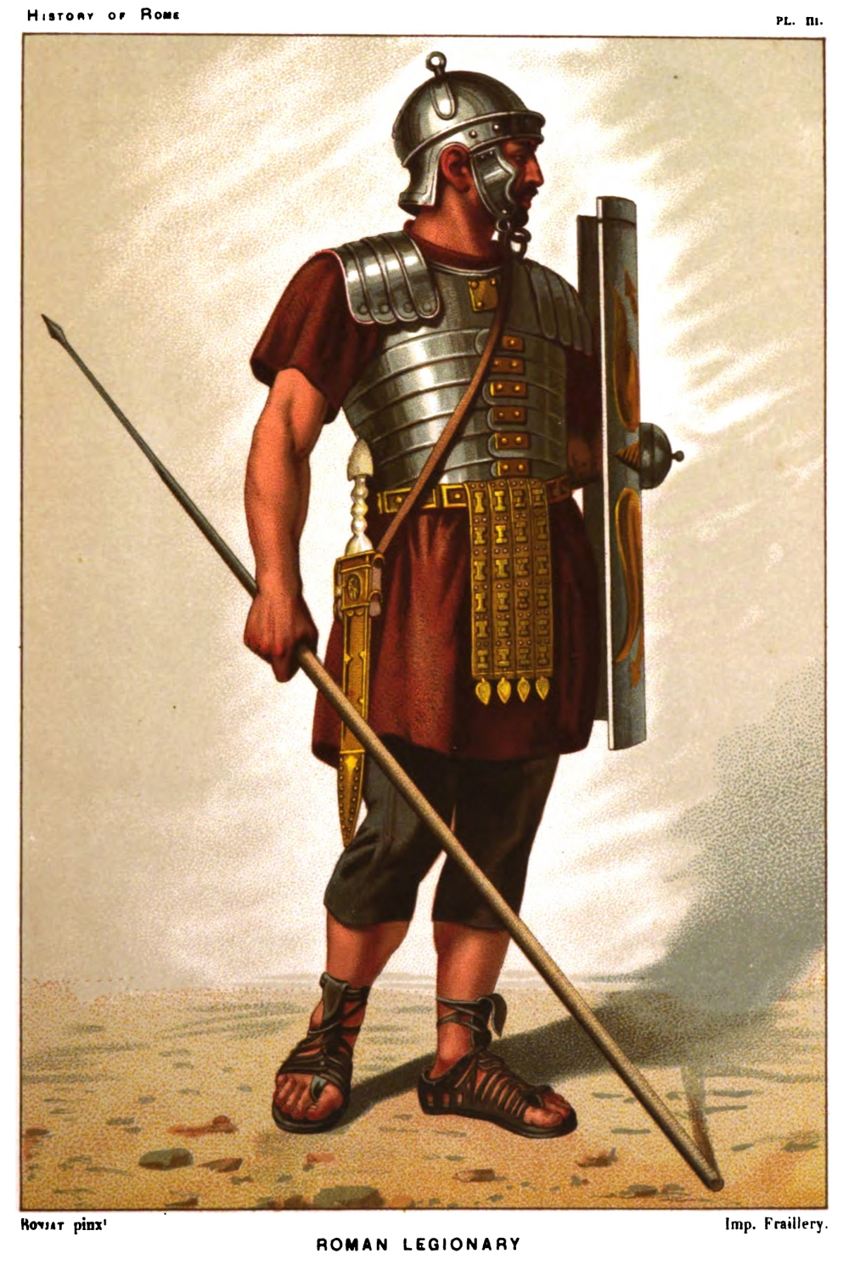

Slide 9
The Armour God Provides – Eph.6 v.14 -17
Belt of truth
Breastplate of righteousness
Boots of the Gospel of Peace
Shield of faith
Helmet of salvation
Sword of the Spirit

Slide 10
The Arsenal & Activity of Prayer – Eph.6 v.18 – 20
PRAY:
constantly
all kinds of prayer
in the Spirit
with alertness
for God’s people
for apostolic & church leaders
for advance of the Gospel

