Slide 2
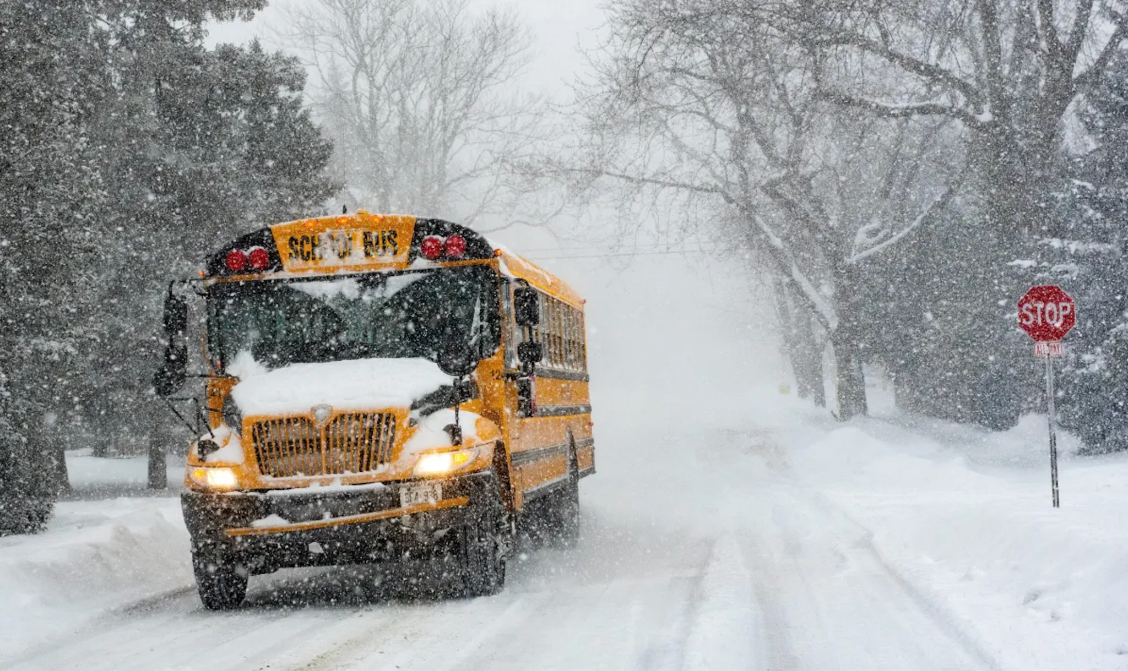

Slide 4
¹¹ While Zechariah was in the sanctuary, an angel of the Lord appeared to him, standing to the right of the incense altar. ¹² Zechariah was shaken and overwhelmed with fear when he saw him.
¹³ But the angel said, “Don’t be afraid, Zechariah! God has heard your prayer. Your wife, Elizabeth, will give you a son, and you are to name him John. ¹⁴ You will have great joy and gladness, and many will rejoice at his birth, ¹⁵ for he will be great in the eyes of the Lord…”
Luke 1:11-15 NLT

Slide 5
¹⁸ Zechariah said to the angel, “How can I be sure this will happen? I’m an old man now, and my wife is also well along in years.”¹⁹ Then the angel said, “I am Gabriel! I stand in the very presence of God. It was He who sent me to bring you this good news! ²⁰ But now, since you didn’t believe what I said, you will be silent and unable to speak until the child is born. For my words will certainly be fulfilled at the proper time.”
Luke 1:18-20 NLT

Slide 7
²⁶ In the sixth month of Elizabeth’s pregnancy, God sent the angel Gabriel to Nazareth, a village in Galilee, ²⁷ to a virgin named Mary. She was engaged to be married to a man named Joseph, a descendant of King David. ²⁸ Gabriel appeared to her and said, “Greetings, favoured woman! The Lord is with you!”
Luke 1:26-28 NLT

Slide 8
²⁹ Confused and disturbed, Mary tried to think what the angel could mean.
³⁰ “Don’t be afraid, Mary,” the angel told her, “for you have found favour with God! ³¹ You will conceive and give birth to a son, and you will name him Jesus. ³² He will be very great and will be called the Son of the Most High. The Lord God will give him the throne of his ancestor David. ³³ And he will reign over Israel forever; his Kingdom will never end!”
Luke 1:29-24 NLT

Slide 9
³⁴ Mary asked the angel, “But how can this happen? I am a virgin.” ³⁵ The angel replied, “The Holy Spirit will come upon you, and the power of the Most High will overshadow you. So the baby to be born will be holy, and he will be called the Son of God. ³⁶ What’s more, your relative Elizabeth has become pregnant in her old age! People used to say she was barren, but she has conceived a son and is now in her sixth month. ³⁷ For the word of God will never fail.
Luke 1:35-38 NLT

Slide 10
³⁸ Mary responded, “I am the Lord’s servant. May everything you have said about me come true.” And then the angel left her.
Luke 1:35-38 NLT

Slide 12
Zechariah | Mary
Important Place | Unimportant Place

Slide 13
Zechariah | Mary
Important Place Clear Communication | Unimportant Place Clear Communication

Slide 14
Zechariah | Mary
Important Place Clear Communication Expected News | Unimportant Place Clear Communication Unexpected News

Slide 15
Zechariah | Mary
Important Place Clear Communication Expected News Good News | Unimportant Place Clear Communication Unexpected News Frightening News

Slide 16
Zechariah | Mary
Important Place Clear Communication Expected News Good News Questioned Gabriel | Unimportant Place Clear Communication Unexpected News Frightening News Questioned Gabriel

Slide 17
Zechariah | Mary
Important Place Clear Communication Expected News Good News Questioned Gabriel Unbelief & Lack of Trust | Unimportant Place Clear Communication Unexpected News Frightening News Questioned Gabriel Belief & Trust

Slide 18
“I am the Lord’s servant. May everything you have said about me come true.”

Slide 19
It’s easy to think that
Zechariah is a numpty

Slide 20
Zechariah | Mary
Educated Righteous & Priest Life experience Disappointed & Scarred | Uneducated Unknown Young Woman Humble & Servant Hearted

Slide 21
Be still and know that I am God
Psalm 46:10

Slide 23
How can I be ready like Mary?
Where do I need to be redeemed like Zechariah?

