Slide 1
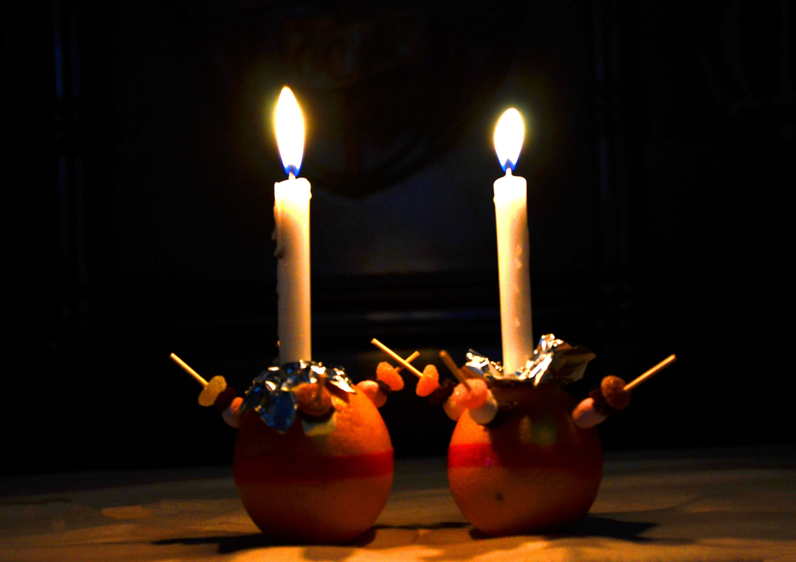
Christingle

Slide 2
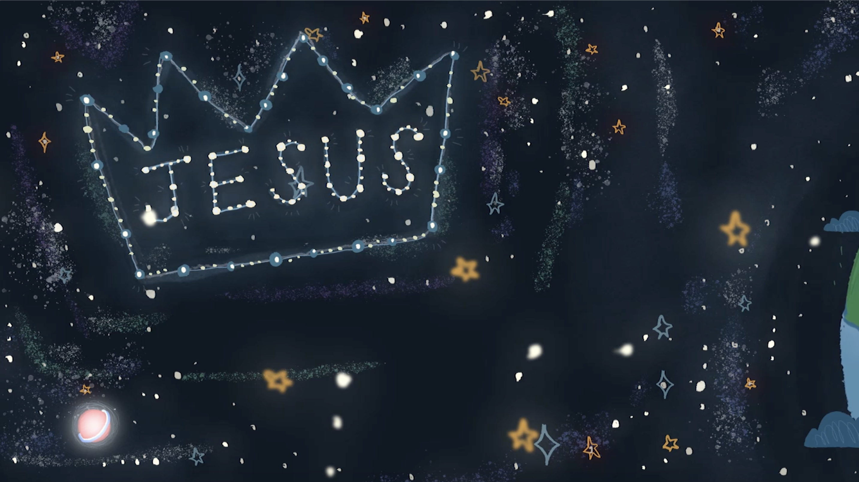

Slide 3
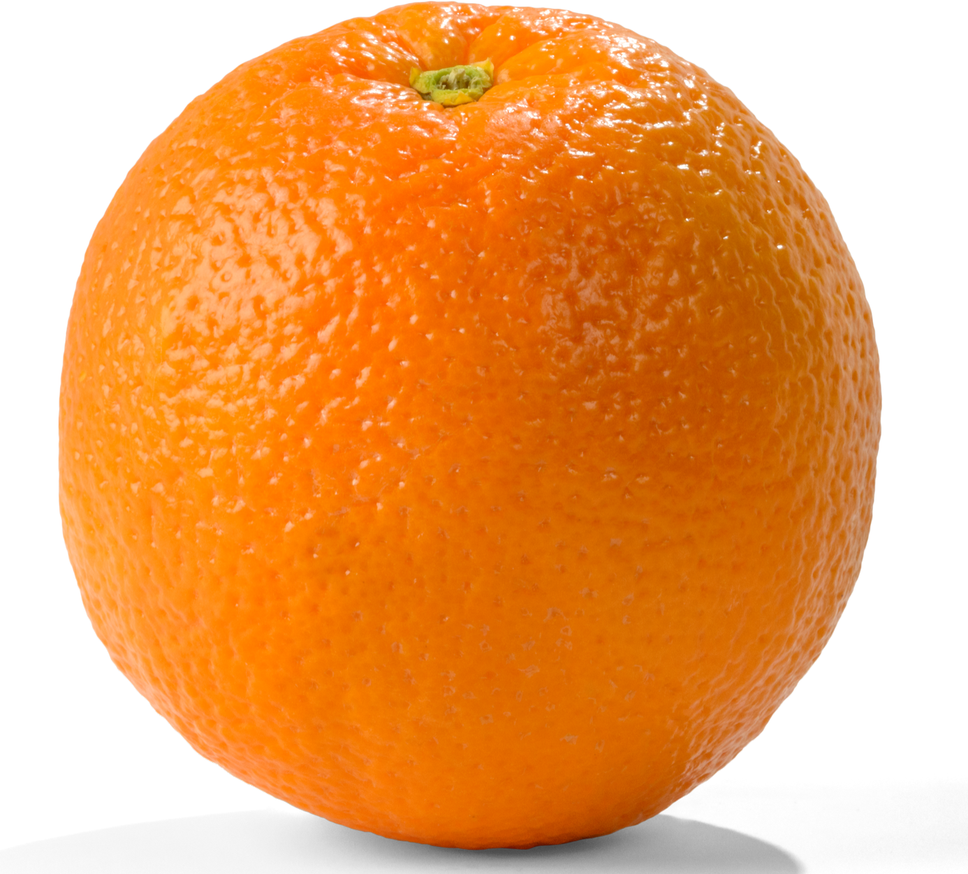
The World

Slide 7
God's Sacrificial Love
‘For Christ died for sins once for all, the righteous for the unrighteous, to bring you to God’. 1 Peter 3:18

Slide 8
God's Gifts To Us
‘I have come that they may have life,
and have it to the full’

Slide 9
The Light of the World
“I am the light of the world.
Whoever follows me will never walk in darkness, but will have the light of life.
John 8:12

Slide 10
For God so loved the world that he gave his one and only Son, that whoever believes in him shall not perish but have eternal life.
John 3:16

