Slide 2
¹⁷ But since we were torn away from you, brothers, for a short time, in person not in heart, we endeavored the more eagerly and with great desire to see you face to face, ¹⁸ because we wanted to come to you—I, Paul, again and again—but Satan hindered us. ¹⁹ For what is our hope or joy or crown of boasting before our Lord Jesus at his coming? Is it not you? ²⁰ For you are our glory and joy.
1 Thessalonians 2v17-20 ESV

Slide 3
¹ Therefore when we could bear it no longer, we were willing to be left behind at Athens alone, ² and we sent Timothy, our brother and God’s coworker in the gospel of Christ, to establish and exhort you in your faith, ³ that no one be moved by these afflictions. For you yourselves know that we are destined for this. ⁴ For when we were with you, we kept telling you beforehand that we were to suffer affliction, just as it has come to pass, and just as you know. ⁵ For this reason, when I could bear it no longer, I sent to learn about your faith, for fear that somehow the tempter had tempted you and our labour would be in vain.
1 Thessalonians 3v1-5 ESV

Slide 4
Satan, Suffering
& Temptation
1 Thessalonians 2:17-3:5 ESV

Slide 5
1. Satan hinders

Slide 6
Satan Hinders
But since we were torn away from you… we wanted to come to you—I, Paul, again and again—but Satan hindered us.
1 Thessalonians 2:17-18 ESV
Notes:
Briefly.Overarching
CONSTANTLY AT WORK TO HINDER / UNDERMINE
Before Saved / After saved
Paul – not sure HOW…circumstances, sickness, stirring up the Jewish persecution, inciting individuals
SCHEMES – not unaware 2 Cor 2:11 – OUTWIT (Unforgiveness)
Dangerous and devious (roaring lion looking to devour / dresses as an angel of light)
It’s not doom and gloom but we are not naïve, not unaware – we know (Last week) God is in charge

Slide 7
2. Expect suffering

Slide 8
Expect suffering
³ that no one be moved by these afflictions. For you yourselves know that we are destined for this.
⁴ For when we were with you, we kept telling you beforehand that we were to suffer affliction, just as it has come to pass, and just as you know
1 Thessalonians 3 ESV
Notes:
3 months of telling
Expectation of the Christian life is? But it will include suffering in fact as you follow Jesus faithfully, that in itself will lead to suffering and hindering by Satan
I am the first – John 10:10 – fullness of life…

Slide 9
¹⁰ The thief comes only to steal and kill and destroy. I came that they may have life and have it abundantly. ¹¹ I am the good shepherd. The good shepherd lays down his life for the sheep.
John 10:10-11 ESV
Notes:
part of that is deliverance FROM. Part of that is his PRESENCE IN suffering – it certainly does not mean there will be NO SUFFERING
In fact that very verse….also says…steal kill and destroy…CONTRAST…what Jesus has come to do and v11 shows how HE SUFFERED – laying down his life, being killed,
SOVERIGNTY & SUFFERING not incompatible…lays down his own life
Raises questions and mystery but does not in any way negate that Christ is ruling and reigning
WE live in a NOW & NOT YET time of the Kingdom…Jesus ruling, satan hindering, general brokeness…IN BETWEEN TIME
Jesus said the kingdom has come – that we may have fullness of life…but the kingdom is not fully here
So WHEN WE SEE/EXPERIENCE something that is not part of the kingdom of God…sickness, suffering, unjustice…we come against it
Lord’s Prayer – Let your Kingdom come / deliver us from the evil one / lead us not into temptation. We are to proactively come against non-kingdom stuff with faith but at the same time also understanding we live in a tension time, the kingdom is here but not yet full there
I have been so helped by 1 Cor 15:24 & 25

Slide 10
²⁴ Then comes the end, when he delivers the kingdom to God the Father after destroying every rule and every authority and power. ²⁵ For he must reign until he has put all his enemies under his feet.
1 Corinthians 15:24-25 ESV
Notes:
Jesus IS reigning and ruling and HE IS destroying and putting enemies under his foot
The advancing kingdom – of the increase of his government and peace there will be no end…Victory assured…but until the full consumation of the Kingdom here on earth, expect suffering…we are destined for it!

Slide 11
Expect suffering
³ that no one be moved by these afflictions. For you yourselves know that we are destined for this.
⁴ For when we were with you, we kept telling you beforehand that we were to suffer affliction, just as it has come to pass, and just as you know
1 Thessalonians 3 ESV

Slide 12
3. Satan uses suffering to tempt you to doubt God and His goodness
Notes:
One of the key things is this –Satan uses suffering to tempt you to doubt God and His goodness

Slide 13
Satan uses suffering to temp you to doubt
³ that no one be moved by these afflictions. For you yourselves know that we are destined for this.
⁵ … for fear that somehow the tempter had tempted you and our labour would be in vain.
1 Thessalonians 3v ESV
Notes:
Wherever that suffering comes from – our foolish choices, satan’s attack, a broken world…wherever it comes from Satan uses and brings suffering to TEMPT US TO DOUBT – God and His goodness, to doubt his good sovereign control over everything
In the boat when Jesus was sleeping and the disciples were overwhelmed by the storm they cried out ‘DO YOU NOT CARE…? Mark 4:38
At the death of Lazarus Martha says to Jesus…If you were here my brother would not have died… John 11:21
Ever feel Jesus DOES NOT CARE OR DOES NOT MOVE QUICK ENOUGH TO HELP?
The Psalms are full of this wrestling…HOW? WHYU? WHY WOULD YOU ALLOW THIS which must be the case if you are sovereign..
AND SATAN USES these afflictions to MOVE US (Hands). Our own hearts struggle enough let alone Satan using the suffering
SO HOW CAN WE RESIST SATAN’S TEMPTING US AND HOW CAN WE KEEP TRUSTING IN THE GOODNESS OF GOD AMIDST SUFFERING?
HOW CAN WE BE LIKE MARTHA?
Martha is a great example…she is honest but STILL TRUSTS…after saying that her brother would have lived if Jesus were there she then says…BUT EVEN NOW I KNOW YOU CAN…

Slide 14
¹⁹ Without weakening in his faith, he faced the fact that his body was as good as dead—since he was about a hundred years old—and that Sarah’s womb was also dead. ²⁰ Yet he did not waver through unbelief regarding the promise of God, but was strengthened in his faith and gave glory to God, ²¹ being fully persuaded that God had power to do what he had promised.
Romans 4:19-22 ESV
Notes:
I have always been encouraged by these verses in Romans 4 - Faith in God does not mean ‘ignoring’ problems’…you can look at the facts from a natural, human point of view….like Abraham…there is suffering, it is alien, it is an intruder, there are deaths and suffering – YES. You can face the facts, you can acknowledge that suffering RAISES QUESTIONS – how can God, if HE is good what about Coronavirus…You can ask, wrestle with and face those questions…and STILL TRUST, STILL BE PURSUADED that God is GOOD & SOVEREIGN.
QUESTIONS/CHOICES
Suffering raises question about God and his goodness and His existence…how can there be a God, let alone a loving God if there is suffering…surely if there was a God He would not let it happen….
CHOICE: So we have a choice…throw God out the picture because of suffering - there cannot be a God…then we are faced with other questions…why do I have a problem with suffering? Where do I get the idea of right and wrong from? Where do I get the idea of ‘how thigns should be from?’ SO we can throw God out the picture…BUT WE HAVE NOWHERE TO GO, NO COMFORT, NO HOPE
OR we can still say God exists but is not sovereign…that feel more palatable because then He doesn’t have to have allowed it (which is a difficult thought) …that feels more palatable…but hat means God is out of control, he cannot do anything about it, there is no hope or comfort…
OR we can COME TO GOD WITH OUR QUESTIONS, AMIDST THE MYSTERY but full of HOPE THAT HE CAN STOP MY SUFFERING, and WILL…either in the NOW or the NOT YET…AND…be confident HE is sufficient for the now, and through suffering should it continue.
In the midst of evil and suffering raising it’s voice you can be FULLY PURSUADED THAT GOD IS GOOD & SOVEREIGN.
Your faith in Him was NEVER IN HIM was never dependent on you comprehending Him…it was because you met Him…HE came to you at your greatest point of need – when you were enslaved in sin and destined for eternity without hope in hell…even though you knew it not, he came to you and rescued you from that pit … how much more will HE not be sufficient for you now?

Slide 15
Satan hinders
Expect suffering
Satan uses suffering to temp you to doubt God and His goodness
Notes:
So we have seen that..
Satan hinders
Expect suffering
Satan uses suffering to temp you to doubt God and His goodness
You need friends to establish and exhort you

Slide 16
Satan hinders
Expect suffering
Satan uses suffering to temp you to doubt God and His goodness
You need friends to establish and exhort you
Notes:
So we have seen that..
Satan hinders
Expect suffering
Satan uses suffering to temp you to doubt God and His goodness
BUT HOW? I have said you can, but HOW can you amidst suffering, the natural question and the confusion…HOW CAN YOU STILL SEE THE GOODNESS OF GOD? How can you resist the temptation to doubt? How can you FLOURISH not FLOUNDER?
4. You need friends to establish and exhort you / to strengthen and exhort you

Slide 17
4. You need friends to establish and exhort you
² … we sent Timothy…to establish and exhort you in your faith, ³ that no one be moved by these afflictions.
1 Thessalonians 3v1-2 ESV
² to strengthen and encourage you in your faith,
1 Thessalonians 3v1-2 NIV
Notes:
Paul says he sent Timothy to establish and exhort them, or as the NIV translates it to STRENGTHEN & ENCOURAGE them.
Now some of that establishing is gifted teaching that is full of grace and truth, that , for example, warns about suffering, speaks of eternal hope, unpacks the gospel and so on, but equally vital are DAER FRIENDS whom you know, love and who look out for you and will lfit your head when it is drooping, who will speak truth to you tenderly, who will pray for you and when you get lost in the mist of suffering they will come to you and bring you to God.
One of the way that I think Satan uses suffering is to lure us away from others into isolation – HE is the Father of lies…he will tell you ‘no one will understand / don’t burden others / your suffering is not worth talking about…and we withdraw, if not physically then emotionally.
We need dear friends who will establish and exhort, who will strengthen and encourage, who will proclaim truth and bring comfort // and may God help us to be such friends
I LOVE THE TONE OF PAUL’S LETTER – he is peaking about difficult things…satan, suffering, persecution….but he is writing, appealing, urging out of affection.
Look at these verses

Slide 18
¹⁷ But since we were torn away from you, brothers, for a short time, in person not in heart, we endeavored the more eagerly and with great desire to see you face to face, ¹⁸ because we wanted to come to you…
1 Thessalonians 2v17-20 ESV
Notes:
Paul is going to great lengths to let them know about his affection, not that he is ‘trying tp’ but it is the overflow of his heart – that is Christian leadership, Christian friendship. This is not someone who just wants to get the truth across…btu someone who wants to win hearts and build them up with truth. It is winsome, it is warm.
RESIST the temptation to ISOLATE / Hebrews urges us to NOT STOP MEETING TOGETHER (even if that has to be online for now and tech terrifies you!)
IF you are doing OK, wonderful…do not stop meeting together and encouraging others
Are you struggling, let someone know, let us know, let people in
Are you supporting someone, speak truth, acknowledge suffering in a comforting, helping, warm way
So to wrap up…

Slide 19
Satan hinders
Expect suffering
Satan uses suffering to temp you to doubt God and His goodness
You need friends to establish and exhort you
Notes:
So….
LET ME PRAY
Not a Christian…get in touch with us…
Next week…

Slide 20
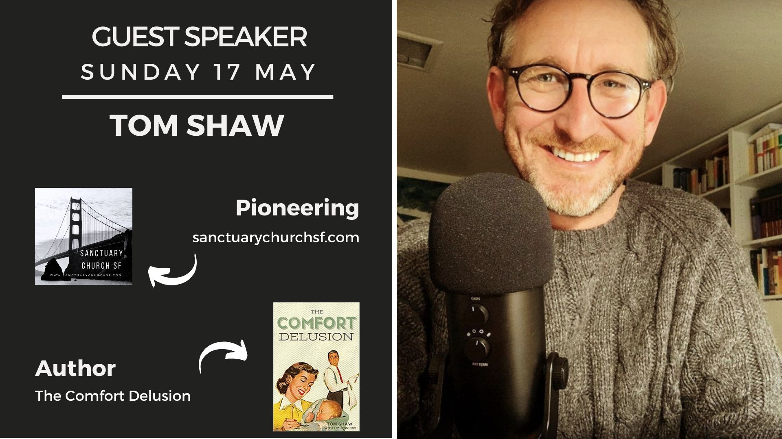
Notes:
idols…chasing after them leads to suffering…some of it…
INVITE A friend along, share the link and pray. Xx
As we come to and end we are going to listen to a song that many are aware of, it is called the Blessing…be still and receive the truth and blessing in them.
God bless you have a great week and may you know closeness of our Lord

