Slide 3
WHAT IS VOCATION?
Commonly associated with an occupation

Slide 4
WHAT IS VOCATION?
Commonly associated with an occupation
Vocation is a calling

Slide 5
WHAT IS VOCATION?
Commonly associated with an occupation
Vocation is a calling
We do not choose it, God calls us

Slide 6
¹⁷ Let each one live his life in the situation the Lord assigned when God called him. This is what I command in all the churches.
1 Corinthians 7v17 CSB

Slide 7
WHAT IS VOCATION?
Commonly associated with an occupation
Vocation is a calling
We do not choose it, God calls us
Different vocations

Slide 8
³ Ahab called for Obadiah, who was in charge of the palace. Obadiah was a man who greatly feared the LORD ⁴ and took a hundred prophets and hid them, fifty men to a cave, and provided them with food and water when Jezebel slaughtered the LORD's prophets.
1 Kings 18v3-4 CSB

Slide 9
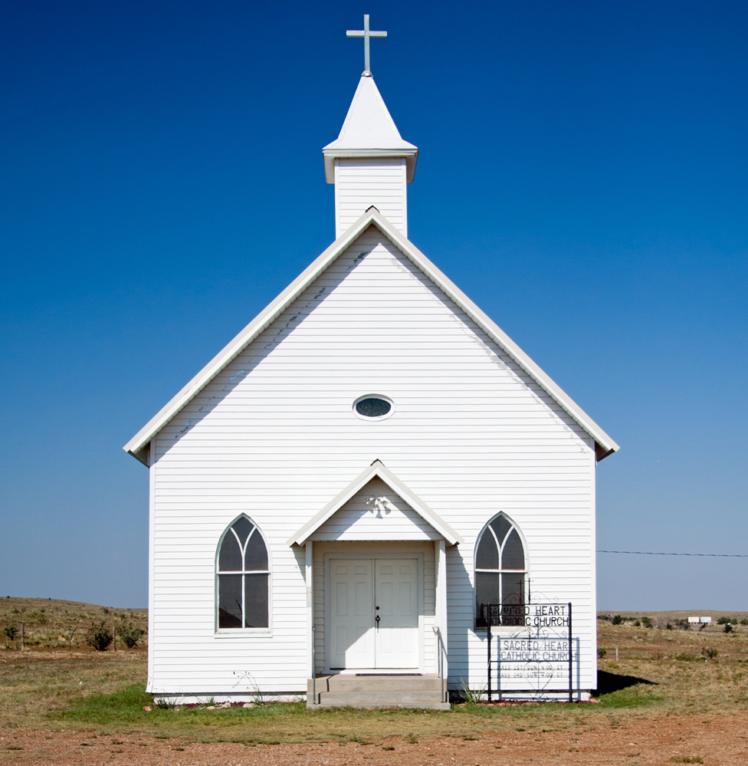
Spiritual
Secular

Slide 10
Spiritual

Slide 11
WHAT IS VOCATION?
Commonly associated with an occupation
Vocation is a calling
We do not choose it, God calls us
Different vocations
A common root

Slide 12
¹⁸ Jesus came near and said to them, “All authority has been given to me in heaven and on earth. ¹⁹ Go, therefore, and make disciples of all nations, baptizing them in the name of the Father and of the Son and of the Holy Spirit, ²⁰ teaching them to observe everything I have commanded you. And remember, I am with you always, to the end of the age.”
Matthew 28v18-20 CSB

Slide 13
WHAT IS VOCATION?
Commonly associated with an occupation
Vocation is a calling
We do not choose it, God calls us
Different vocations
A common root
It’s all for the glory of God

Slide 14
¹⁷ And whatever you do, in word or in deed, do everything in the name of the Lord Jesus, giving thanks to God the Father through him. ... ²³ Whatever you do, do it from the heart, as something done for the Lord and not for people, ²⁴ knowing that you will receive the reward of an inheritance from the Lord. You serve the Lord Christ.
Colossians 3v17, 23-24 CSB

Slide 15
WHAT IS VOCATION?
Commonly associated with an occupation
Vocation is a calling
We do not choose it, God calls us
Different vocations
A common root
It’s all for the glory of God
God is the source

Slide 16
¹ Now Elijah the Tishbite, from the Gilead settlers, said to Ahab, “As the LORD God of Israel lives, in whose presence I stand, there will be no dew or rain during these years except by my command!”
1 Kings 17v1 CSB

Slide 17
WHAT IS VOCATION?
Commonly associated with an occupation
Vocation is a calling
We do not choose it, God calls us
Different vocations
A common root
It’s all for the glory of God
God is the source
We are equipped

Slide 18
³ His divine power has given us everything required for life and godliness through the knowledge of him who called us by his own glory and goodness.
2 Peter 1v3 CSB

Slide 19
THE THREAT TO OUR VOCATIONAL WELLBEING

Slide 20
¹ Ahab told Jezebel everything that Elijah had done and how he had killed all the prophets with the sword. ² So Jezebel sent a messenger to Elijah, saying, “May the gods punish me and do so severely if I don’t make your life like the life of one of them by this time tomorrow!”
1 Kings 19v1-2 CSB

Slide 21
THE THREAT TO OUR VOCATIONAL WELLBEING
People or circumstances will threaten our wellbeing

Slide 22
³ Then Elijah became afraid and immediately ran for his life. When he came to Beer-sheba that belonged to Judah, he left his servant there, ⁴ but he went on a day’s journey into the wilderness. He sat down under a broom tree and prayed that he might die. He said, “I have had enough! Lord, take my life, for I’m no better than my ancestors.” ⁵ Then he lay down and slept under the broom tree.
1 Kings 19v3-5 CSB

Slide 23
THE THREAT TO OUR VOCATIONAL WELLBEING
People or circumstances will threaten our wellbeing
Feelings of despair and failure

Slide 24
RECOVER AND GUARD OUR VOCATIONAL WELLBEING

Slide 25
RECOVER AND GUARD OUR VOCATIONAL WELLBEING
Keep our focus on God

Slide 26
³ Then Elijah became afraid and immediately ran for his life. When he came to Beer-sheba that belonged to Judah, he left his servant there, ⁴ but he went on a day’s journey into the wilderness. He sat down under a broom tree and prayed that he might die. He said, “I have had enough! Lord, take my life, for I’m no better than my ancestors.” ⁵ Then he lay down and slept under the broom tree.
1 Kings 19v3-5 CSB

Slide 27
¹⁰ He replied, “I have been very zealous for the Lord God of Armies, but the Israelites have abandoned your covenant, torn down your altars, and killed your prophets with the sword. I alone am left, and they are looking for me to take my life.“
1 Kings 19v10 CSB

Slide 28
RECOVER AND GUARD OUR VOCATIONAL WELLBEING
Keep our focus on God
God cares about our wellbeing

Slide 29
⁵ Then he lay down and slept under the broom tree. Suddenly, an angel touched him. The angel told him, “Get up and eat.“ ⁶ Then he looked, and there at his head was a loaf of bread baked over hot stones, and a jug of water. So he ate and drank and lay down again. ⁷ Then the angel of the Lord returned for a second time and touched him. He said, “Get up and eat, or the journey will be too much for you.“ ⁸ So he got up, ate, and drank. Then on the strength from that food, he walked forty days and forty nights to Horeb, the mountain of God. ⁹ He entered a cave there and spent the night.
1 Kings 19v5-9 CSB

Slide 30
RECOVER AND GUARD OUR VOCATIONAL WELLBEING
Keep our focus on God
God cares about our wellbeing
We need to rest

Slide 31
RECOVER AND GUARD OUR VOCATIONAL WELLBEING
Keep our focus on God
God cares about our wellbeing
We need to rest
What next God?

Slide 32
¹⁵ Then the Lord said to him, “Go and return by the way you came to the Wilderness of Damascus. When you arrive, you are to anoint Hazael as king over Aram. ¹⁶ You are to anoint Jehu son of Nimshi as king over Israel and Elisha son of Shaphat from Abel-meholah as prophet in your place. ¹⁷ Then Jehu will put to death whoever escapes the sword of Hazael, and Elisha will put to death whoever escapes the sword of Jehu. ¹⁸ But I will leave seven thousand in Israel—every knee that has not bowed to Baal and every mouth that has not kissed him.“
1 Kings 19v15-18 CSB

Slide 33
RECOVER AND GUARD OUR VOCATIONAL WELLBEING
Keep our focus on God
God cares about our wellbeing
We need to rest
What next God?
Prepare the next generation

Slide 34
RECOVER AND GUARD OUR VOCATIONAL WELLBEING
Keep our focus on God
God cares about our wellbeing
We need to rest
What next God?
Prepare the next generation
Recognise that you are not alone

