Slide 2
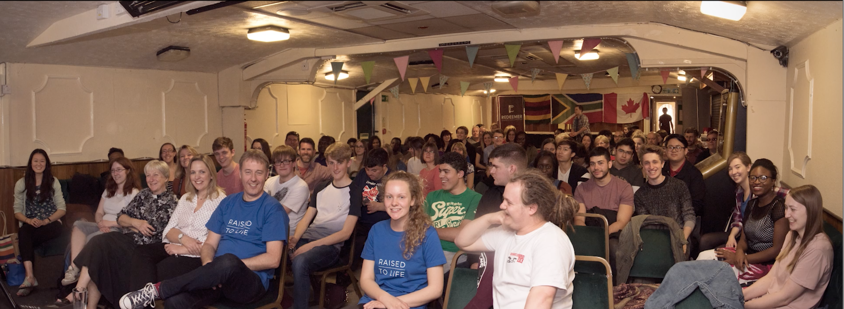
5+ years
(late 2016 and before…first few months of Belle Vue)
3-5 years
(late 2016 - late 2018//pre St. John’s)
1-3 years
(Covid or just before(2019- late ‘20) // St John’s + or online)
Less than a year (Christmas 2020+)

Slide 3
The thief comes only to steal and kill and destroy; I have come that they may have life, and have it to the full.
John 10:10 NIV

Slide 9
¹ Unless the Lord builds the house, those who build it labour in vain. Unless the Lord watches over the city, the watchman stays awake in vain. ² It is in vain that you rise up early and go late to rest, eating the bread of anxious toil; for he gives to his beloved sleep.
Proverbs 27:1-2 CSB

Slide 10
¹⁻² If God doesn’t build the house, the builders only build shacks. If God doesn’t guard the city, the night watchman might as well nap. It’s useless to rise early and go to bed late, and work your worried fingers to the bone. Don’t you know he enjoys giving rest to those he loves?
Proverbs 27:1-2 MSG

