Slide 3
³ Blessed be the God and Father of our Lord Jesus Christ, who has blessed us in Christ with every spiritual blessing in the heavenly places, ⁴ even as he chose us in him before the foundation of the world, that we should be holy and blameless before him. In love ⁵ he predestined us for adoption to himself as sons through Jesus Christ, according to the purpose of his will, ⁶ to the praise of his glorious grace, with which he has blessed us in the Beloved.

Slide 4
⁷ In him we have redemption through his blood, the forgiveness of our trespasses, according to the riches of his grace, ⁸ which he lavished upon us, in all wisdom and insight ⁹ making known to us the mystery of his will, according to his purpose, which he set forth in Christ ¹⁰ as a plan for the fullness of time, to unite all things in him, things in heaven and things on earth. ¹¹ In him we have obtained an inheritance, having been predestined according to the purpose of him

Slide 5
who works all things according to the counsel of his will, ¹² so that we who were the first to hope in Christ might be to the praise of his glory.¹³ In him you also, when you heard the word of truth, the gospel of your salvation, and believed in him, were sealed with the promised Holy Spirit, ¹⁴ who is the guarantee of our inheritance until we acquire possession of it, to the praise of his glory. – Ephesians 1:3-14

Slide 6
¹⁹ So then you are no longer strangers and aliens, but you are fellow citizens with the saints and members of the household of God, ²⁰ built on the foundation of the apostles and prophets, Christ Jesus himself being the cornerstone, ²¹ in whom the whole structure, being joined together, grows into a holy temple in the Lord. ²² In him you also are being built together into a dwelling place for God by the Spirit.– Ephesians 2:19-22

Slide 7
who works all things according to the counsel of his will, ¹² so that we who were the first to hope in Christ might be to the praise of his glory.¹³ In him you also, when you heard the word of truth, the gospel of your salvation, and believed in him, were sealed with the promised Holy Spirit, ¹⁴ who is the guarantee of our inheritance until we acquire possession of it, to the praise of his glory. – Ephesians 1:3-14

Slide 8
Adopted
Born of God

Slide 9
Adopted
Born of God
1. Children bear the characteristics of their parents

Slide 10
Adopted

Slide 11
Adopted
Born of God
Children bear the characteristics of their parents
Loved by the Father

Slide 12
Adopted
Born of God
Children bear the characteristics of their parents
Loved by the Father
New name and identity

Slide 13
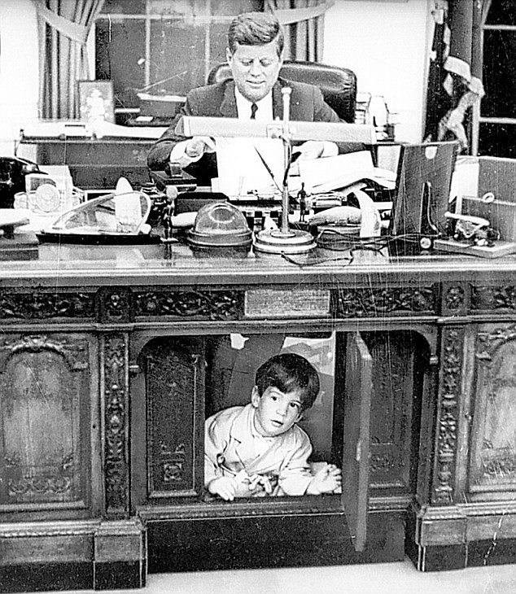
Adopted

Slide 14
God’s children

Slide 15
God’s children
1. Love the Father

Slide 16
God’s children
Love the Father
Love each other
John 13:35 - By this everyone will know that you are my disciples, if you love one another

Slide 17
God’s children
⁹ Do not lie to one another, seeing that you have put off the old self with its practices ¹⁰ and have put on the new self, which is being renewed in knowledge after the image of its creator. ¹¹ Here there is not Greek and Jew, circumcised and uncircumcised, barbarian, Scythian, slave, free; but Christ is all, and in all. ¹² Put on then, as God's chosen ones, holy and beloved, compassionate hearts, kindness, humility,

Slide 18
God’s children
meekness, and patience, ¹³ bearing with one another and, if one has a complaint against another, forgiving each other; as the Lord has forgiven you, so you also must forgive. ¹⁴ And above all these put on love, which binds everything together in perfect harmony. ¹⁵ And let the peace of Christ rule in your hearts, to which indeed you were called in one body. And be thankful.

Slide 19
God’s children
¹⁶ Let the word of Christ dwell in you richly, teaching and admonishing one another in all wisdom, singing psalms and hymns and spiritual songs, with thankfulness in your hearts to God. ¹⁷ And whatever you do, in word or deed, do everything in the name of the Lord Jesus, giving thanks to God the Father through him. – Colossians 3:9-17

