Slide 2
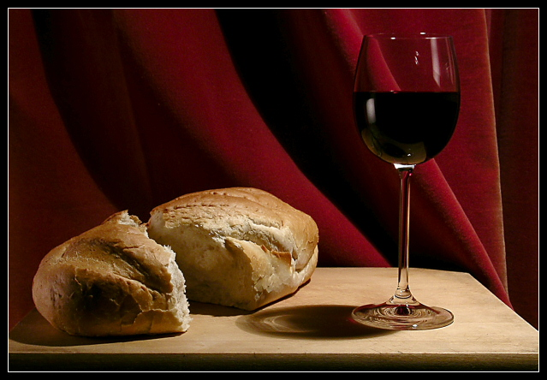
What Comes To Mind?
I would like you to close your eyes and think about the photo below. What thoughts come to mind when you view it?

Slide 3
What does the Bible Say?
¹⁷ But in the following instructions I do not commend you, because when you come together it is not for the better but for the worse. ¹⁸ For, in the first place, when you come together as a church, I hear that there are divisions among you. And I believe it in part, ¹⁹ for there must be factions among you in order that those who are genuine among you may be recognized. ²⁰ When you come together, it is not the Lord’s supper that you eat. ²¹ For in eating, each one goes ahead with his own meal. One goes hungry, another gets drunk. ²² What! Do you not have houses to eat and drink in? Or do you despise the church of God and humiliate those who have nothing? What shall I say to you? Shall I commend you in this? No, I will not.

Slide 4
What does the Bible Say?
²³ For I received from the Lord what I also delivered to you, that the Lord Jesus on the night when he was betrayed took bread, ²⁴ and when he had given thanks, he broke it, and said, “This is my body, which is for you. Do this in remembrance of me.” ²⁵ In the same way also he took the cup, after supper, saying, “This cup is the new covenant in my blood. Do this, as often as you drink it, in remembrance of me.” ²⁶ For as often as you eat this bread and drink the cup, you proclaim the Lord’s death until he comes. ²⁷ Whoever, therefore, eats the bread or drinks the cup of the Lord in an unworthy manner will be guilty concerning the body and blood of the Lord.

Slide 5
What does the Bible Say?
²⁸ Let a person examine himself, then, and so eat of the bread and drink of the cup. ²⁹ For anyone who eats and drinks without discerning the body eats and drinks judgment on himself. ³⁰ That is why many of you are weak and ill, and some have died. ³¹ But if we judged ourselves truly, we would not be judged. ³² But when we are judged by the Lord, we are disciplined so that we may not be condemned along with the world. ³³ So then, my brothers, when you come together to eat, wait for one another— ³⁴ if anyone is hungry, let him eat at home—so that when you come together it will not be for judgment. About the other things I will give directions when I come.
1 Corinthians 11:17-34 ESV

Slide 6
The Heart of the Problem is the Heart
Meetings were doing more harm than good v17
They were divided. No sense of unity! v18
They were not recognising what the Lord’s Supper is all about v20
They were thinking selfishly – only bothered about themselves v21
Some were left hungry & others were getting drunk v21
They were despising God’s people and humiliating those who were poor v22
When it came to gathering together to participate in the Lord’s Supper, this church had a heart problem that needed to be addressed.

Slide 7
Time for a Heart Check Up!
Proverbs 4:23 encourages us to make the condition of our heart a priority in our walk with God. It says:
“Above all else, guard your heart, for everything you do flows from it.” NIV “Guard your heart above all else, for it determines the course of your life.” NLT “Keep your heart with all vigilance, for from it flow the springs of life.” ESV
I want to give you 3 health tips that will improve your spiritual heart condition as you come to participate in the Lord’s Supper.

Slide 8
The Posture of our Hearts
1. With SOBERNESS (not somber, as in “gloomy or depressing.”)
There should be a sense of gravity about what we are participating in as we consider what Jesus has done for us.
“This is my body *, which is for you; do this in remembrance of me.” (v24)
“This cup is the new covenant in my blood; do this, whenever you drink it, in remembrance of me.” (v25) * Illustration: Family Photograph
When we participate in Communion, we “proclaim the Lord’s death” (v26) and that causes our hearts to have a sense of weightiness as we think about His suffering on our behalf.

Slide 9
The Posture of our Hearts
A Kingdom of God Health Warning (Vs 27-32)
When Paul says “Therefore whoever eats the bread or drinks the cup of the Lord in an unworthy manner” (v27), he is not talking about the “worthiness” of the participant but the “worthiness” of his manner of partaking of it.
Therefore, it is vital that we “examine ourselves” (v28) before we participate otherwise we could be bringing judgement on ourselves (v29) which Paul infers presents itself in people becoming weak and sick, and some even dying. (v30)
“He (Paul) warns that if you come to the Lord’s Supper in a cavalier, callous, careless way that does not discern the seriousness of what happened on the cross, you may, if you are a believer, lose your life, not because of wrath, but as an act of God’s fatherly discipline.” John Piper

Slide 10
The Posture of our Hearts
2. With THANKFULNESS (Showing Appreciation)
“Rejoice always; pray without ceasing; in everything give thanks; for this is God’s will for you in Christ Jesus.” 1 Thess. 5:16-18
“Gratitude is a response. There has to be a previous action or reality. When we take Communion, we are responding to all that the Lord has done and continues to do for us.” Beni Johnson
When we participate in Communion, we “proclaim the Lord’s death until he comes” (v26) and that causes our hearts to rejoice because it reminds us that Jesus is alive and He is coming again to receive us to himself.

Slide 11
The Posture of our Hearts
3. With CELEBRATION
“the action of marking one’s pleasure at an important event or occasion by engaging in enjoyable, typically social, activity.”
When we take Communion, it is our chance to celebrate with our brothers and sisters in Christ.
“Communion is a vertical realigning of ourselves with Christ, but it is also a horizontal realigning: We are the Body of Christ.” Beni Johnson

Slide 12
Practicalities
Front
Chairs
Time of Celebration
Chairs
Time of Celebration
Bread
Sober Reflection
Bread
Sober Reflection
Fruit Juice
Thankful Response
Fruit Juice
Thankful Response

