Slide 2
Why We Worship
Psalm 33

Slide 3
Psalm 33 (NIV)
1 Sing joyfully to the Lord, you righteous;
it is fitting for the upright to praise him.
2 Praise the Lord with the harp;
make music to him on the ten-stringed lyre.
^{3 Sing to him a new song;}
play skillfully, and shout for joy.

Slide 4
Psalm 33
NIV:
Sing joyfully to the Lord, you righteous;
it is fitting for the upright to praise him.
KJV
Rejoice in the Lord, O ye righteous:
for praise is comely for the upright.

Slide 5
Song of Songs 4:3 (NIV)
Your lips are like a scarlet ribbon;
your mouth is lovely.
Your temples behind your veil
are like the halves of a pomegranate.
Song of Songs 6:4 (NIV)
You are as beautiful as Tirzah, my darling,
as lovely as Jerusalem,
as majestic as troops with banners.

Slide 6
Psalm 33 (NIV)
1 Sing joyfully to the Lord, you righteous;
it is fitting for the upright to praise him.
2 Praise the Lord with the harp;
make music to him on the ten-stringed lyre.
^{3 Sing to him a new song;}
play skillfully, and shout for joy.

Slide 7
HOW we worship
^{With Songs and Music}
^{Skillfully}
^{Creatively}
^{With Great Joy}

Slide 8
2 Samuel 6:14-16 (NIV)
14 Wearing a linen ephod, David was dancing before the Lord with all his might,
15 while he and all Israel were bringing up the ark of the Lord with shouts and the sound of trumpets.
16 As the ark of the Lord was entering the City of David, Michal daughter of Saul watched from a window. And when she saw King David leaping and dancing before the Lord, she despised him in her heart.

Slide 9
Psalm: Why We Worship
God is incomparable
God is involved
God is invested in you

Slide 10
Psalm 33 (NIV)
4 For the word of the LORD is right and true;
^{he is faithful in all he does.}
5 The LORD loves righteousness and justice;
the earth is full of his unfailing love.
6 By the word of the LORD the heavens were made,
their starry host by the breath of his mouth.

Slide 11
Psalm 33 (NIV)
7 He gathers the waters of the sea into jars[a];
he puts the deep into storehouses.
8 Let all the earth fear the LORD;
let all the people of the world revere him.
9 For he spoke, and it came to be;
he commanded, and it stood firm.

Slide 12
Psalm 33 (NIV)
4 For the word of the LORD is right and true;
^{he is faithful in all he does.}
5 The LORD loves righteousness and justice;
the earth is full of his unfailing love.
6 By the word of the LORD the heavens were made,
their starry host by the breath of his mouth.

Slide 13
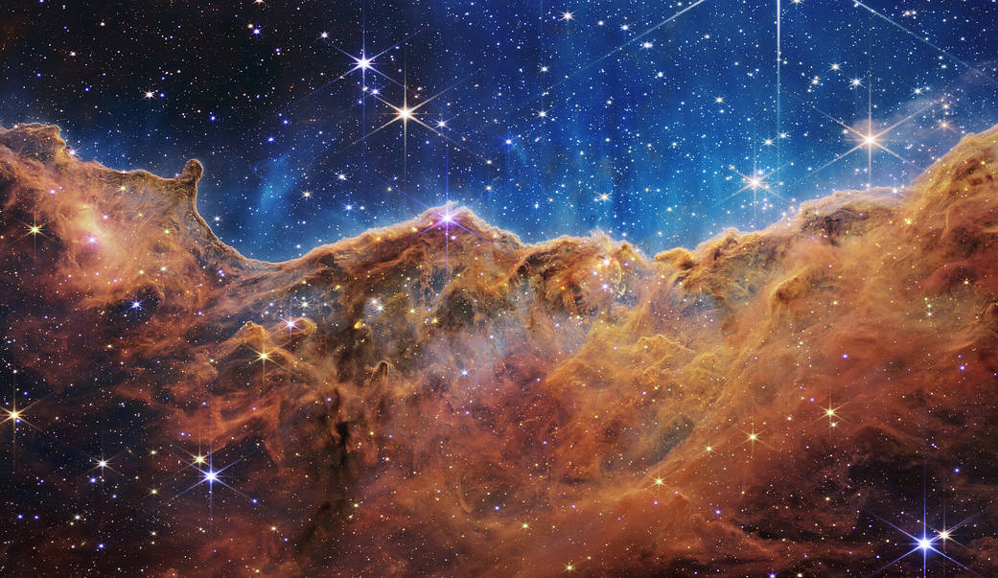
Psalm 33 (NIV)

Slide 14
Psalm 33 (NIV)
7 He gathers the waters of the sea into jars;
he puts the deep into storehouses.
8 Let all the earth fear the LORD;
let all the people of the world revere him.
9 For he spoke, and it came to be;
he commanded, and it stood firm.

Slide 15
Psalm 33 (NIV)
10 The LORD foils the plans of the nations;
he thwarts the purposes of the peoples.
11 But the plans of the LORD stand firm forever,
the purposes of his heart through all generations.
12 Blessed is the nation whose God is the LORD,
the people he chose for his inheritance.

Slide 16
Psalm 33 (NIV)
13 From heaven the LORD looks down
^{and sees all mankind;}
14 from his dwelling place he watches
^{all who live on earth}
15 he who forms the hearts of all,
who considers everything they do.

Slide 17
Psalm 33 (NIV)
16 No king is saved by the size of his army;
no warrior escapes by his great strength.
17 A horse is a vain hope for deliverance;
despite all its great strength it cannot save

Slide 18
Psalm: Why We Worship
God is incomparable
God is involved
God is invested in you

Slide 19
Psalm 33 (NIV)
18 But the eyes of the LORD are on those who fear him,
on those whose hope is in his unfailing love,
^{19 to deliver them from death}
^{and keep them alive in famine.}
20 We wait in hope for the LORD;
^{he is our help and our shield.}
^{21 In him our hearts rejoice,}
^{for we trust in his holy name.}

Slide 20
Psalm 33 (NIV)
16 No king is saved by the size of his army;
no warrior escapes by his great strength.
17 A horse is a vain hope for deliverance;
despite all its great strength it cannot save

Slide 21
Psalm 33 (NIV)
18 But the eyes of the LORD are on those who fear him,
on those whose hope is in his unfailing love,
^{19 to deliver them from death}
^{and keep them alive in famine.}

Slide 22
Psalm 33 (NIV)
But the eyes of the LORD are on those who fear him,
^{to deliver them from death}

Slide 23
Psalm 33 (NIV)
18 But the eyes of the LORD are on those who fear him,
on those whose hope is in his unfailing love,
^{19 to deliver them from death}
^{and keep them alive in famine.}
20 We wait in hope for the LORD;
^{he is our help and our shield.}
^{21 In him our hearts rejoice,}
^{for we trust in his holy name.}

Slide 24
Psalm: Why We Worship
God is incomparable
God is involved
God is invested in you

Slide 25
Psalm 33 (NIV)
1 Sing joyfully to the Lord, you righteous;
it is fitting for the upright to praise him.
2 Praise the Lord with the harp;
make music to him on the ten-stringed lyre.
^{3 Sing to him a new song;}
play skillfully, and shout for joy.

