Slide 1
REMEMBER YOUR LEADERS
Lessons for a church from Hebrews 13

Slide 2
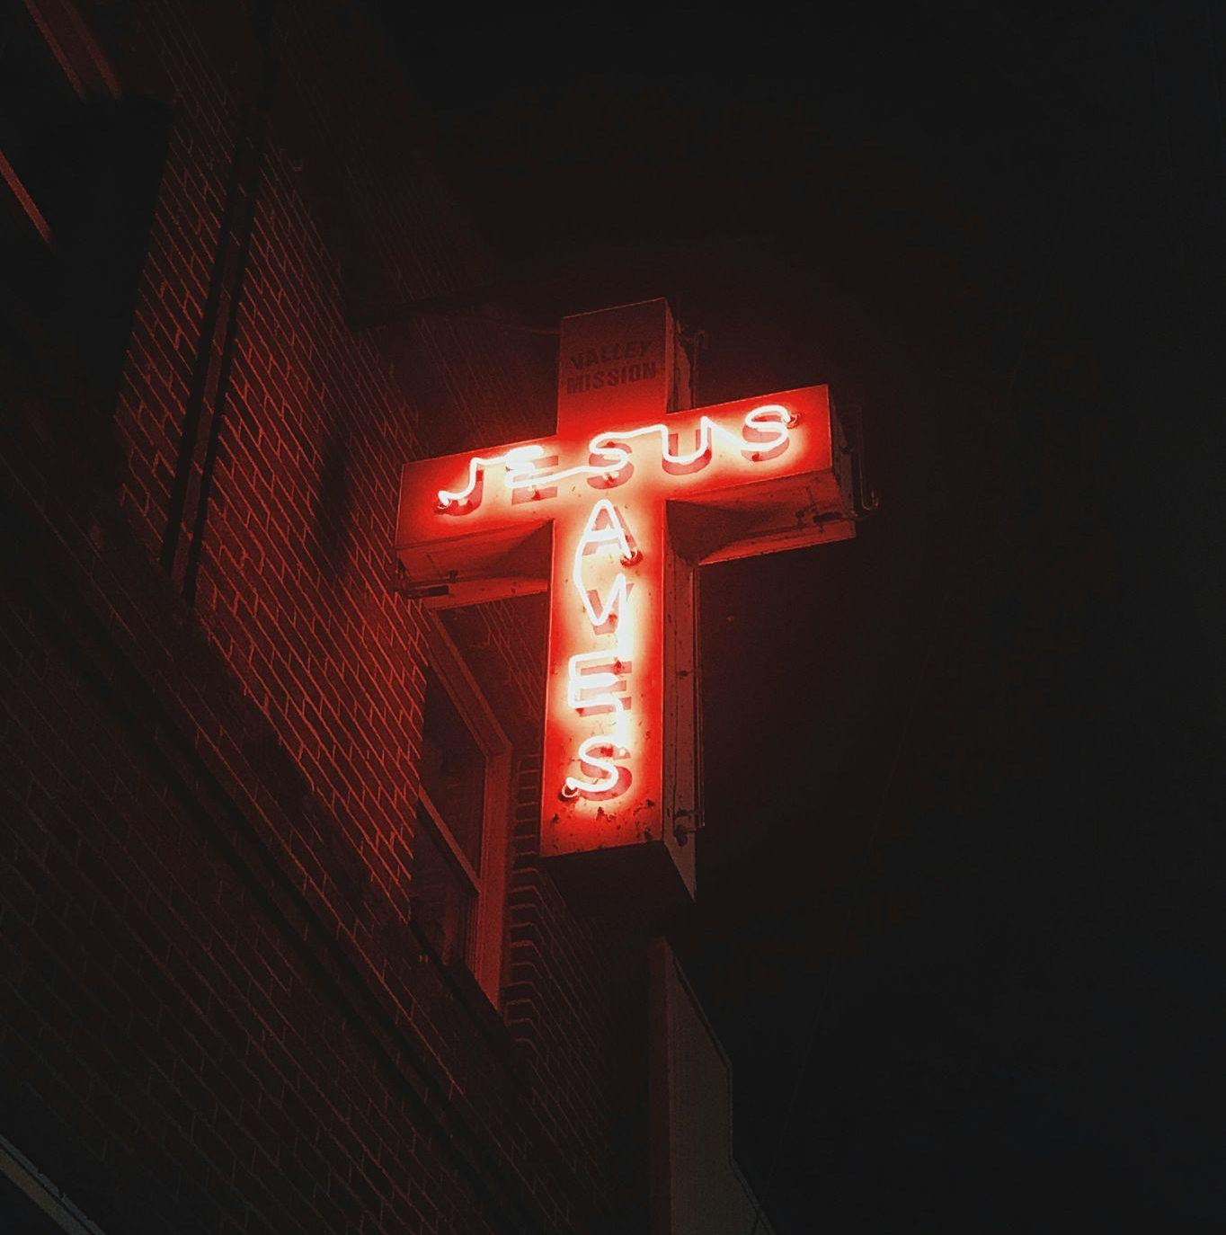
GOSPEL

Slide 3
OUR GOSPEL FOUNDATIONS
The Cross of Christ
The empty tomb
“Therefore Jesus also suffered outside the city gate in order to sanctify the people by his own blood” (verses 11-12)
“...the God of peace who brought again from the dead our Lord Jesus…” (verse 20)

Slide 4
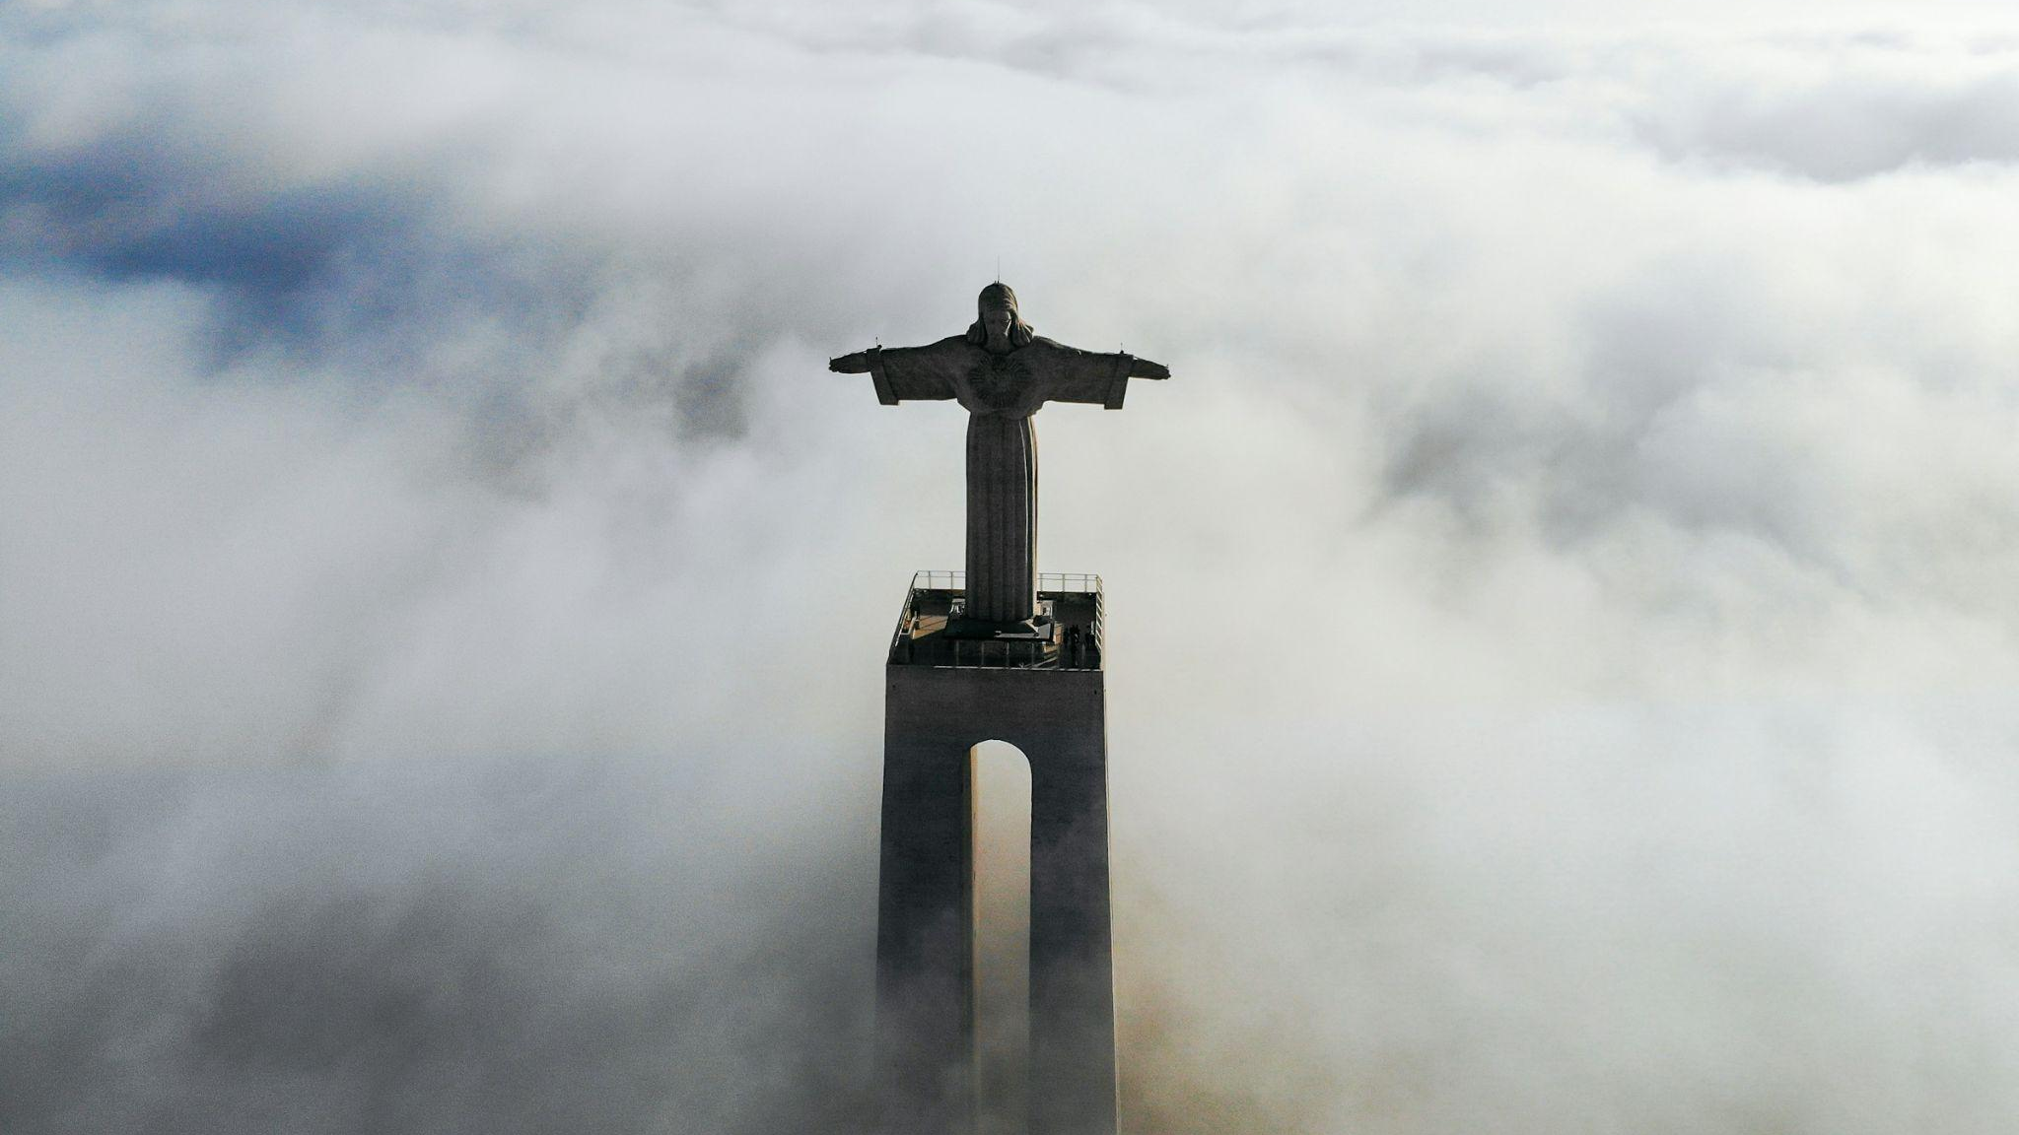
He identifies with sinful people
We identify with a crucified saviour

Slide 5
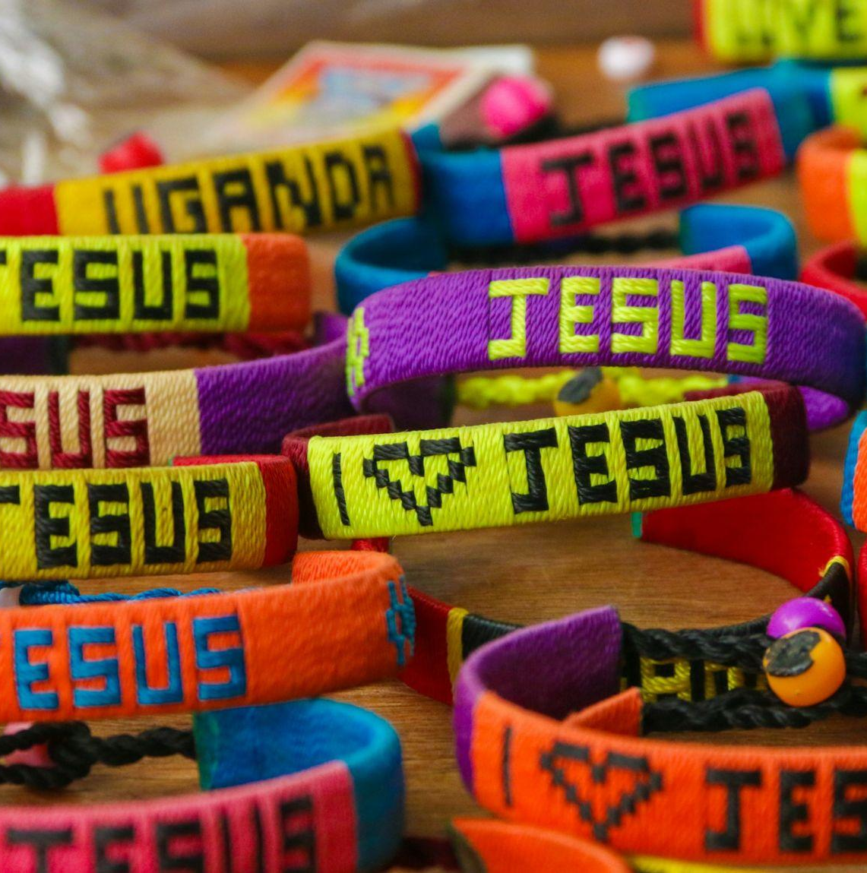
FAITH

Slide 6
OUR FAITH FOUNDATIONS
Everything changes
Except Jesus
“ we have no lasting city” (verse 14)
“Jesus Christ is the same yesterday and today and forever.” (verse 8)

Slide 7
THE POWER OF HIS WORDS
Because He has said
So we can say
‘for he has said, “I will never leave you or forsake you.”’ (Verse 5)
“So we can say with confidence,
“The Lord is my helper;
I will not be afraid.
What can anyone do to me?””
(Verse 6)

Slide 8
LIFE

Slide 9
Love one another (v.1)
Our Life Foundations
Show hospitality (v.2)
Care for the persecuted (v.3)
Honour marriage (v.4)
Don’t love money (v.5)
Be Content (v.5)

Slide 10
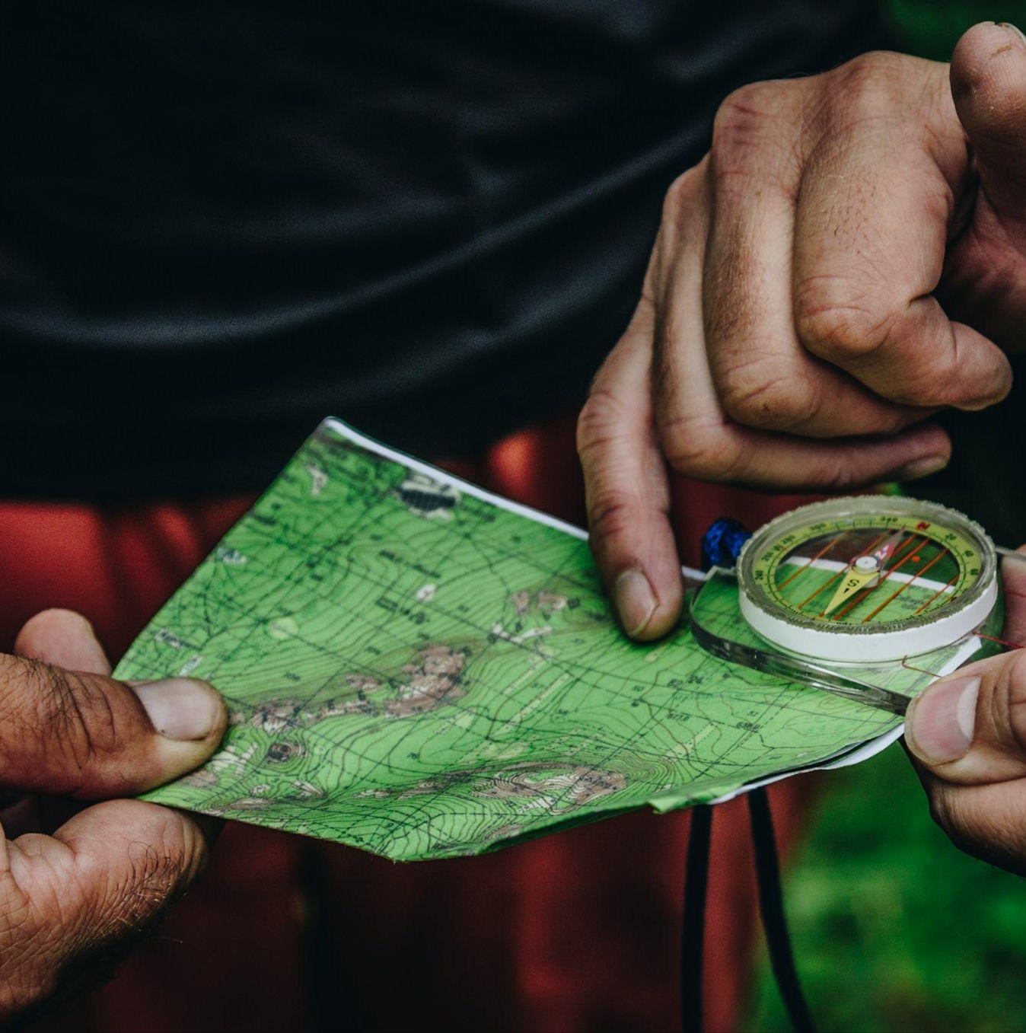
LEADERS

Slide 11
Our Leadership Foundations
Truth
Faith
Life
Sound
They speak the word of God to you (v.7)
They have a faith worth imitating (v.7)
They have a way of life worth considering (v.7)
No strange or weird teachings (v.9)
Encourage
Watchful
Integrity
Trustworthy
They strengthen your heart by grace (v. 9)
They keep watch over your souls (v.17)
They act honourably (v.18)
They have a clear conscience (v.18)

Slide 12
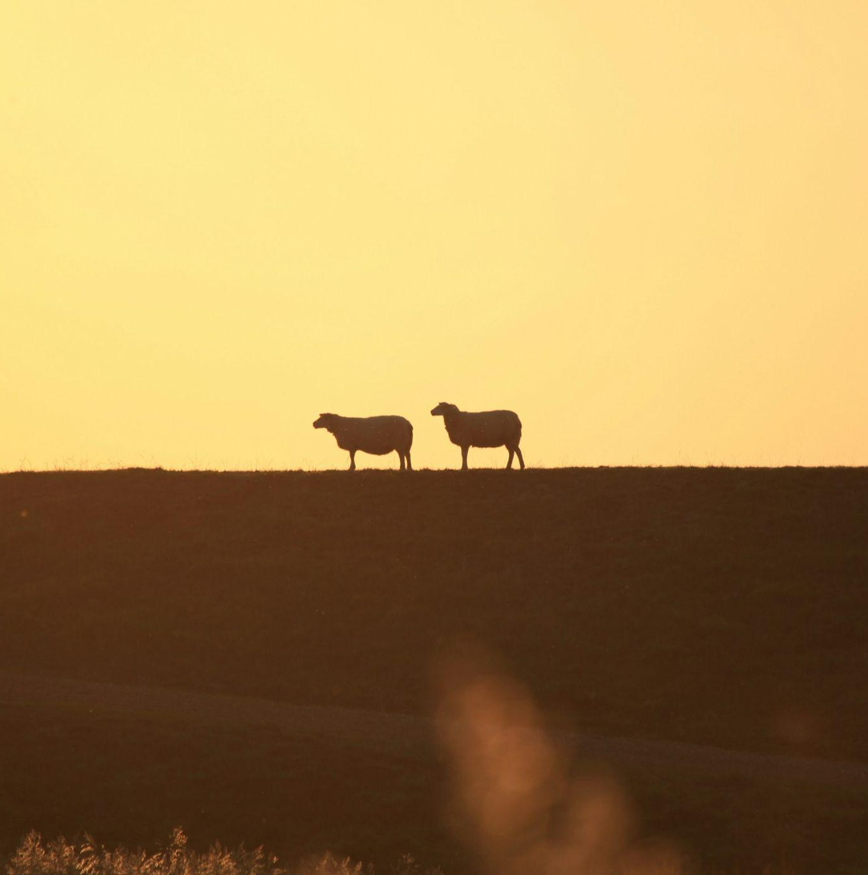
FOLLOW

Slide 13
Our discipleship foundations
REFLECT
CONSIDER
IMITATE
“Remember your leaders, those who spoke to you the word of God.” (Verse 7)
“Consider the outcome of their way of life.” (Verse 7)
“Imitate their faith” (verse 7)
OBEY
SUBMIT
PRAY
“Obey your leaders…”
(Verse 17)
“...and submit to them.”
(Verse 17)
“Pray for us…” (Verse 18)

Slide 14
OUR MOTIVATION
For your own good
And theirs
This is to your advantage. It benefits YOU. (v.17)
If you do then your leaders can lead with JOY and not with GROANING (v.17)

Slide 15
PURPOSE

Slide 16
Our Mission Foundations
Kingdom
Worship
Witness
Service

