Slide 3
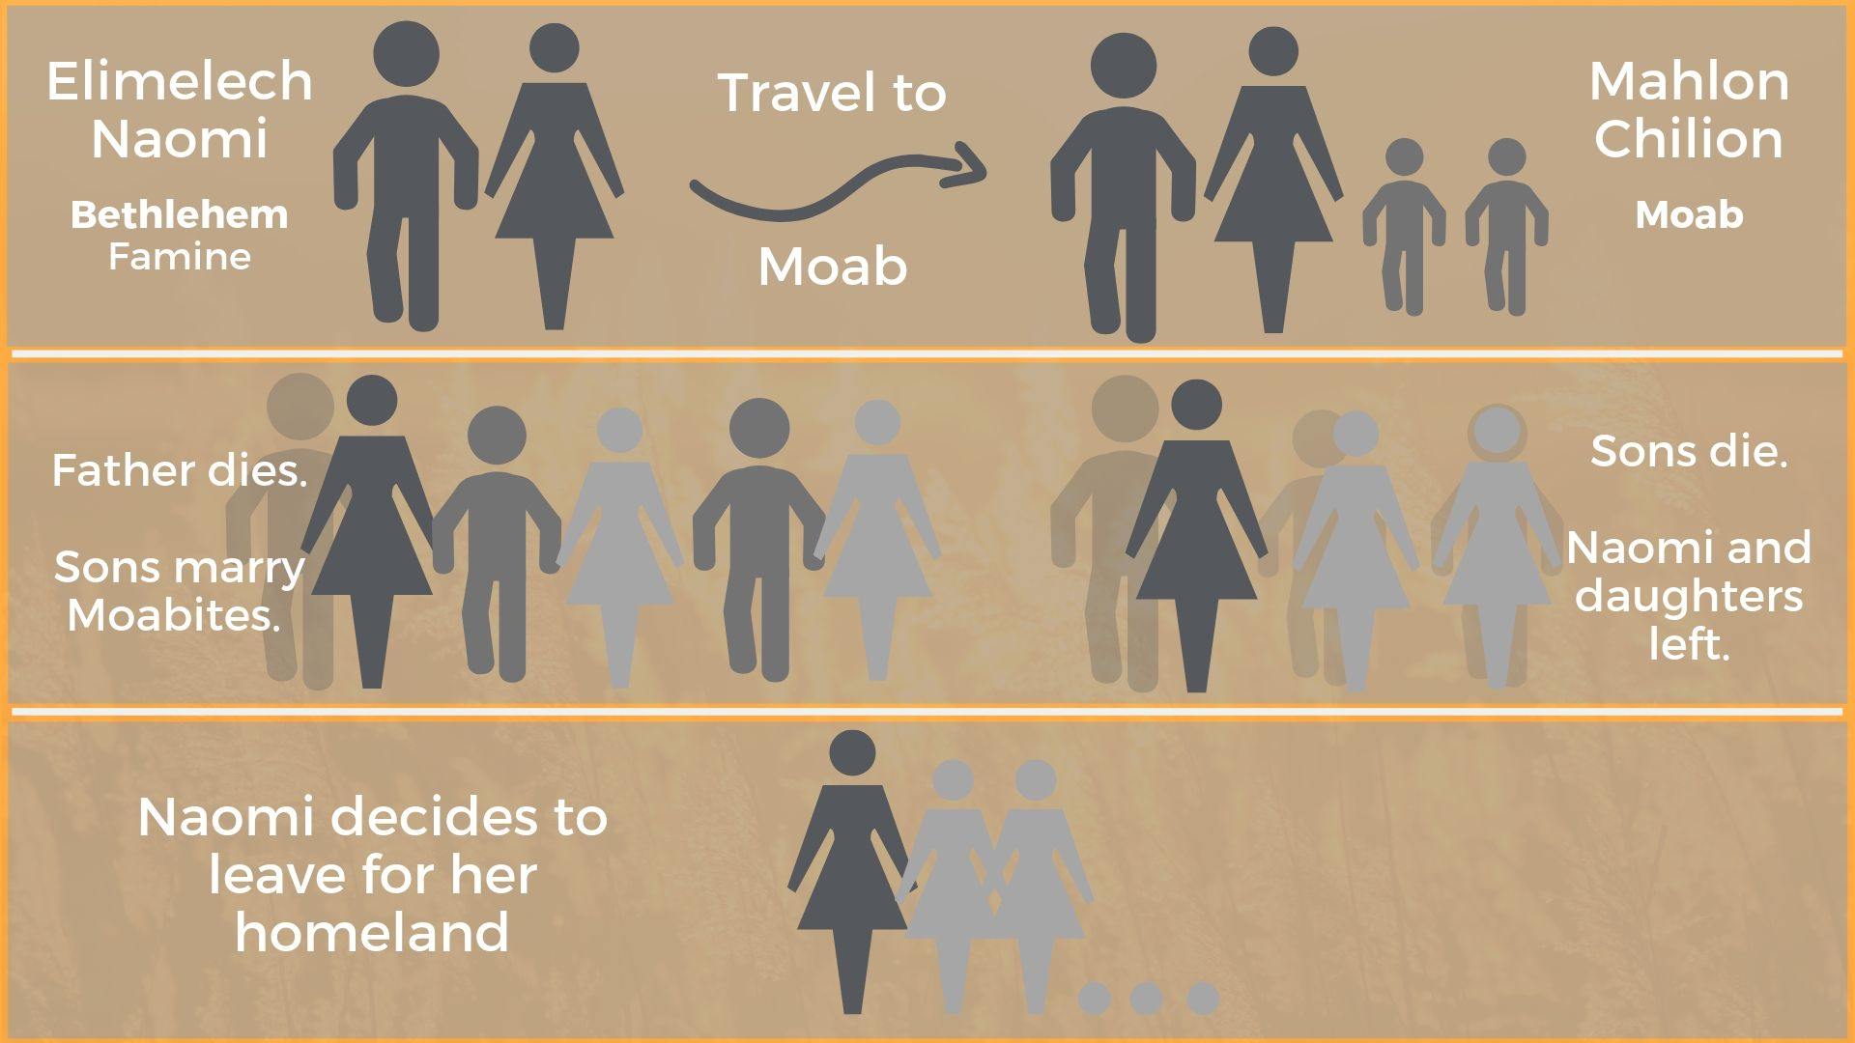

Slide 4
¹⁵“Look,” said Naomi, “your sister-in-law is going back to her people and her gods. Go back with her.” ¹⁶But Ruth replied, “Don’t urge me to leave you or to turn back from you. Where you go I will go, and where you stay I will stay. Your people will be my people and your God my God.
Ruth 1v15-16 ESV

Slide 5
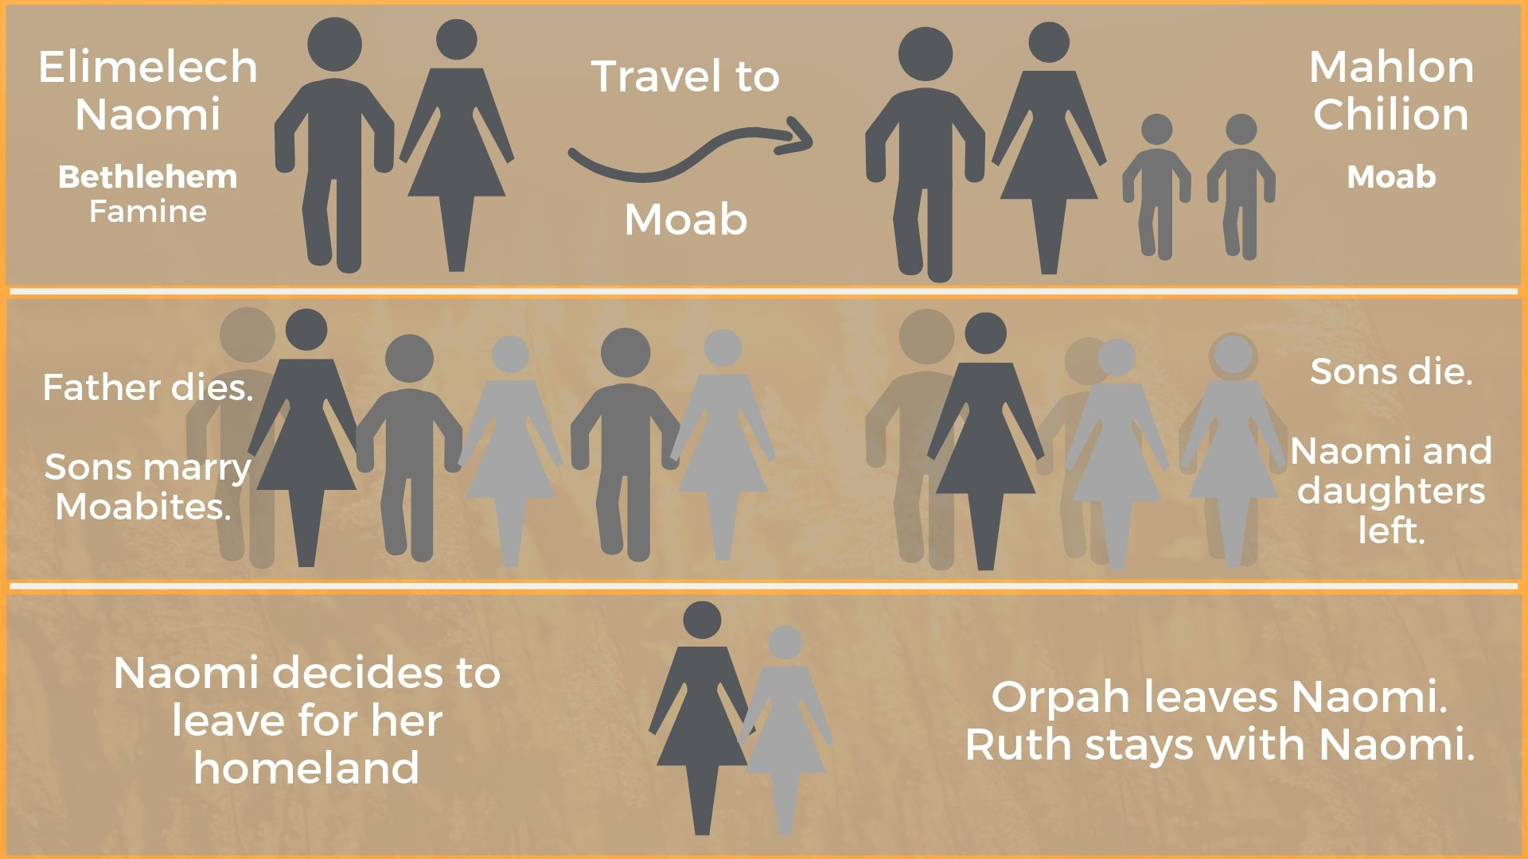

Slide 6
¹⁹ So the two of them went on until they came to Bethlehem. And when they came to Bethlehem, the whole town was stirred because of them. And the women said, “Is this Naomi?” ²⁰ She said to them, “Do not call me Naomi; call me Mara, for the Almighty has dealt very bitterly with me. ²¹ I went away full, and the Lord has brought me back empty. Why call me Naomi, when the Lord has testified against me and the Almighty has brought calamity upon me?”
Ruth 1v19-21 ESV

Slide 7
¹Now Naomi had a relative of her husband's, a worthy man of the clan of Elimelech, whose name was Boaz. ² And Ruth the Moabite said to Naomi, “Let me go to the field and glean among the ears of grain after him in whose sight I shall find favour.” And she said to her, “Go, my daughter.” ³ So she set out and went and gleaned in the field after the reapers, and she happened to come to the part of the field belonging to Boaz, who was of the clan of Elimelech. ⁴ And behold, Boaz came from Bethlehem. And he said to the reapers, “The Lord be with you!” And they answered, “The Lord bless you.”
Ruth 2v1-4 ESV

Slide 8
⁵ Then Boaz said to his young man who was in charge of the reapers, “Whose young woman is this?” ⁶ And the servant who was in charge of the reapers answered, “She is the young Moabite woman, who came back with Naomi from the country of Moab. ⁷ She said, ‘Please let me glean and gather among the sheaves after the reapers.’ So she came, and she has continued from early morning until now, except for a short rest.”.
Ruth 2v5-7 ESV

Slide 9
⁸Then Boaz said to Ruth, “Now, listen, my daughter, do not go to glean in another field or leave this one, but keep close to my young women. ⁹Let your eyes be on the field that they are reaping, and go after them. Have I not charged the young men not to touch you? And when you are thirsty, go to the vessels and drink what the young men have drawn.” ¹⁰ Then she fell on her face, bowing to the ground, and said to him, “Why have I found favour in your eyes, that you should take notice of me, since I am a foreigner?”
Ruth 2v8-10 ESV

Slide 10
¹¹ But Boaz answered her, “All that you have done for your mother-in-law since the death of your husband has been fully told to me, and how you left your father and mother and your native land and came to a people that you did not know before. ¹²The Lord repay you for what you have done, and a full reward be given you by the Lord, the God of Israel, under whose wings you have come to take refuge!” ¹³ Then she said, “I have found favour in your eyes, my lord, for you have comforted me and spoken kindly to your servant, though I am not one of your servants.”
Ruth 2v11-13 ESV

Slide 11
¹⁴And at mealtime Boaz said to her, “Come here and eat some bread and dip your morsel in the wine.” So she sat beside the reapers, and he passed to her roasted grain. And she ate until she was satisfied, and she had some left over. ¹⁵When she rose to glean, Boaz instructed his young men, saying, “Let her glean even among the sheaves, and do not reproach her. ¹⁶And also pull out some from the bundles for her and leave it for her to glean, and do not rebuke her.” ¹⁷So she gleaned in the field until evening. Then she beat out what she had gleaned, and it was about an ephah of barley. ¹⁸And she took it up and went into the city. Her mother-in-law saw what she had gleaned. She also brought out and gave her what food she had left over after being satisfied.
Ruth 2v14-18 ESV

Slide 12
¹⁹ And her mother-in-law said to her, “Where did you glean today? And where have you worked? Blessed be the man who took notice of you.” So she told her mother-in-law with whom she had worked and said, “The man's name with whom I worked today is Boaz.” ²⁰ And Naomi said to her daughter-in-law, “May he be blessed by the Lord, whose kindness has not forsaken the living or the dead!” Naomi also said to her, “The man is a close relative of ours, one of our redeemers.”
Ruth 2v19-20 ESV

Slide 13
¹²The Lord repay you for what you have done, and a full reward be given you by the Lord, the God of Israel, under whose wings you have come to take refuge!” ¹³ Then she said, “I have found favour in your eyes, my lord, for you have comforted me and spoken kindly to your servant, though I am not one of your servants.”
Ruth 2v12-13 ESV

Slide 14
“Come, everyone who thirsts, come to the waters; and he who has no money, come, buy and eat! Come, buy wine and milk without money and without price. ² Why do you spend your money for that which is not bread, and your labour for that which does not satisfy? Listen diligently to me, and eat what is good, and delight yourselves in rich food.
Isaiah 55:1-2 ESV

Slide 15
I stand amazed in the presence of Jesus the Nazarene And wonder how he could love me, a sinner, condemned, unclean
How marvellous! How wonderful! And my song shall ever be How marvellous! How wonderful! Is my Saviour's love for me!
He took my sins and my sorrows, He made them his very own He bore the burden to Calvary, And suffered and died alone
When with that ransomed in glory, His face I at last shall see It will be my joy through the ages, To sing of his love for me

