Slide 2
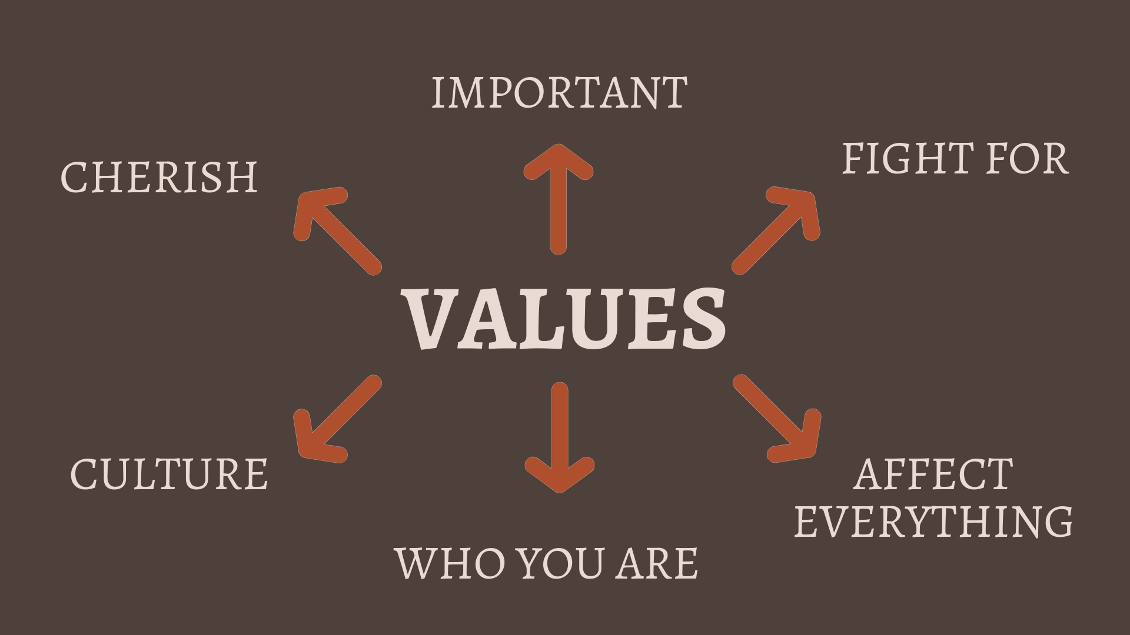

Slide 7
¹⁷ Since by the one man’s trespass, death reigned through that one man, how much more will those who receive the overflow of grace and the gift of righteousness reign in life through the one man, Jesus Christ
Romans 5:17

Slide 8
⁴You who are trying to be justified by the law have been alienated from Christ; you have fallen away from grace.
Galatians 5:4 NIV

Slide 9
¹⁷ Since by the one man’s trespass, death reigned through that one man, how much more will those who receive the overflow of grace and the gift of righteousness reign in life through the one man, Jesus Christ
Romans 5:17

Slide 10
WHAT IS OUR RELATIONSHIP TO THE LAW?
¹⁴For sin will not rule over you, because you are not under the law but under grace.
Romans 6:14 CSB
⁴ For Christ is the end of the law for righteousness to everyone who believes
Romans 10:4 CSB

Slide 11
¹Since I am speaking to those who know the law, brothers and sisters, don’t you know that the law rules over someone as long as he lives? ²For example, a married woman is legally bound to her husband while he lives. But if her husband dies, she is released from the law regarding the husband. ³So then, if she is married to another man while her husband is living, she will be called an adulteress. But if her husband dies, she is free from that law. Then, if she is married to another man, she is not an adulteress.
Romans 7:1-3 CSB

Slide 12
⁴ Therefore, my brothers and sisters, you also were put to death in relation to the law through the body of Christ so that you may belong to another. You belong to him who was raised from the dead in order that we may bear fruit for God. ⁵ For when we were in the flesh, the sinful passions aroused through the law were working in us to bear fruit for death. ⁶ But now we have been released from the law, since we have died to what held us, so that we may serve in the newness of the Spirit and not in the old letter of the law.
Romans :4-6 CSB

Slide 13
¹Since I am speaking to those who know the law, brothers and sisters, don’t you know that the law rules over someone as long as he lives?
⁴ Therefore, my brothers and sisters, you also were put to death in relation to the law through the body of Christ so that you may belong to another. You belong to him who was raised from the dead in order that we may bear fruit for God.
Romans 7:1-4 CSB

Slide 14
¹⁹ For through the law I died to the law, so that I might live for God. ²⁰ I have been crucified with Christ, and I no longer live, but Christ lives in me. The life I now live in the body, I live by faith in the Son of God, who loved me and gave himself for me.
Galatians 2:19-20 CSB

Slide 15
⁴ Therefore, my brothers and sisters, you also were put to death in relation to the law through the body of Christ so that you may belong to another. You belong to him who was raised from the dead in order that we may bear fruit for God. ⁵ For when we were in the flesh, the sinful passions aroused through the law were working in us to bear fruit for death. ⁶ But now we have been released from the law, since we have died to what held us, so that we may serve in the newness of the Spirit and not in the old letter of the law.
Romans 7:4-6 CSB

Slide 16
²¹Is the law therefore contrary to God’s promises? Absolutely not! For if the law had been granted with the ability to give life, then righteousness would certainly be on the basis of the law.
Galatians 3:21 CSB

Slide 17
¹⁷ Since by the one man’s trespass, death reigned through that one man, how much more will those who receive the overflow of grace and the gift of righteousness reign in life through the one man, Jesus Christ
Romans 5:17

Slide 18
GRACE FILLED PEOPLE WILL…
be secure, approachable, and down-to-earth
be quick to say sorry and to forgive
be holy in our lifestyle
have lots of fun
be radically generous
be people of expressive praise

Slide 19
¹¹ For the grace of God has appeared that offers salvation to all people. ¹² It teaches us to say “No” to ungodliness and worldly passions, and to live self-controlled, upright and godly lives in this present age, ¹³ while we wait for the blessed hope—the appearing of the glory of our great God and Saviour, Jesus Christ,¹⁴ who gave himself for us to redeem us from all wickedness and to purify for himself a people that are his very own, eager to do what is good.
Titus 2:11-14 NIV

Slide 20
⁸ For by grace you have been saved through faith. And this is not your own doing; it is the gift of God
Ephesians 2:8 ESV

Slide 21
On the night when he was betrayed, the Lord Jesus took bread, ²⁴ and when he had given thanks, broke it, and said, “This is my body, which is for you. Do this in remembrance of me.” ²⁵In the same way also he took the cup, after supper, and said, “This cup is the new covenant in my blood. Do this, as often as you drink it, in remembrance of me.”²⁶For as often as you eat this bread and drink the cup, you proclaim the Lord’s death until he comes.
1 Corinthians 11:23-26 CSB

