Slide 2
Notes:
We are wrapping up our series on one anothering this morning.
Nicole and I are speaking on loving one another. That’s loving each other as disciples of Christ (gesture to the crowd) not Nicole and I loving one another as husband and wife (pointing to me and Nicole)- (those verses are found in the song of songs) that’s an entirely different preach.
Over the last three weeks we’ve been looking at how we follow the commands of God so that we become increasingly a community marked out by forgiveness, where we bear with one another’s foibles and flaws, and sin. A community full of love for one another with a love that covers a multitude of sins. A family that encourages, frequently, generously and effectively, that doesn’t flatter, but builds one another up in love, stirring one another on to good works. A family that is made up of men, women and kids from different ages, nations, stations, races, and cultures- but having a genuine affection for one another, like that found naturally in family.
That’s our hope and desire here at Redeemer. That we’re strengthened with love for one another and known by our love for one another.

Slide 3
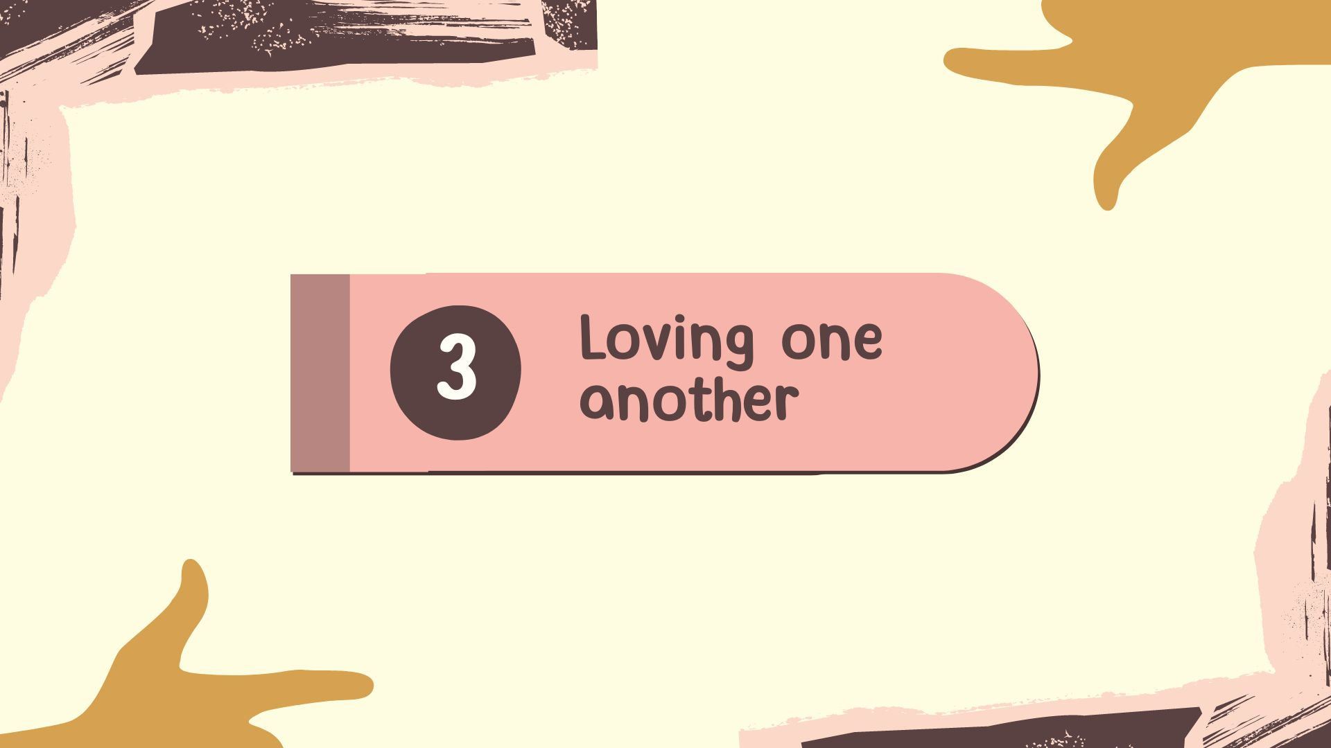

Slide 4
John 13:34-35 NIV
34 “A new command I give you: Love one another. As I have loved you, so you must love one another. 35 By this all men will know that you are my disciples, if you love one another”.
Notes:
The key verses today are from John chapter 13 verses 34 and 35. Read.
Prayer:
Father, thank you that you love us. Please help me now to preach your word faithfully. May Redeemer grow in our love of one another. May we be marked out by the sacrificial love of Christ. May we prefer to give honour to each other more than we would to receive it. May your love in us lead to transformed attitudes and actions that glorify your name. May we forgive and forbear and put courage in whenever it’s needed to step out for love and good works. May Colchester look on and see that we are disciples of Jesus Christ, and may many men, women and children in this town and beyond be drawn in, saved and added to your beautiful church, one at a time. Amen

Slide 5
Loving one another
WHAT is it?
WHY do we need it?
HOW do we show it?
Notes:
Looking at this scripture, we’re going to ask three questions
1- What is this love that Jesus commands us to have for one another?
2- Why is it so important that we love one another this way?
3- And How do we express this love for one another?
-What is it? Why do we need it? And How do we show it?

Slide 6
A New Command
³⁴ “A new command I give you: Love one another. As I have loved you, so you must love one another. ³⁵ By this all men will know that you are my disciples, if you love one another”
John 13:34-35 NIV
Notes:
WHAT is this love that Jesus commands?
Set the scene
A New Command- In what way?: By Degree and by Design
a new command “I give you”. Leviticus 19:18 “Do not seek revenge or bear a grudge against anyone among your people but love your neighbour as yourself. I am the Lord”. Jesus says, a new command “I give you”. No one has ever loved like Jesus, when he took all the sins of the world upon himself on the cross. The righteous one given for the unrighteous. I don’t think in that moment John, or any of the other disciples realised what Jesus was saying until after he had died and risen again- “I am giving you this command”. “I am the Lord”. And he’s about to show them the extent, the degree of his love as he goes to the cross for them.
Jesus is not just repeating the command to love your neighbour as yourself but commanding his followers to love as he himself -The Lord, loves. I’ve washed your feet. I’m going to lay my life down for you. And I want you to love the same way. This is a new command by degree.
2) And, it’s a new command by Design:
No one has lived and loved like Jesus. The very light of the world had broken into the world, the word at the beginning made flesh, and he was here amongst them, Immanuel, God with them. He has laid his life down for us and calls us to do the same. “As I have loved you”.
Jesus’ life is the Pattern to love…”as I have loved you”. Wash one another’s feet. Lay down your lives for one another. And he gives us the Power to love. Where I’m going you cannot follow now, but don’t worry, I am sending the HS. That was new. The empowering of the HS for each and every one of his followers to obey the command- to love like Jesus. The true mark of discipleship is our love of one another. And that’s gonna take the power of the HS!
We cannot conjure up this love or work at it in our own strength.
(Only Jesus’ sacrifice, the lamb of God, can take away sins. My death for you, your death for me could not do that.)

Slide 7
Loving one another
WHAT is it?
WHY do we need it?
HOW do we show it?
Notes:
That leads us into Why we need to love like Jesus.
Bridge: We can only live out the love of Christ, if we’re abiding in the love of Christ!
(my first Bible)
John 15- Jesus said, “As the Father has loved me, so I have loved you. Abide in my love… and then later he repeats this command “This is my commandment, that you love one another as I have loved you”. So, he invites us to enter into the love of the Father for the son, and then calls us to love one another with the same love.
He described himself as the true vine, we can bear the fruit of love for one another only if we are drawing on the love of Jesus, like a branch draws upon the vine. You break it off, its dead. If we abide in Jesus, we will bear fruit, much fruit.
Q. If you want confidence that you abide in the light of God’s love, ask yourself, “How am I doing with loving those who are following Jesus as best as they can?” Regardless of how well I get on with them or not.
John writes in 1John 3: 14 “We know that we have passed from death to life, because we love our brothers”. “Anyone who loves their brother or sister lives in the light” (1John 2:9). “But anyone who hates a brother or sister (Jesus said that’s murder from the heart, and murder is punishable by death under the law of God) is in the darkness and walks around in darkness. They do not have the light, They do not have eternal life in Christ in them.
1John 3:16 “This is how we know what love is: Jesus Christ laid down his life for us. And we ought to lay down our lives for our brothers” NIV
1John 4:19-21 “We love because he first loved us. Whoever claims to love God yet hates a brother or sister is a liar. For whoever does not love their brother or sister, whom they have seen, cannot love God, whom they have not seen. And he has given us this command: Anyone who loves God must also love their brother and sister”.
Why is it so important that we love like Jesus?
Because it is the fruit of a life that’s been born again by God- In Christ- the love of the Father for us, working in us and through us toward one another by the power of the HS.
It’s not something that can be fabricated, forced or faked.
The same Spirit in us that cries “Abba, Father”, recognises “brother, sister”- it’s real affection, genuine love. Devoted to one another with the affection of family as it says in Romans 12:10.
Perhaps you wouldn’t say you’re a follower of Jesus. My hope is that you find yourself being drawn to men and woman that follow Jesus by the love they show for one another. Jesus said by our love of one another, all men will know that you are my disciples. It was like that for me- 20 something years ago. I didn't know why at the time, but I just wanted to be around Christians. You know when you meet a family that has real affection for one another, is caring of one another and clearly enjoy being together, you wanna be around them, right? Not the family that bickers, back bites, and bashes each other with their words, or their hands.
By our love of one another, Jesus said we will be known to others.
We’re running an Alpha course at the moment- I’m loving doing the Alpha course. I can feel and see the love of God in me and the other leaders growing toward our guests. It’s like, we’re beginning to love like they’re a brother or sister. To have care and concern for them as they share their lives with us. As they’re on a journey with Jesus. It’s such a privilege and a wonderful pleasure. My hope and prayer is that as they see the love of brothers and sisters for one another, they too will be drawn in.. My prayer is that God will save them, and they will be added. Welcome to the family!
It’s the same root cause for why we honour one another, as Romans 12:10 calls us to- preferring to give honour than to receive honour. Not primarily because of what we do, but because of who we are- Sons of God- Jesus died for him, He died for her. He’s my brother, shes my sister. I will honour them.
There’s no place for partiality in God’s family- whatever our race, our sex, our age, our station in life, there’s to be no favouritism.
James 2:1 “my brothers show no partiality as you hold the faith of our Lord Jesus Christ” James was addressing favouritism toward rich people in the congregation- it led to Gods people dishonouring the poor.
We love to celebrate one another’s achievements in Redeemer, however big or small. Praise God! We do “bestow” honour this way and let’s be generous. But the reason we are commanded to honour one another, and to even outdo one another in this, is because of whom each one is in Christ!
God has seen to it that the parts that lacked honour (that appear less impressive to us) he gave more honour too, so that we would have concern for one another, equally. And the parts that seem less honourable to us (perhaps not so visible, just getting on with loving and serving quietly behind the scenes) we are to bestow greater honour to.
Hannah is leading the Alpha course excellently. I love how she honours Anne and Jean at Alpha- reminding the serving team and letting the guests know, that these wonderful Godly women whom they have never even met, pray for them regularly, and hear from God for them. It’s a great culture of honour I’m seeing and hearing. And it speaks profoundly to our guests.
Honour and thank Hannah and Anne and Jean.

Slide 8
Loving one another
WHAT is it?
WHY do we need it?
HOW do we show it?
Notes:
Finally, 3) How do we love one another like Jesus commands us to?
Introduce Nicole: Nicole is going to share some helpful hints to consider as we work out how we practically love one another.

Slide 9
Love languages
Words of affirmation
Physical Touch
Acts of Service
Quality Time
Receiving Gifts

Slide 10
Notes:
Thank Nicole. Some helpful insights for us. Let’s prayerfully consider how we can learn about one another’s love languages, and then creatively show love for one another.
(Honour Joan- LG text messages, sharing encouragement for the day, birthday and Christmas cards she’s made. Words are one of her love languages. And she prays! Revivals have begun by a few older women praying. Amen)
We’re going to share communion shortly. If you have something against a brother or sister here this morning, please make sure you go to them in a spirit of reconciliation before taking the bread and juice. If you need help with that please ask. If you need someone to listen to you and pray with you, please find someone. Perhaps you can go to someone in the room and bring some encouragement today. Let’s be ready to have communion-be active.
Invite the band up
Jesus has commanded us to love like he loves. He has shown us the pattern for love, and he gives the power to love.
-Abide in me, says Jesus, the true vine. As we receive the love of the Father, we will find we have power to love one another. Let’s be creative in this, grow in this. What’s his/her love language. Be attentive, “what needs do they have”, and be proactive with our concern and care for one another, ask yourself, “how can I encourage, and honour”. How can I make much of my brothers and sisters in Christ as I get down to wash feet? I think when we lower ourself to serve, our heavenly Father looks on saying, “that’s my Son”.
-Let’s look for God’s grace in one another’s lives, flawed as they are- (1 Corinthians 13 a very famous wedding reading says paraphrase- Love is patient, love is kind…it does not envy or boast, it’s not proud. It does not dishonour others, it’s not self-seeking or easily angered, and keeps no record of wrongs. In love we may need to correct one another sometimes. Love means we will step in when we see a brother or sister heading toward sin. We pray, “Father, lead us not into temptation”- may that include by the love of dear brothers and sisters who warn us, hem us in, and help us on into holy living. Love hopes for the best. Let’s be praying for one another. And as we see God’s grace at work in our lives, let us celebrate together. Amen.
Communion.

Slide 11
communion

