Slide 2
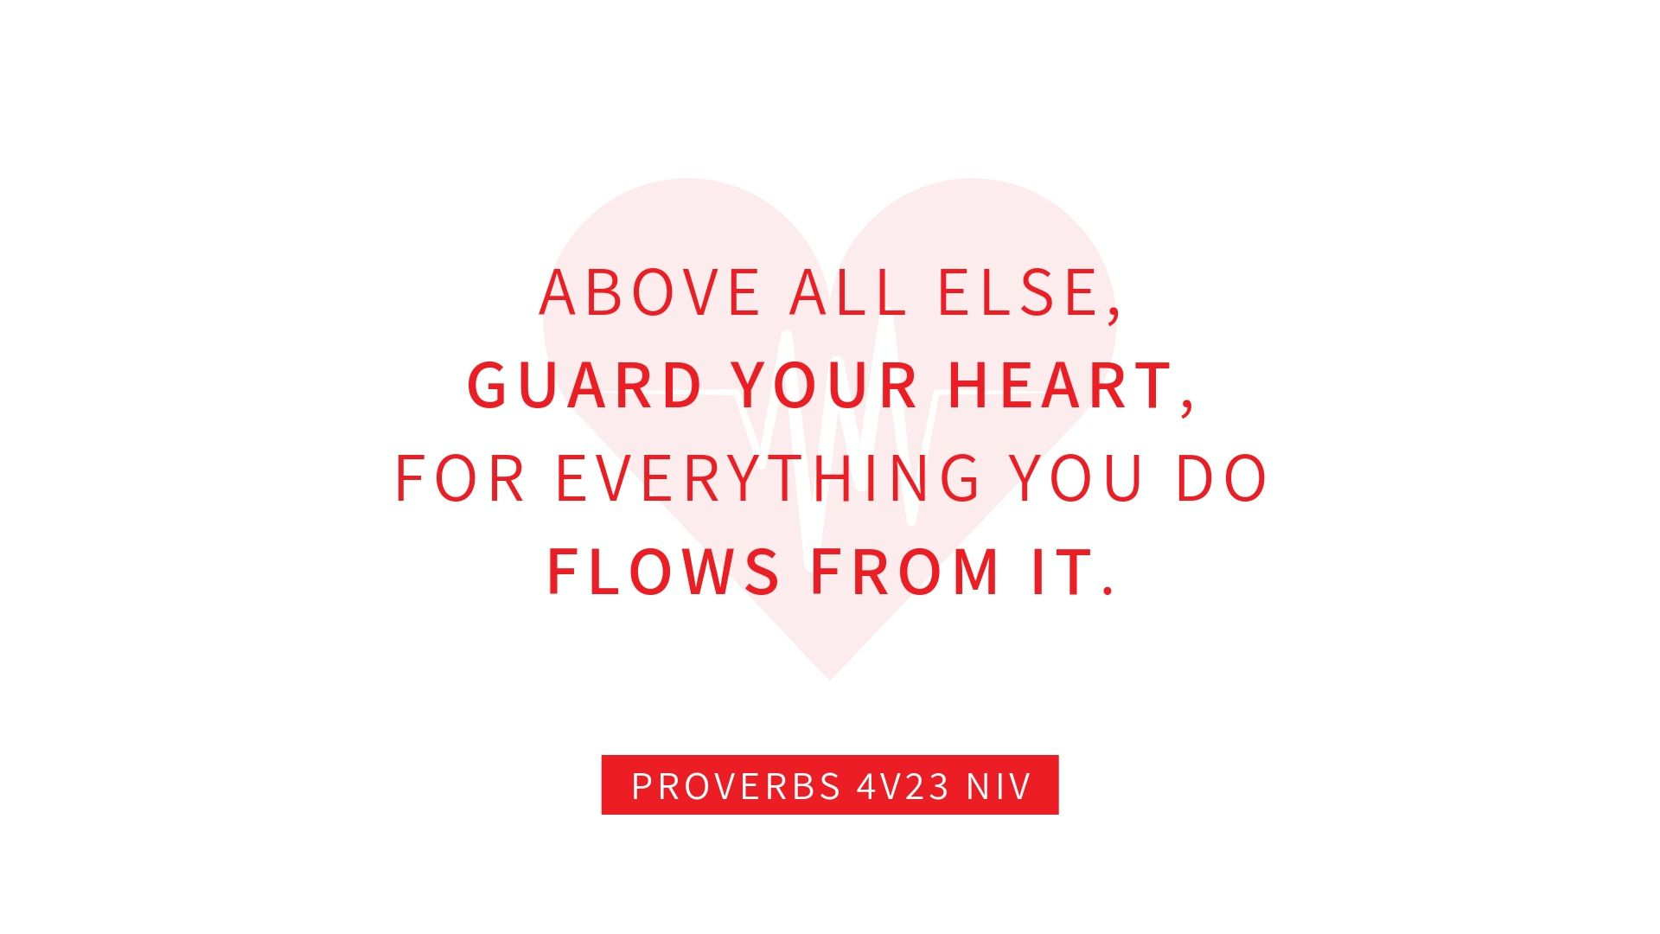

Slide 4
It is for freedom that Christ has set us free. Stand firm, then, and do not let yourselves be burdened again by a yoke of slavery.
Galatians 5v1 NIV

Slide 6
²¹ For although they knew God, they neither glorified him as God nor gave thanks to him, but their thinking became futile and their foolish hearts were darkened. ²² Although they claimed to be wise, they became fools ²³ and exchanged the glory of the immortal God for images made to look like a mortal human being and birds and animals and reptiles. ²⁴ Therefore God gave them over in the sinful desires of their hearts… ²⁵ They exchanged the truth about God for a lie, and worshiped and served created things rather than the Creator—who is forever praised. Amen.
Romans 1v21-15 NIV

Slide 7
It is for freedom that Christ has set us free. Stand firm, then, and do not let yourselves be burdened again by a yoke of slavery.
Galatians 5v1 NIV

Slide 9
RULING DESIRE (IDOL): COMFORT
WHAT WE DESIRE | COST WILLING TO PAY | BIGGEST FEAR | OTHERS FEEL
LACK OF STRESS NO RESPONSIBILITY AVOID SUFFERING | REDUCED PRODUCTIVITY | STRESS DEMANDS | HURT
SYMPTOMS / PROBLEMS / EMOTIONS
BOREDOM Addictions | Stress | Detached | Inconvenience Avoiding entanglements | Non-committal Overprotective your time

Slide 10
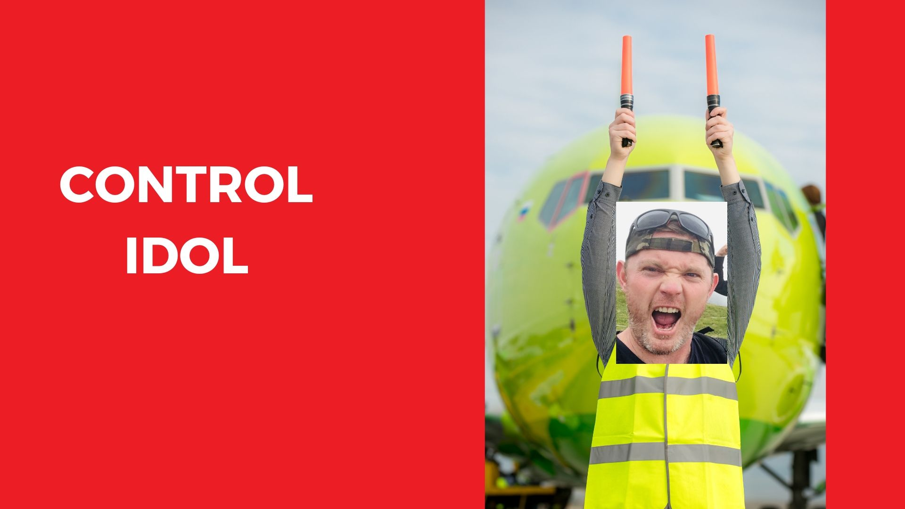

Slide 11
RULING DESIRE (IDOL): CONTROL
WHAT WE DESIRE | COST WILLING TO PAY | BIGGEST FEAR | OTHERS FEEL
SELF-DISCIPLINE CERTAINTY STANDARDS | LONELINESS | UNCERTAINTY | CONDEMNED
SYMPTOMS / PROBLEMS / EMOTIONS
WORRY Anxiety | Boasting | Cannot delegate Struggle share power (anything!) Manipulate (guilt and pressure) Overprotective of time and others

Slide 12
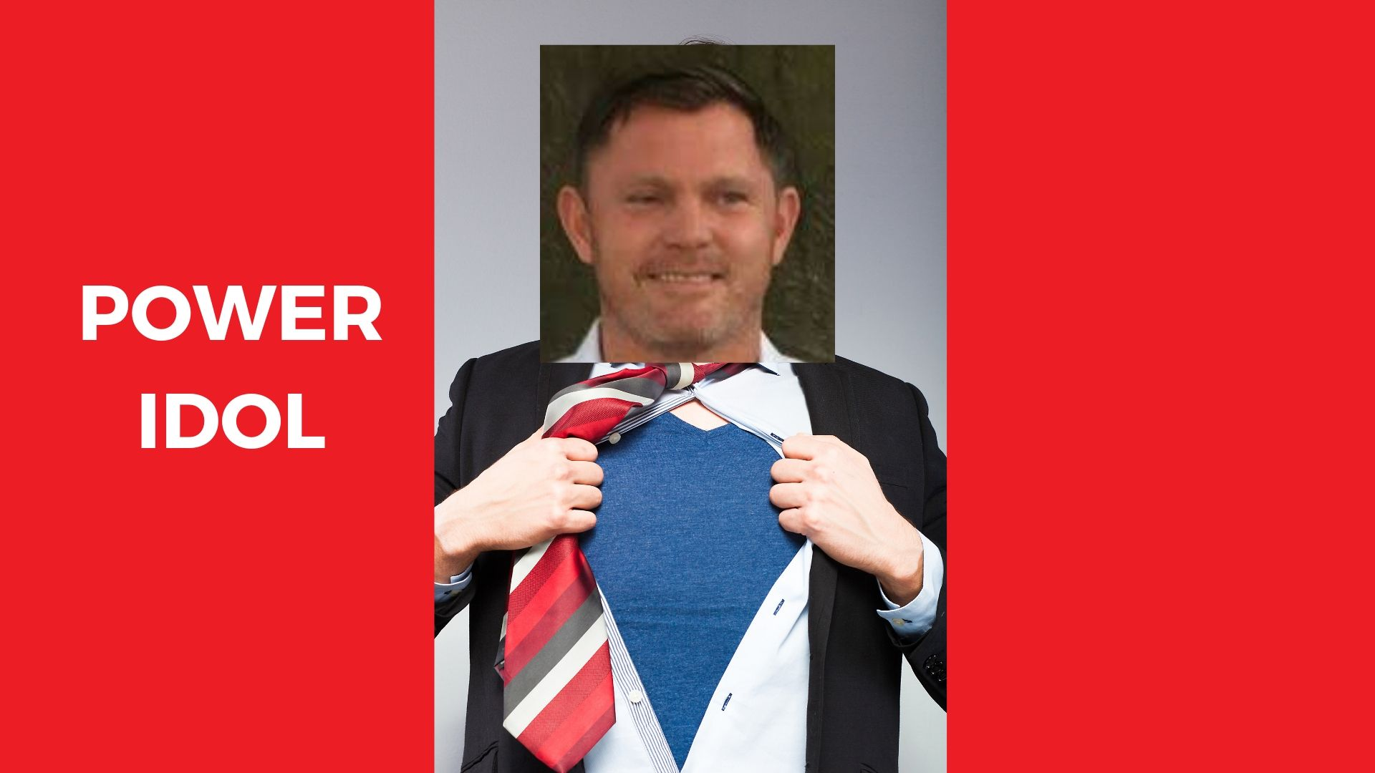

Slide 13
RULING DESIRE (IDOL): POWER
WHAT WE DESIRE | COST WILLING TO PAY | BIGGEST FEAR | OTHERS FEEL
SUCCESS WINNING INFLUENCE | BURDENED RESPONSIBILITY | HUMILIATION (used to winning) | USED
SYMPTOMS / PROBLEMS / EMOTIONS
ANGER Opinionated |Poor listeners Argumentative | Unteachable Afraid to admit they’ve been in the wrong

Slide 15
RULING DESIRE (IDOL): APPROVAL
WHAT WE DESIRE | COST WILLING TO PAY | BIGGEST FEAR | OTHERS FEEL
AFFIRMATION RELATIONSHIP LOVE | LESS INDEPENDENCE | REJECTION (approval addict)) | SMOTHERED
SYMPTOMS / PROBLEMS / EMOTIONS
COWARDICE Worry/Anxiety | Over commitment |Easily hurt/offended Handling criticism | Cowardice to confront | Parents not disciplining Employees don’t confront corruption | Inability to withdraw

Slide 16
RULING DESIRE IDOL | WHAT WE DESIRE | COST WILLING TO PAY | BIGGEST FEAR | OTHERS FEEL | PROBLEMS / EMOTIONS
COMFORT | Lack of stress No responsibility Avoid suffering | Reduced Productivity | SUFFERING | HURT | BOREDOM
CONTROL | Self-discipline Certainty Standards | Loneliness | UNCERTAINTY | CONDEMNED | WORRY
POWER | Success Winning Influence | Burdened Responsibility | HUMILIATION | USED | ANGER
APPROVAL | Affirmation Relationship Love | Less independence | REJECTION | SMOTHERED | COWARDICE

Slide 17
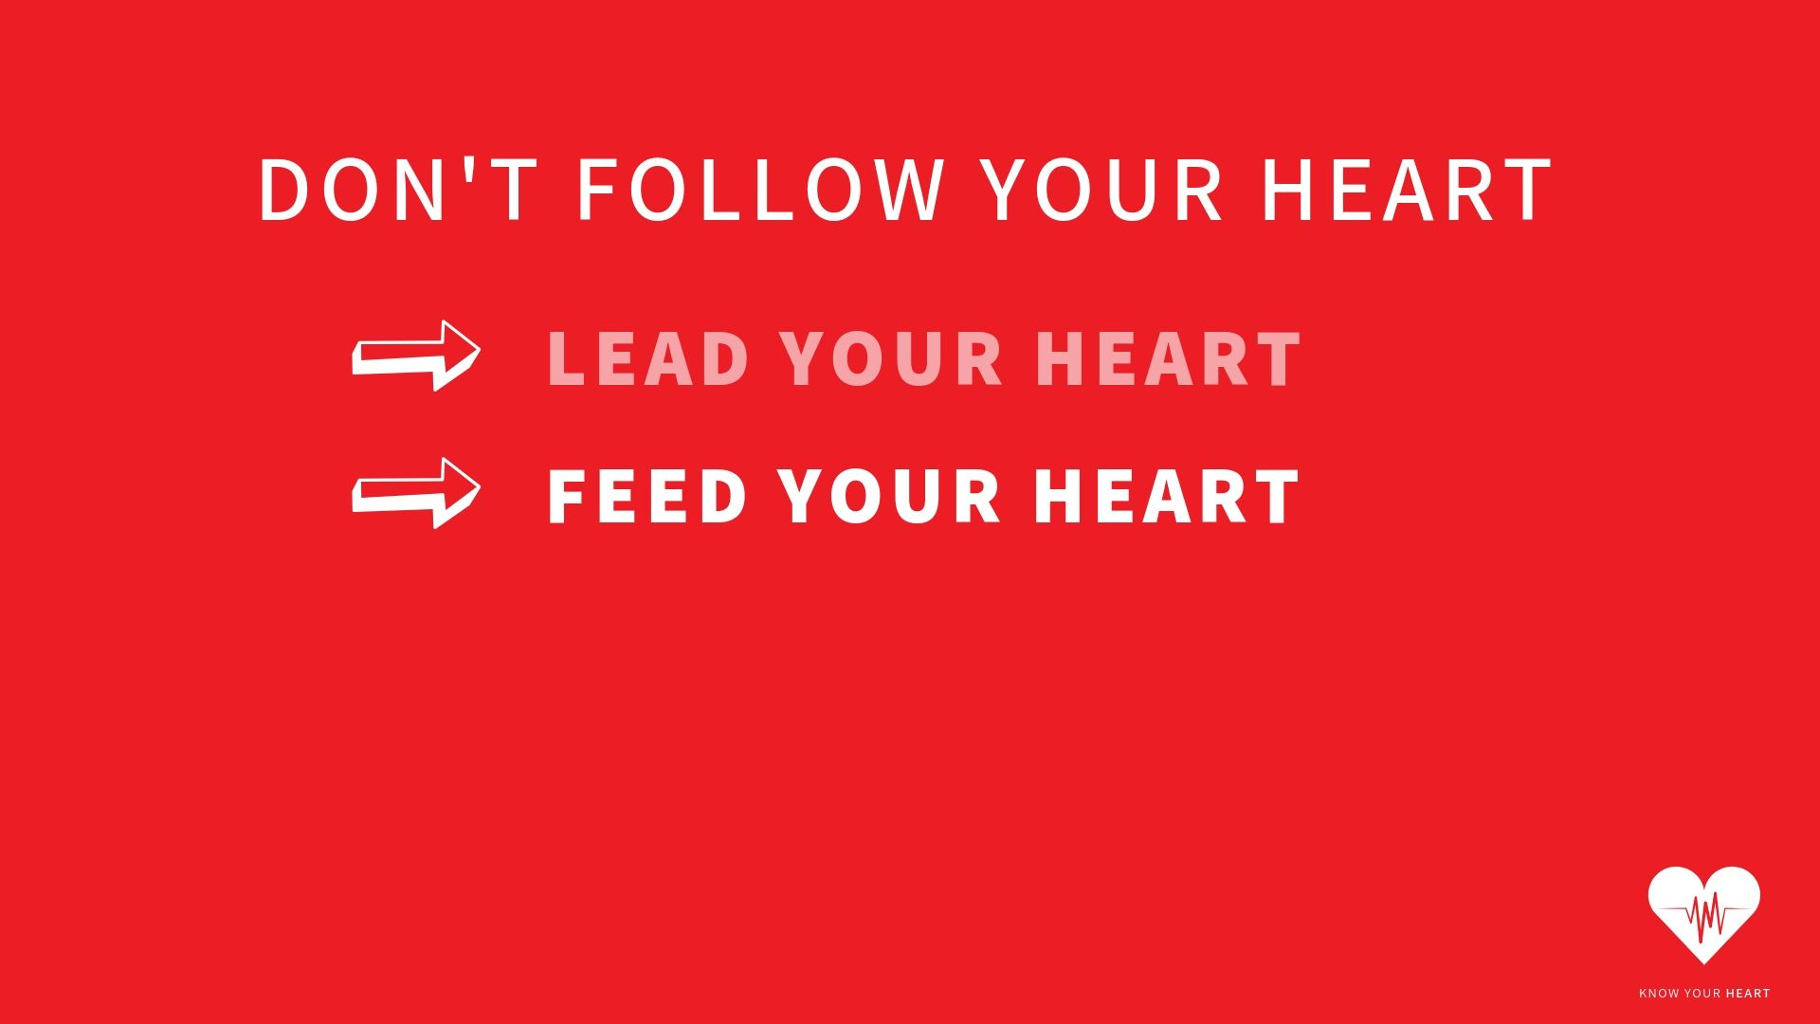
GUARD YOUR HEART

Slide 18
May the Lord direct your hearts to the love of God and to the steadfastness of Christ.
2 Thessalonians 3v5 NIV

Slide 19
It is for freedom that Christ has set us free. Stand firm, then, and do not let yourselves be burdened again by a yoke of slavery.
Galatians 5v1 NIV

Slide 20
⁹ If we confess our sins, he is faithful and just and will forgive us our sins and purify us from all unrighteousness.
1 John 1:9 NIV
My dear children, I write this to you so that you will not sin. But if anybody does sin, we have an advocate with the Father—Jesus Christ, the Righteous One. ² He is the atoning sacrifice for our sins, and not only for ours but also for the sins of the whole world.
1 John 2:1-2 NIV

