Slide 1


Slide 2


Slide 3


Slide 4
²² The righteousness of God is through faith in Jesus Christ to all who believe, since there is no distinction. ²³ For all have sinned and fall short of the glory of God. ²⁴ They are justified freely by his grace through the redemption that is in Christ Jesus.
Romans 3v23 CSB
²³ For the wages of sin is death, but the gift of God is eternal life in Christ Jesus our Lord
Romans 6v23 CSB

Slide 5
BROKEN
²² The righteousness of God is through faith in Jesus Christ to all who believe, since there is no distinction. ²³ For all have sinned and fall short of the glory of God. ²⁴ They are justified freely by his grace through the redemption that is in Christ Jesus.
Romans 3v23 CSB
²³ For the wages of sin is death, but the gift of God is eternal life in Christ Jesus our Lord
Romans 6v23 CSB

Slide 6
GOD’S SOLUTION IS SUBSTITUTION
But he was pierced for our transgressions, he was crushed for our iniquities; the punishment that brought us peace was on him...
Isaiah 53v6 NIV

Slide 7
GOD’S SOLUTION IS SUBSTITUTION
⁸ But God demonstrates his own love for us in this: While we were still sinners, Christ died for us.
Romans 5v8 NIV
But he was pierced for our transgressions, he was crushed for our iniquities; the punishment that brought us peace was on him...
Isaiah 53v6 NIV

Slide 8
SECURE IN GOD’S FAMILY
⁸ For it is by grace you have been saved, through faith—and this is not from yourselves, it is the gift of God— ⁹not by works, so that no one can boast.
Ephesians 2v8-9 NIV

Slide 9


Slide 10
WHO IS MORE,
(OR LESS) A SON?

Slide 11
SECURE IN GOD’S FAMILY
²⁸I give them eternal life, and they shall never perish; no one will snatch them out of my hand. ²⁹My Father, who has given them to me, is greater than all; no one can snatch them out of my Father’s hand. ³⁰I and the Father are one.”
John 10v28-30 NIV

Slide 12
SO HOW CAN I BE BORN AGAIN?
⁹ If you confess with your mouth, “Jesus is Lord,” and believe in your heart that God raised him from the dead, you will be saved.
John 10v28-30 CSB

Slide 13


Slide 14


Slide 15


Slide 16
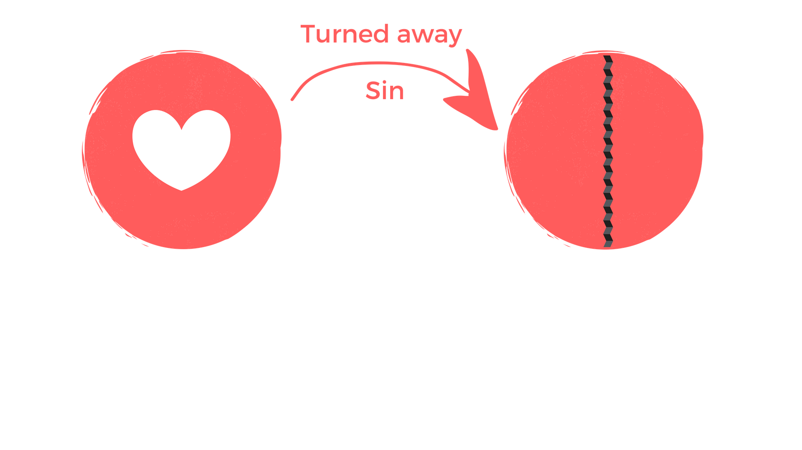

Slide 17
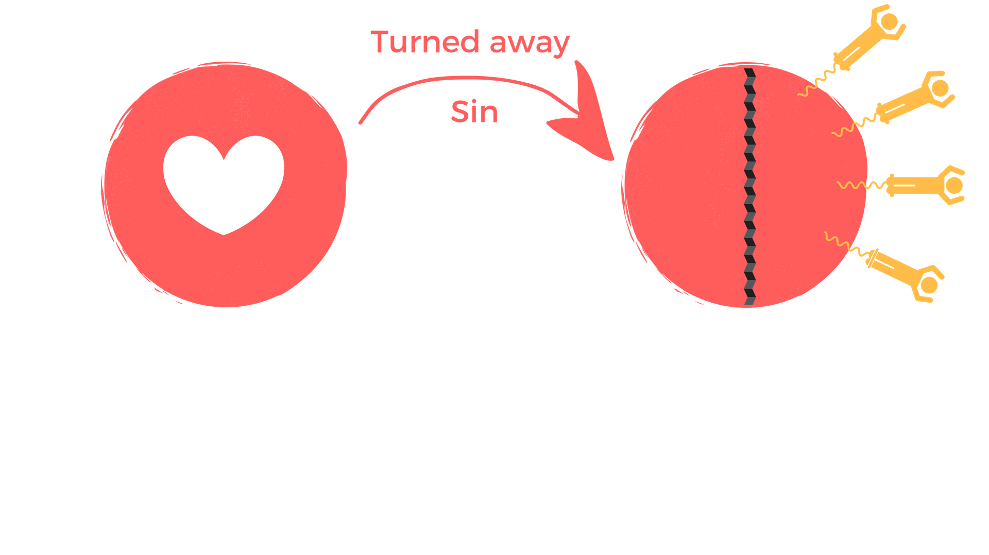

Slide 18


Slide 19
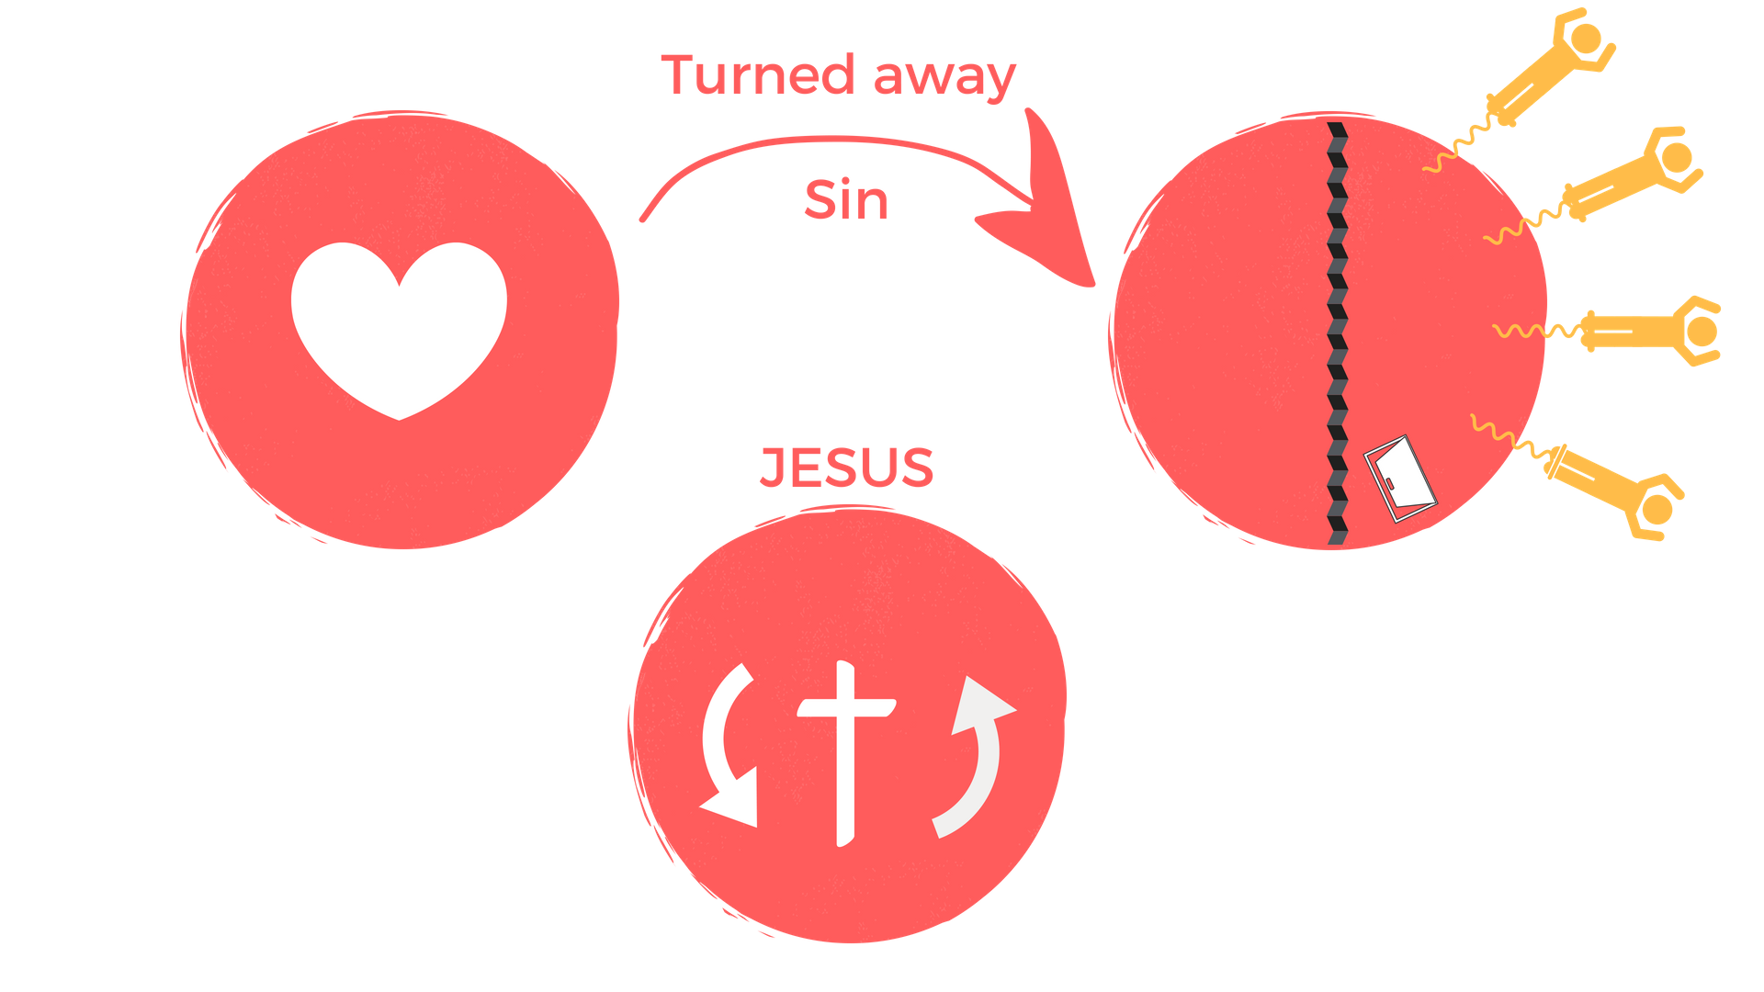

Slide 20


Slide 21
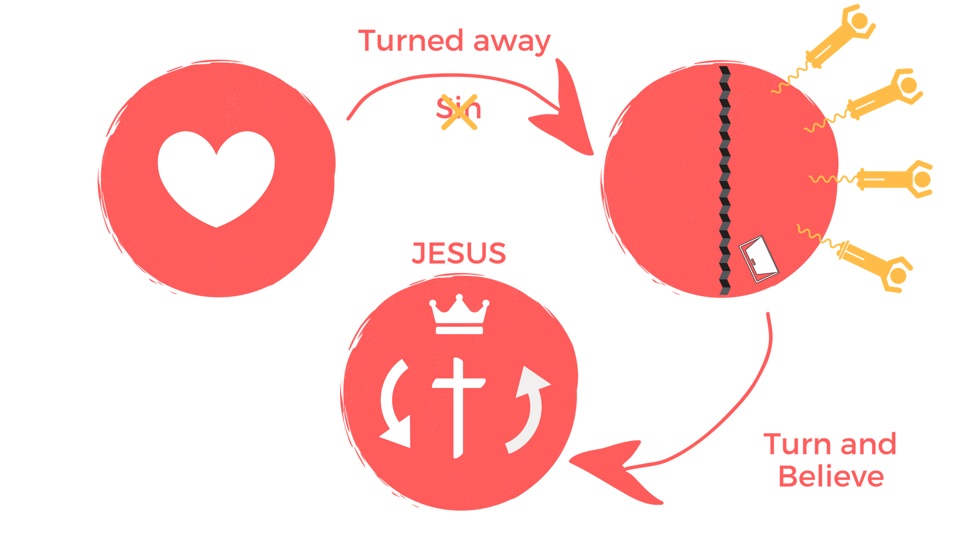

Slide 22
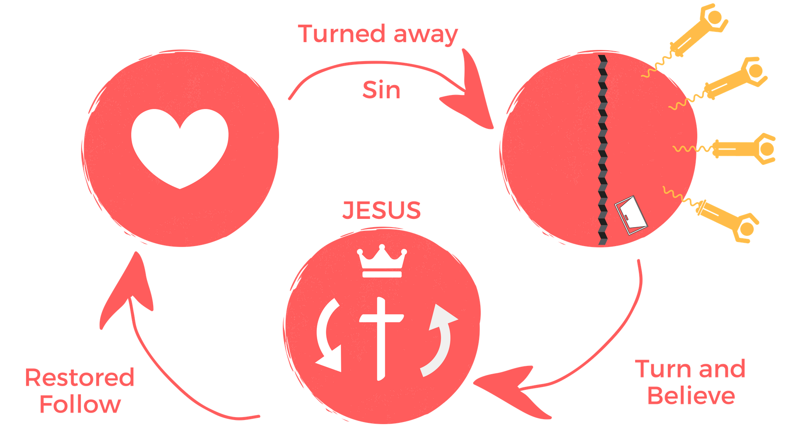

Slide 23
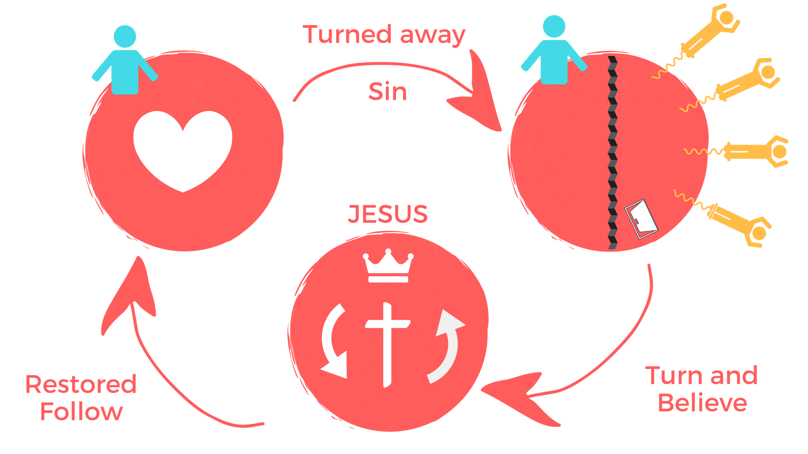

Slide 24
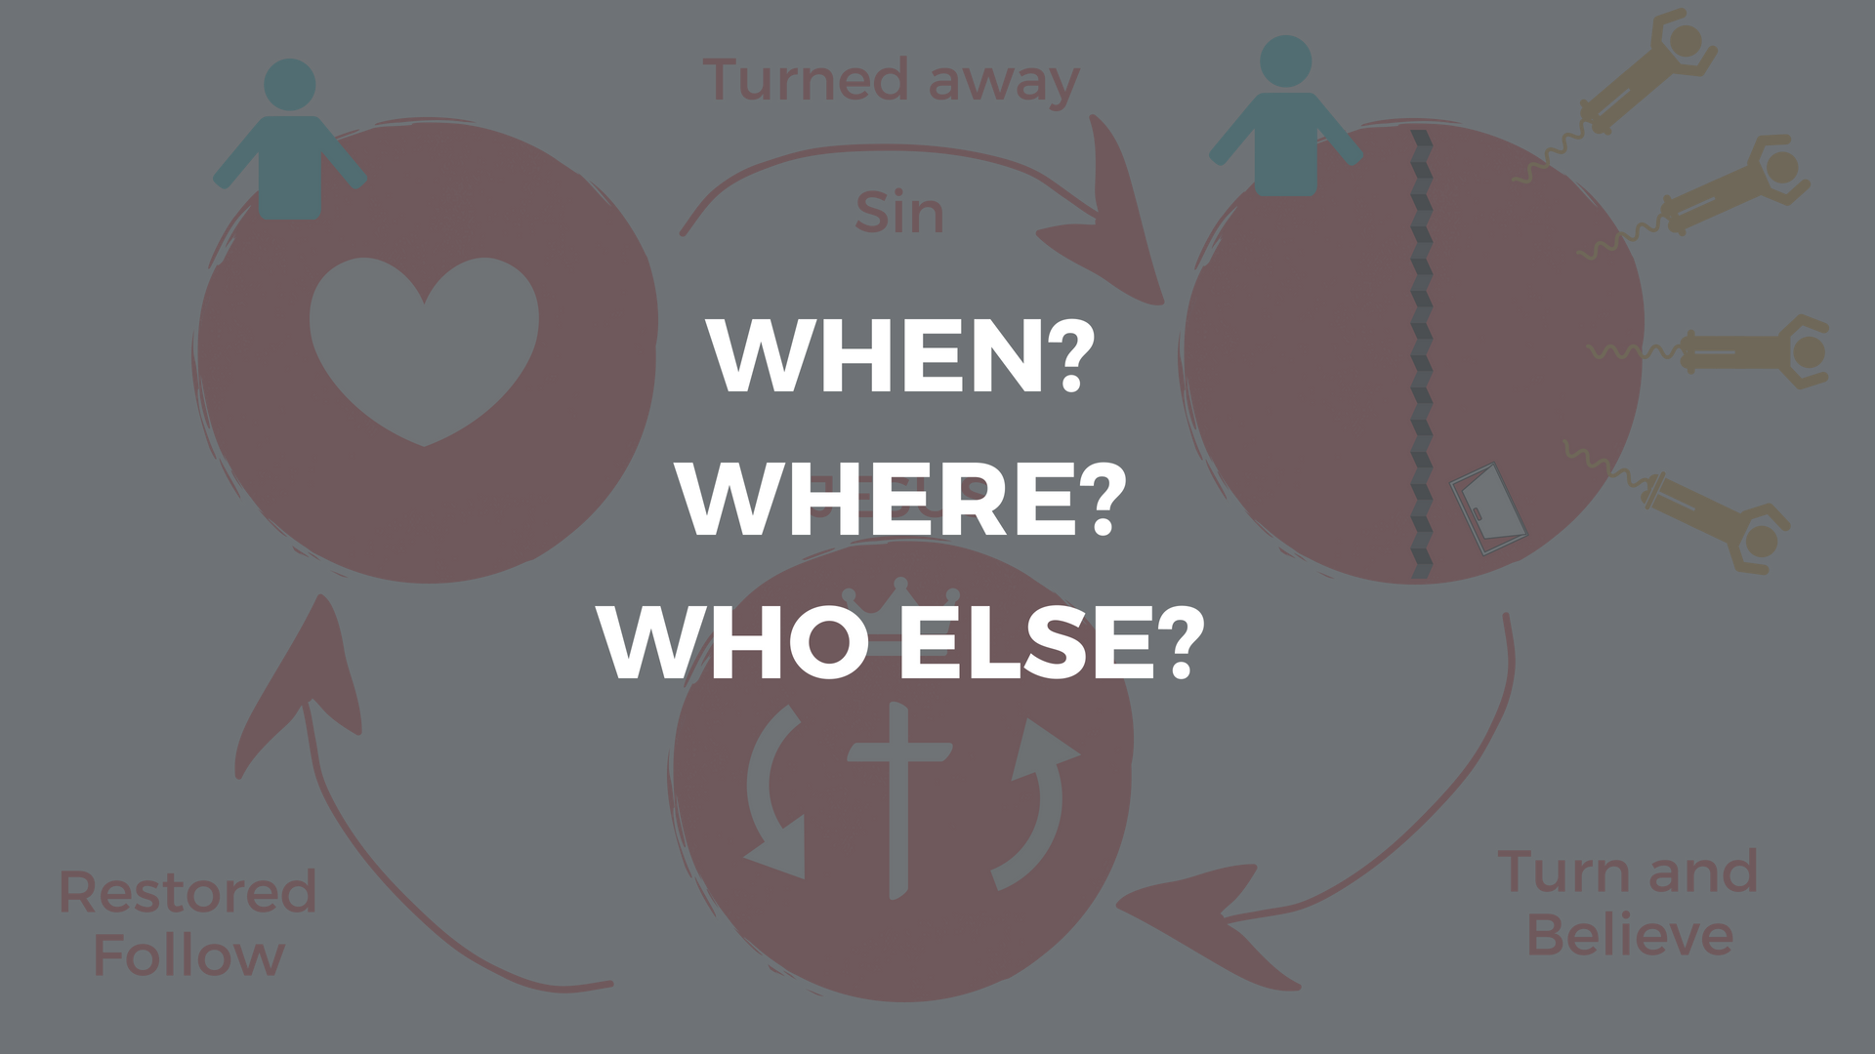

Slide 25


Slide 26


