Slide 2
Freedom & Faithfulness
Galatians 5:1-15

Slide 3
For freedom Christ has set us free; stand firm therefore, and do not submit again to a yoke of slavery. ² Look: I, Paul, say to you that if you accept circumcision, Christ will be of no advantage to you. ³ I testify again to every man who accepts circumcision that he is obligated to keep the whole law. ⁴ You are severed from Christ, you who would be justified by the law; you have fallen away from grace. ⁵ For through the Spirit, by faith, we ourselves eagerly wait for the hope of righteousness. ⁶ For in Christ Jesus neither circumcision nor uncircumcision counts for anything, but only faith working through love.

Slide 4
⁷ You were running well. Who hindered you from obeying the truth? ⁸ This persuasion is not from him who calls you. ⁹ A little leaven leavens the whole lump. ¹⁰ I have confidence in the Lord that you will take no other view, and the one who is troubling you will bear the penalty, whoever he is. ¹¹ But if I, brothers, still preach circumcision, why am I still being persecuted? In that case the offense of the cross has been removed. ¹² I wish those who unsettle you would emasculate themselves!

Slide 5
¹³ For you were called to freedom, brothers. Only do not use your freedom as an opportunity for the flesh, but through love serve one another. ¹⁴ For the whole law is fulfilled in one word: “You shall love your neighbour as yourself.” ¹⁵ But if you bite and devour one another, watch out that you are not consumed by one another.

Slide 6
Christ Has Set Us Free
Paul reminds the believers that “Christ has set them free.” (v1)
“The Christian freedom he describes is freedom of conscience, freedom from the tyranny of the law, the dreadful struggle to keep the law, with a view to winning the favour of God. It is the freedom of acceptance with God and of access to God through Christ.” John Stott
We must never lapse into the idea that we have to win our acceptance with God by our own obedience. Paul says “Stand firm” v1 – don’t go back to being a slave to works.

Slide 7
The Sign of False Christianity
Teaching that clearly or subtly states that faith in Jesus Christ ALONE is insufficient for salvation. In other words, a belief that I can contribute to my salvation by my good works.
The slogan of the false teachers was: ‘Unless you are circumcised and keep the law, you cannot be saved.’
This was basically saying that Moses must be allowed to finish what Jesus had begun.

Slide 8
The Outcomes of False Christianity
Christ will be of no value to you at all (v2)
When you add your own good works to what Christ has already accomplished you are declaring that Christ in and of himself is not enough.
You will alienate yourself from Christ (v4)
You develop a lifestyle that is increasingly about you & your own righteousness and less about the greatness of the grace of God.

Slide 9
The Outcomes of False Christianity
3. You will fall away from grace (v4)
Paul tells the Galatians in v3 that if they get circumcised they will be obliged to obey ALL the law. It is tiresome, heavy going and at times drudgery. This is what false religion becomes when you wander away from the grace of God found in the all sufficiency of Christ.
When you depart from living in the grace of God & start to live by other rules & regulations that others put on you, you will be exhausted.

Slide 10
The Sign of True Christianity
We are living in the blessing of the revelation that we have been saved by grace alone, through faith alone in Christ alone.
We have nothing to boast in about ourselves and our good works but we boast in all that Jesus has done.
Paul says in Ephesians 2:8,9 – “For it is by grace you have been saved, through faith – and this not from yourselves, it is the gift of God – not by works, so that NO-ONE can boast.” Hallelujah!

Slide 11
The Outcomes of True Christianity
1. By faith we eagerly wait through the help of the Holy Spirit for the righteousness for which we hope. (v5)
What Paul is saying is that through the power of the Holy Spirit at work in us, we are looking forward with eager anticipation to spending eternity with Christ in heaven. This is our inheritance, won for us through Christ’s death and resurrection.
Are you looking forward to seeing Jesus?

Slide 12
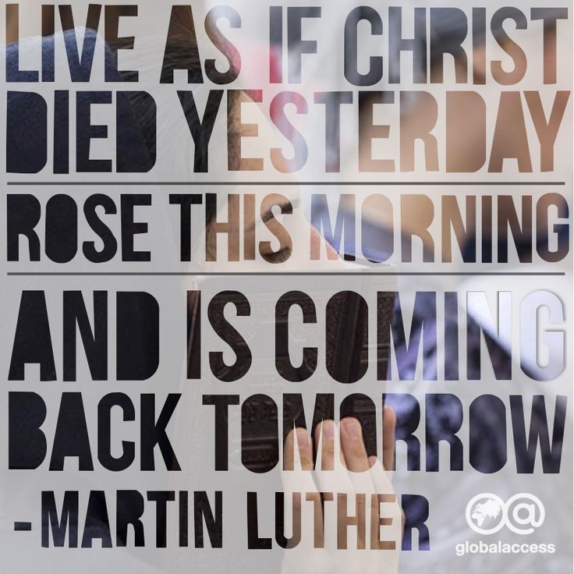

Slide 13
The Outcomes of True Christianity
2. We express our faith in Christ through love. (v6)
Paul says whether you are circumcised or not, makes absolutely no difference to your standing before God.
What counts is our faith in Christ alone being expressed through love for him, his church & the lost.
He goes on to say in v14: “Love your neighbour as yourself.” We love others, not to earn God’s favour, but because through faith in Christ we have experienced His love.

Slide 14
The Fruit of False Teachers
They hinder progress – “You were running a good race. Who cut in on you and kept you from obeying the truth?” (v7)
They are persuasive (v8) & permeate churches with their false teaching (v9) – Paul says to the Ephesian elders – “Even from your own number men will arise and distort the truth in order to draw away disciples after them. So be on your guard!” Acts 20:30, 31
They avoid persecution by watering down the truth – “the offense of the cross has been abolished.” (v11)

Slide 15
“So to preach circumcision is to avoid persecution; to preach Christ crucified is to invite it. People hate to be told that they can be saved only at the foot of the cross, and they oppose the preacher who tells them so.”
“The good news of Jesus Christ crucified is still a ‘scandal’ (Greek, skandalon, stumbling block), grievously offensive to the pride of men.” John Stott
If the message shared lovingly is offensive, then so be it. But let’s avoid any behaviour that would cause us to be offensive in the way we reach out to people.

Slide 16
The Fruit of True Teachers
They passionately defend the truth of the Gospel. (Vs 11,12)
Paul was willing to endure persecution in order that the truth of the Gospel would be preserved. 2 Cor. 11:23-28
We thank God for those who in times of great opposition & dreadful persecution stood firm/are standing firm for the sake of the Gospel.
We honour them, we salute their heroics in Christ Jesus and we long that we would emulate their obedience to Christ.

Slide 17
The Fruit of True Teachers
2. They encourage God’s people to live in true freedom. (v13)
It is not freedom to live according to what your sinful flesh longs for but a freedom to live in loving service towards others.
It could be lovingly serving your fellow Christians (v13) or “loving your neighbour as you love yourself.” (v14)
Who is my neighbour? “Our neighbour is anyone in need that we are in a position to help.” Compassion UK

Slide 18
The Fruit of True Teachers
3. They bring loving correction (v15)
We all need correction at times in our walk with God.
Who does the correcting & how it is done is important.
Love must be the motivation behind all correction.
Paul’s pastoral heart encourages him to say to the believers in Galatia: “Watch Out” because he does not want them to harm one another.

Slide 19
Response
Have you turned away from doing life your own way to receive God’s offer of a new life that is found in Jesus ALONE?
Are there areas of your life where you are trying through your own efforts to gain God’s approval?
Are you using your freedom to indulge in sinful behaviour?
Is your heart growing in love towards others with a desire to serve them?

