Slide 2
GOSPEL
RELATIONSHIPS

Slide 3
Galatians 5:26-6:5
5:25 “If we live by the Spirit, let us also keep in step with the Spirit. 26Let us not become conceited, provoking one another, envying one another.6:1 Brothers, if anyone is caught in any transgression, you who are spiritual should restore him in a spirit of gentleness. Keep watch on yourself, lest you too be tempted. 2 Bear one another’s burdens, and so fulfil the law of Christ. 3 For if anyone thinks he is something, when he is nothing, he deceives himself. 4 But let each one test his own work, and then his reason to boast will be in himself alone and not in his neighbour. 5 For each will have to bear his own load”.

Slide 4
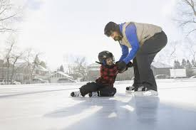
A Grace Filled Community is a Restorative Community

Slide 5
Not Condemning

Slide 6
A Grace Filled Community Restores Gently

Slide 7
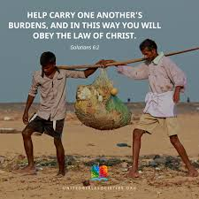
A Grace Filled Community Bears One Another’s Burdens

Slide 8
The Deception of Comparison: Conceit, something or nothing

Slide 9
“This paragraph (Gal5:26-6:5) is the New Testament’s answer to Cain’s irresponsible question “Am I my brother’s keeper?” (Genesis 4:9). If a man is my brother, then I am his keeper. I am to care for him in love, to be concerned for his welfare. I am neither to assert my fancied superiority over him and “provoke him”, nor resent his superiority over me and “envy” him. I am to love him and to serve him. If he is heavy-laden, I am to bear his burdens. If he falls into sin, I am to restore him, and that gently. It is to such practical Christian living, brotherly care and service that walking by the Spirit will lead us, and it is by such too that the law of Christ is fulfilled”. J Stott

