Slide 2
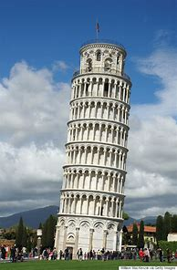
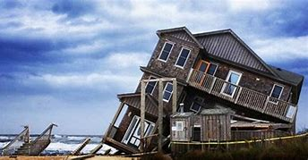

Slide 3
“You cannot build a superstructure on cracked foundations”
Billy Graham

Slide 4
¹ I therefore, a prisoner for the Lord, urge you to walk in a manner worthy of the calling to which you have been called, ² with all humility and gentleness, with patience, bearing with one another in love,³ eager to maintain the unity of the Spirit in the bond of peace. ⁴ There is one body and one Spirit- just as you were called to the one hope that belongs to your call- ⁵ one Lord, one faith, one baptism, ⁶ one God and Father of all, who is over all and through all and in all.
Ephesians 4:1-6 (ESV)

Slide 5
“mind stretching theology to it’s down-to-earth, concrete implications in everyday life”, “from exposition to exhortation”, “from what God has done (in the indicative) to what we must be and do (in the imperative)”
BST, The message of Ephesians, J Stott, P146.

Slide 6
One
Ephesians 4:1-6

Slide 7
Walking in a Worthy Manner
² with all humility and gentleness, with patience, bearing with one another in love ³ eager to maintain the unity of the Spirit in the bond of peace.
Ephesians 4: 2-3

Slide 8
Humility and Gentleness
“Jesus, who, though he was God, he did not think equality with God as something to cling to. Instead, he gave up his divine privileges; he took the humble position of a slave and was born as a human being…he humbled himself in obedience to God (the Father) and died a criminals death on a cross”.
Philippians 2: 6-8, NLT

Slide 9
Patience and Forbearance
“ The Lord is merciful and gracious, slow to anger and abounding in steadfast love”
Psalm 103.8

Slide 10
Guard what God has Given
³ eager to maintain the unity of the Spirit in the bond of peace.
Ephesians 4: 3

Slide 11
Unity Rooted in the Oneness of God
⁴ There is one body and one Spirit- just as you were called to the one hope that belongs to your call- ⁵ one Lord, one faith, one baptism, ⁶ one God and Father of all, who is over all and through all and in all.
Ephesians 4: 4-6
⁴ Hear O Israel: Yahweh our God, Yahweh is one.
Deuteronomy 6:4

Slide 12
One
Ephesians 4:1-6

