Slide 2
IDENTITY
Who am I?
BELONGING
Where do I belong?
PURPOSE
What am I living for?

Slide 3
The Wonder of Belonging
Ephesians 2:11-22

Slide 4
¹¹ Therefore, remember that formerly you who are Gentiles by birth and called “uncircumcised” by those who call themselves “the circumcision” (which is done in the body by human hands)— ¹² remember that at that time you were separate from Christ, excluded from citizenship in Israel and foreigners to the covenants of the promise, without hope and without God in the world. ¹³ But now in Christ Jesus you who once were far away have been brought near by the blood of Christ. ¹⁴ For he himself is our peace, who has made the two groups one and has destroyed the barrier, the dividing wall of hostility,

Slide 5
¹⁵ by setting aside in his flesh the law with its commands and regulations. His purpose was to create in himself one new humanity out of the two, thus making peace, ¹⁶ and in one body to reconcile both of them to God through the cross, by which he put to death their hostility. ¹⁷ He came and preached peace to you who were far away and peace to those who were near. ¹⁸ For through him we both have access to the Father by one Spirit.

Slide 6
¹⁹ Consequently, you are no longer foreigners and strangers, but fellow citizens with God’s people and also members of his household, ²⁰ built on the foundation of the apostles and prophets, with Christ Jesus himself as the chief cornerstone. ²¹ In him the whole building is joined together and rises to become a holy temple in the Lord. ²² And in him you too are being built together to become a dwelling in which God lives by his Spirit.
Ephesians 2:11-22 NIV

Slide 7
Remember Your Past Situation – v.11 - 12
Distant from God
Excluded from His people
Outside of His covenant promises
Without hope and without God

Slide 8
Rejoice in Your New State
Through Christ’s Shed Blood, you have been:
Brought near to God – v.13
Reconciled – v.14 - 17
Given Access to God as Father – v.18

Slide 9
Reflect on Your New Status
IN CHRIST, you have become:
A citizen of God’s Kingdom – v.19
A member of God’s Family – v.19
A part of God’s Temple – v.21 – 22

Slide 10
What is Your Response?
Believe
Be Baptised
Belong
Be Built-in

Slide 11
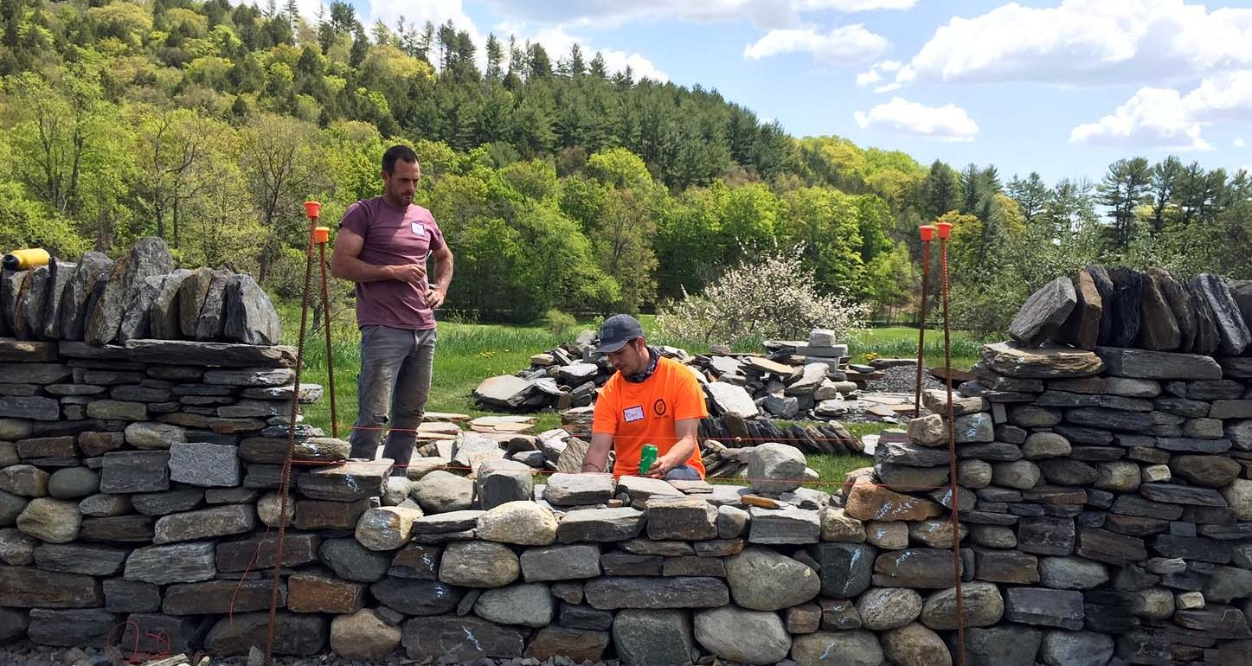
We, like living stones are being built into a spiritual house – 1 Peter 2 v.5

Slide 12
“We who believe are carefully joined together with Christ as parts of a beautiful, constantly growing temple for God. … you … are joined with him and with each other by the Spirit and are part of this dwelling place of God.”
Eph.2 v.21 – 22 - The Living Bible

Slide 13
What is Your Response?
Believe
Be Baptised
Belong
Be Built-in

