Slide 3
MAKING THE MOST OF THE SERIES
Read Ephesians
Focus on the sermon verses
Be part of a Life Group
redeemerchurchcolchester/lifegroups
Get the daily devotional
Transformed Life & Transformed Living (Dave Smith)

Slide 4
¹ Paul, an apostle of Christ Jesus by the will of God, To God’s holy people in Ephesus, the faithful in Christ Jesus: ² Grace and peace to you from God our Father and the Lord Jesus Christ.
Ephesians 1:1-2 NIV

Slide 5
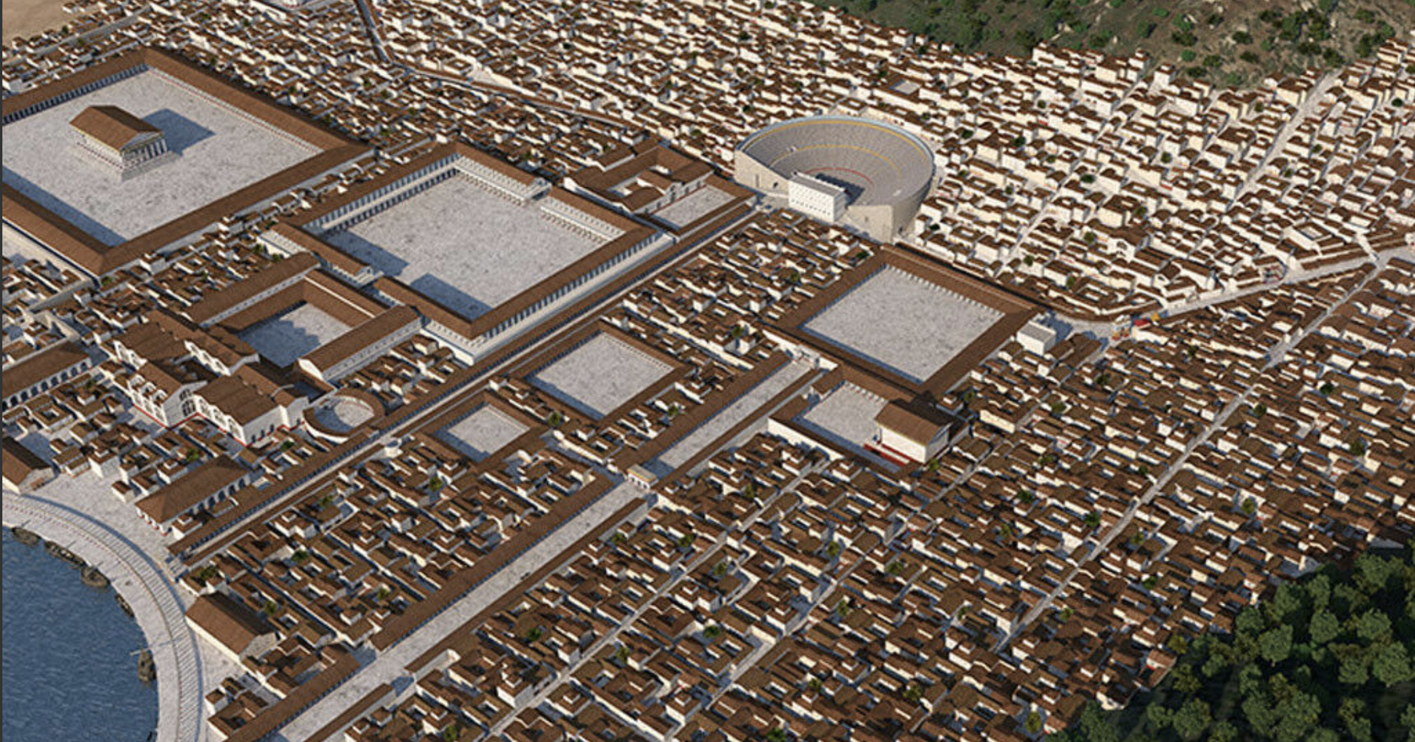
EPHESUS

Slide 6
¹ While Apollos was in Corinth, Paul travelled through the interior regions until he reached Ephesus, on the coast, where he found several believers. ² “Did you receive the Holy Spirit when you believed?” he asked them. “No,” they replied, “we haven’t even heard that there is a Holy Spirit.”
Acts 19v1-2 NLT

Slide 7
⁵ As soon as they heard this, they were baptized in the name of the Lord Jesus. ⁶ Then when Paul laid his hands on them, the Holy Spirit came on them, and they spoke in other tongues and prophesied. ⁷ There were about twelve men in all.
Acts 19v5-7 NLT

Slide 8
⁸ Then Paul went to the synagogue and preached boldly for the next three months, arguing persuasively about the Kingdom of God. ⁹ But some became stubborn, rejecting his message and publicly speaking against the Way. So Paul left the synagogue and took the believers with him. Then he held daily discussions at the lecture hall of Tyrannus. ¹⁰ This went on for the next two years, so that people throughout the province of Asia—both Jews and Greeks—heard the word of the Lord.
Acts 19 NLT

Slide 9
¹¹ God gave Paul the power to perform unusual miracles. ¹² When handkerchiefs or aprons that had merely touched his skin were placed on sick people, they were healed of their diseases, and evil spirits were expelled.
Acts 19 NLT

Slide 10
¹³A group of Jews was traveling from town to town casting out evil spirits. They tried to use the name of the Lord Jesus in their incantation, saying, “I command you in the name of Jesus, whom Paul preaches, to come out!” ¹⁴Seven sons of Sceva, a leading priest, were doing this. ¹⁵But one time when they tried it, the evil spirit replied, “I know Jesus, and I know Paul, but who are you?” ¹ Then the man with the evil spirit leaped on them, overpowered them, and attacked them with such violence that they fled from the house, naked and battered.
Acts 19 NLT

Slide 11
¹⁷ The story of what happened spread quickly all through Ephesus, to Jews and Greeks alike. A solemn fear descended on the city, and the name of the Lord Jesus was greatly honoured. ¹⁸ Many who became believers confessed their sinful practices. ¹⁹ A number of them who had been practicing sorcery brought their incantation books and burned them at a public bonfire. The value of the books was several million dollars. ²⁰ So the message about the Lord spread widely and had a powerful effect.
Acts 19 NLT

Slide 12
IDENTITY
Who am I?
BELONGING
Where do I belong?
PURPOSE
What am I living for?

Slide 13
IDENTITY: Who am I?
¹ Paul, an apostle of Christ Jesus by the will of God, To God’s holy people in Ephesus, the faithful in Christ Jesus: ² Grace and peace to you from God our Father and the Lord Jesus Christ.
Ephesians 1:1-2 NIV

Slide 14
BELONGING: Where do I belong?
¹⁹ So now you Gentiles are no longer strangers and foreigners. You are citizens along with all of God’s holy people. You are members of God’s family.
Ephesians 2:19 NLT

Slide 15
PURPOSE: What am I living for?
¹ Paul, an apostle of Christ Jesus by the will of God, To God’s holy people in Ephesus, the faithful in Christ Jesus: ² Grace and peace to you from God our Father and the Lord Jesus Christ.
Ephesians 1:1-2 NIV

Slide 16
PURPOSE: What am I living for?
¹⁰ For we are his workmanship, created in Christ Jesus for good works, which God prepared beforehand, that we should walk in them.
Ephesians 2:10 ESV

Slide 17
IDENTITY
Who am I?
BELONGING
Where do I belong?
PURPOSE
What am I living for?

