Slide 4
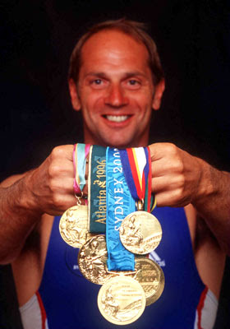

Slide 5
The act or process of giving
someone a reason for doing
something
The condition of being eager to act
or work

Slide 6
A force or influence that causes someone to do something

Slide 7
What is the ultimate goal of
the church?

Slide 9
John Piper
Mission is not the ultimate goal of the church. Worship is.

Slide 10
John Piper
If the pursuit of God’s glory is not ordered above the pursuit of man’s good in the affections of the heart and the priorities of the church, man will not be well served and God will not be duly honoured.

Slide 11
Guilt
Duty
Need
Compassion

Slide 12
Matthew 9 v 36
When he saw the crowds, he had compassion on them, because they were harassed and helpless, like sheep without a shepherd.

Slide 13
Glory of god
Take the news of God’s glory to the lost so that they may become true worshippers of Him!

Slide 14
Psalm 96
This is a prophecy concerning the kingdom of Christ, and the spreading of the gospel over the whole world and before every creature; which gospel will be a word of joy and thanksgiving, of peace, of rejoicing and of a continued sacrifice of praise.

Slide 15
Psalm 96 v 3
Declare his glory among the nations
Take this news of his glory to the lost

Slide 16
Melissa Briggs
Hebrew word (Kavod) is a complicated word to describe because it is grand and complex, rather than concrete. God’s glory is impossible to put in a box, as it is endlessly abundant.

Slide 17
Unveils his loving character

Slide 18
Exodus 33 v 19
I will cause all my goodness to pass in front of you, and l will proclaim my name, the Lord, in your presence. I will have mercy on whom l will have mercy, and l will have compassion on whom l will have compassion.

Slide 19
Describes his majesty

Slide 20
Psalm 19 v 1-4
The heavens declare the glory of God; the skies proclaim the work of his hands. Day after day they pour forth speech; night after night they display knowledge.

Slide 21
Psalm 19 v 1-4
There is no speech or language where their voice is not heard.
Their voice goes out into all the earth, their words to the ends of the world.

Slide 22
Active presence among his people

Slide 23
Dr Martyn Lloyd-Jones
The essential nature of God, it is that which makes God, God!

Slide 24
God’s awesome greatness on display. God’s glory is the public presentation of his infinite worth, majestic beauty, astounding creativity, limitless power, righteous nature, unmatched significance, and perfect holiness;

Slide 25
Melissa Briggs
he is intrinsically worthy of great honour. God is so weighty and important, that when this is shown forth publicly, it is described as his glory.

Slide 26
Ascribe to the Lord glory and strength
Ascribe to the Lord the glory due his name

Slide 27
Psalm 96 v 7-9
Bring an offering and come
into his courts
Worship the Lord in the splendour of his holiness

Slide 28
Steven Hawthorne
God reveals his glory in order to receive glory

Slide 29
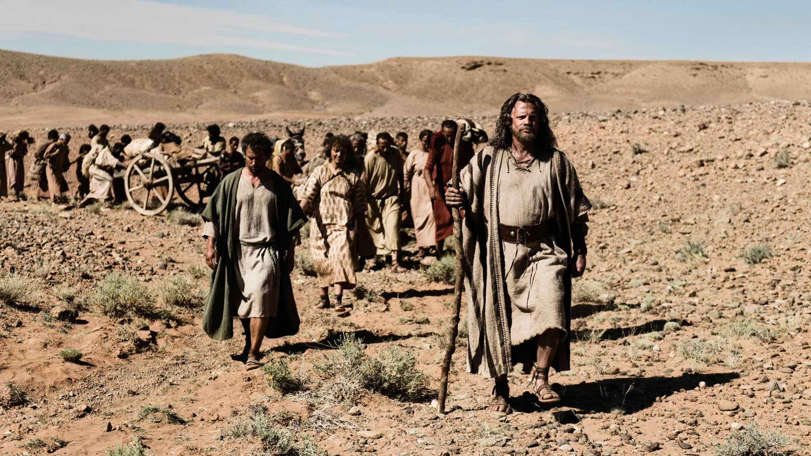

Slide 30
Exodus 9 v 13-16
There was no one like God in all the earth
He might show Pharaoh his power so that God’s name might be proclaimed in all the earth

Slide 31
Exodus 14 v 4, 17 & 18
He will have gotten glory over them

Slide 32
Psalm 106 v 7, 8
Yet he saved them for his name’s sake, to make his mighty power known

Slide 33
Nehemiah 9 v 9, 10; Daniel 9 v 15
You made a name for yourself which remains to this day

Slide 34
Isaiah 63 v 11-14
To gain for himself everlasting renown
To make for yourself a glorious name

Slide 36
2 Samuel 7 v 23
And who is like your people Israel – the one nation on earth that God went out to redeem as a people for himself, and to make a name for himself, and …..

Slide 37
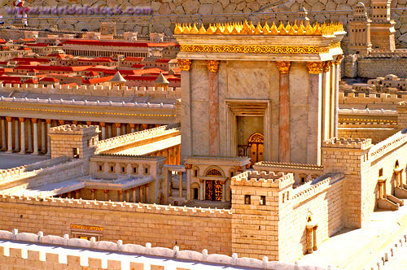

Slide 38
As for the foreigner who does not belong to your people Israel but has come from a distant land because of your name – for men will hear of your great name and your mighty hand and your outstretched arm -

Slide 39
when he comes and prays toward this temple, then hear from heaven, your dwelling place, and do whatever the foreigner asks of you, so that all the peoples of the earth may know your name and fear you,

Slide 40
1 Kings 8 v 41-43
as do your own people Israel, and may know that this house l have built bears your name

Slide 41
1 Kings 8 v 60
So that all the peoples of the earth may know that the Lord is God and that there is no other.

Slide 42
Psalm 67
Your ways may be known on the earth, your salvation among all nations
All the ends of the earth will fear him!

Slide 43
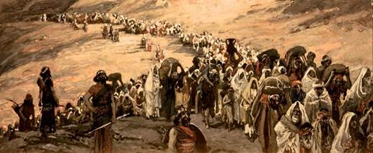

Slide 44
Ezekiel 36 v 16-23
It is not for your sake, O house of Israel, that l am going to do these things, but for the sake of my holy name, which you have profaned among the nations.

Slide 45
John 1 v 14
We have seen his glory, the glory of the One and Only, who came from the Father, full of grace and truth.

Slide 46
John 1 v 16
No one has ever seen God, but God the One and Only, who is at the Father’s side, has made him known.

Slide 47
Hebrews 1 v 3
The son is the radiance of God’s glory and the exact representation of his being.

Slide 48
REVEALED IN HIS MIRACULOUS SIGNS

Slide 49
HIGHLIGHTED IN HIS TEACHING

Slide 50
DEMONSTRATED IN HIS ACTIONS

Slide 51
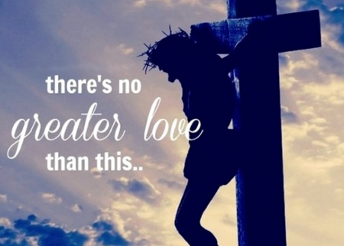

Slide 52
❖ THE WISDOM OF GOD
❖ THE HOLINESS & RIGHTEOUSNESS OF GOD
❖ THE LOVE, MERCY AND GRACE OF GOD

Slide 53
When we show the world how satisfied we are in him – expressing that God is more fulfilling and better than all this world has to offer – then God is beautifully glorified through our lives.

Slide 54
1Peter 2 v 9
We are a chosen people, a royal priesthood, a holy nation, a people belonging to God, that we may declare the praise of him who called us out of darkness into his wonderful light

Slide 55
Who the community is and how it lives points to God and is an invitation to join the community in praising God.
The church by its life together shows others the nature of the reign of God.

Slide 56
Barrett
The church is a preview of life under the rule of God in the age to come, a forerunner of the New Jerusalem, a foretaste of the heavenly banquet, a sign of the reign of God.”

