Slide 4
David

Slide 5
What is Righteousness?
The quality of being morally RIGHT or JUST.
Righteousness before God = being morally RIGHT or JUST in his eyes.

Slide 6
Why do we need Righteousness?
We were made unrighteous through Adams sin.
Romans 5:12: Therefore, just as sin entered the world through one man, and death through sin, and in this way death came to all people, because all sinned

Slide 7
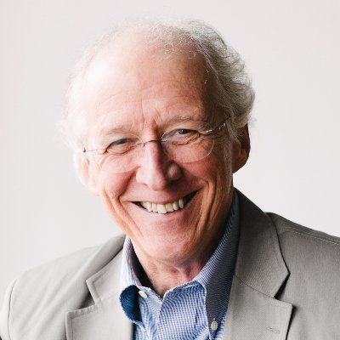
‘The deepest problem is that behind all our depravity and all our guilt and all our sinning there is a mysterious connection with Adam whose sin became our sin and whose judgement became our judgement.’
John Piper

Slide 8
How do we Obtain Righteousness?
Romans 3:21 - 24 says this:
21 But now apart from the law the righteousness of God has been made known, to which the Law and the Prophets testify. 22 This righteousness is given through faith in Jesus Christ to all who believe. There is no difference between Jew and Gentile, 23 for all have sinned and fall short of the glory of God, 24 and all are justified freely by his grace through the redemption that came by Christ Jesus.

Slide 9
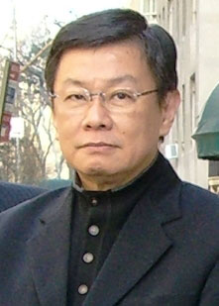
Righteousness is an attribute that belongs to God, the Lawgiver, and is manifested in His laws. No man can be justified by his own works apart from God’s ordinance. Therefore, righteousness is a wonderful gift from God to humanity through His love: it is the God-given quality imputed to man upon believing in the Son of God
Philip Wajaya

Slide 10
Pauls Picture of Life Under Law
Romans 7:1-2
Do you not know, brothers and sisters—for I am speaking to those who know the law—that the law has authority over someone only as long as that person lives? ² For example, by law a married woman is bound to her husband as long as he is alive, but if her husband dies, she is released from the law that binds her to him.
Matthew 5:18
For truly I tell you, until heaven and earth disappear, not the smallest letter, not the least stroke of a pen, will by any means disappear from the Law until everything is accomplished.

Slide 11
Romans 7:4-6
⁴ So, my brothers and sisters, you also died to the law through the body of Christ, that you might belong to another, to him who was raised from the dead, in order that we might bear fruit for God. ⁵ For when we were in the realm of the flesh, the sinful passions aroused by the law were at work in us, so that we bore fruit for death. ⁶ But now, by dying to what once bound us, we have been released from the law so that we serve in the new way of the Spirit, and not in the old way of the written code.

Slide 12
2 Corinthians 5:21
God made him who had no sin to be sin for us, so that in him we might become the righteousness of God.
1 Peter 3:18
¹⁸ For Christ also suffered once for sins, the righteous for the unrighteous, to bring you to God. He was put to death in the body but made alive in the Spirit.

Slide 13
Romans 7:4-6
So, my brothers and sisters, you also died to the law through the body of Christ, that you might belong to another, to him who was raised from the dead, in order that we might bear fruit for God.

Slide 14
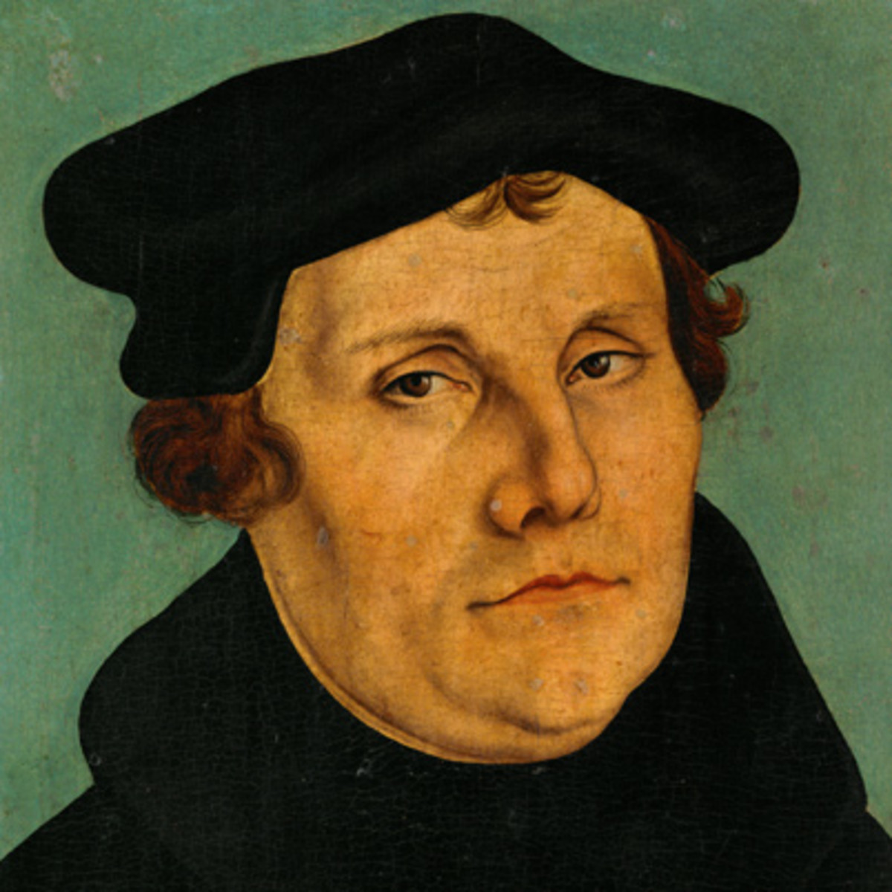
‘Our works do not generate righteousness, rather our righteousness in Christ generates works.
Martin Luther

Slide 15
Reigning In Life
Romans 5:17
For if, by the trespass of the one man, death reigned through that one man, how much more will those who receive God’s abundant provision of grace and of the gift of righteousness reign in life through the one man, Jesus Christ!
Galatians 5:4
You who are trying to be justified by the law have been alienated from Christ; you have fallen away from grace.

Slide 16
1 John 1:9
If we confess our sins, he is faithful and just to forgive us our sins and to cleanse us from all unrighteousness.
Romans 8:1
There is therefore now no condemnation for those who are in Christ Jesus.

Slide 17
Romans 5:17
For if, by the trespass of the one man, death reigned through that one man, how much more will those who receive God’s abundant provision of grace and of the gift of righteousness reign in life through the one man, Jesus Christ!

Slide 18
FAITH
FREELY GIVEN
FRUIT

Slide 19
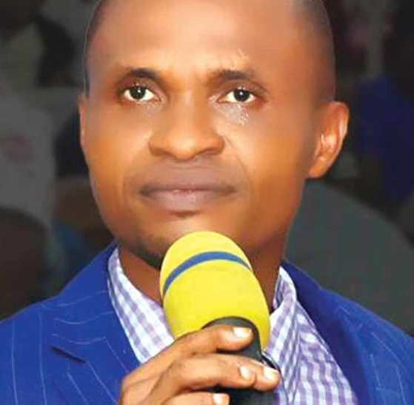
Righteousness is very easy and attainable. It is a nature of a child of God. It is easy as the oxygen we breathe. Nobody struggles to breath…The benefits of righteousness are inestimable. Righteousness brings a man closer to God, as it enhances fellowship with the Almighty God.

Slide 20
A man that has righteousness has everything. Nothing brings peace to man more than righteousness. The world is oblivious of the fact that there is no gain in mundane things. Whatever the enemy flashes on a man in the world is fake and makebelief. There is no enjoyment in the world. The world and the sins in it do not give peace and happiness. The offer of the world destroys; it stings and brings its prey to untimely death. On the contrary, righteousness is the best life a man can live..

