Slide 1
Communion – What, Why & How?

Slide 2
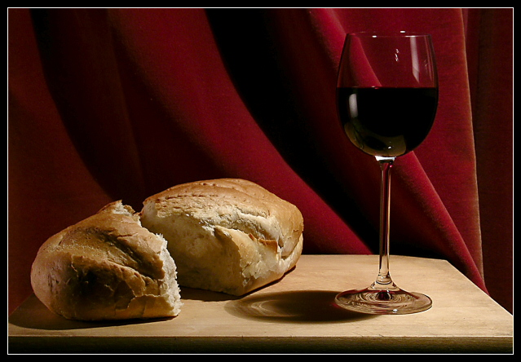
What Comes To Mind?
I would like you to close your eyes and think about the photo below. What thoughts come to mind when you view it?

Slide 3
What does the Bible Say?
¹⁷ But in the following instructions I do not commend you, because when you come together it is not for the better but for the worse. ¹⁸ For, in the first place, when you come together as a church, I hear that there are divisions among you. And I believe it in part, ¹⁹ for there must be factions among you in order that those who are genuine among you may be recognized. ²⁰ When you come together, it is not the Lord’s supper that you eat. ²¹ For in eating, each one goes ahead with his own meal. One goes hungry, another gets drunk. ²² What! Do you not have houses to eat and drink in? Or do you despise the church of God and humiliate those who have nothing? What shall I say to you? Shall I commend you in this? No, I will not.

Slide 4
What does the Bible Say?
²³ For I received from the Lord what I also delivered to you, that the Lord Jesus on the night when he was betrayed took bread, ²⁴ and when he had given thanks, he broke it, and said, “This is my body, which is for you. Do this in remembrance of me.” ²⁵ In the same way also he took the cup, after supper, saying, “This cup is the new covenant in my blood. Do this, as often as you drink it, in remembrance of me.” ²⁶ For as often as you eat this bread and drink the cup, you proclaim the Lord’s death until he comes. ²⁷ Whoever, therefore, eats the bread or drinks the cup of the Lord in an unworthy manner will be guilty concerning the body and blood of the Lord.

Slide 5
What does the Bible Say?
²⁸ Let a person examine himself, then, and so eat of the bread and drink of the cup. ²⁹ For anyone who eats and drinks without discerning the body eats and drinks judgment on himself. ³⁰ That is why many of you are weak and ill, and some have died. ³¹ But if we judged ourselves truly, we would not be judged. ³² But when we are judged by the Lord, we are disciplined so that we may not be condemned along with the world. ³³ So then, my brothers, when you come together to eat, wait for one another— ³⁴ if anyone is hungry, let him eat at home—so that when you come together it will not be for judgment. About the other things I will give directions when I come. 1 Corinthians 11:17-34 ESV

Slide 6
What does the ‘Church’ Say?
Transubstantiation - the official teaching of Roman Catholicism. Trans- means “change” and substantiation means “substance.” The idea is that when the bread and wine are blessed by the priest during the Mass, the bread and the wine are transformed into the actual physical body and blood of Jesus Christ. Natural Understanding (Family Photo) & Parallelism Bread/Body & Cup/New Covenant.
Consubstantiation—con- meaning “together,” and substantiation still meaning “substance.” The substance of the bread and wine coexists with the body and blood of Christ in the Eucharist. Jesus Christ is present in, with, and under the bread and the wine whenever the Lord’s Supper is celebrated. eg a sponge full of water.

Slide 7
What does the ‘Church’ Say?
Memorial - Christ commanded us to “do this in remembrance of Him,” and that is all it is: an act of remembrance. The bread and wine are merely symbols, reminding us that Christ’s body was broken for us, and His blood was shed for us.
Reformed - It is certainly symbolic, but the symbols do more than merely represent—they actually bring to us the presence of Jesus Christ and His benefits.

Slide 8
Why?
Modelled/Commanded by Jesus – “While they were eating, Jesus took bread, and when he had given thanks, he broke it and gave it to his disciples, saying, ‘Take it; this is my body. Then he took a cup, and when he had given thanks, he gave it to them, and they all drank from it. ‘This is my blood of the covenant, which is poured out for many,’ he said to them. ‘Truly I tell you, I will not drink again from the fruit of the vine until that day when I drink it new in the kingdom of God.”
Mark 14:22-24

Slide 9
Why?
Modelled by the Early Church
“On the first day of the week we came together to break bread.” Acts 20:7
“Then he went upstairs again and broke bread and ate.” Acts 20:11
“Is not the cup... Is not the bread... One loaf” 1 Corinthians 10:16-17
“Do this in remembrance of me.” 1 Corinthians 11:17-34

Slide 10
HOW?
1. With SOBERNESS (not somber, as in “gloomy or depressing.”)
There should be a sense of gravity about what we are participating in as we consider what Jesus has done for us.
“This is my body, which is for you; do this in remembrance of me.” (v24)
“This cup is the new covenant in my blood; do this, whenever you drink it,
in remembrance of me.” (v25)
When we participate in Communion, we “proclaim the Lord’s death” (v26) and that causes our hearts to have a sense of weightiness as we think about His suffering on our behalf.

Slide 11
HOW?
A Kingdom of God Health Warning (Vs 27-32)
When Paul says “Therefore whoever eats the bread or drinks the cup of the Lord in an unworthy manner” (v27), he is not talking about the “worthiness” of the participant but the “worthiness” of his manner of partaking of it.
Therefore, it is vital that we “examine ourselves” (v28) before we participate otherwise we could be bringing judgement on ourselves (v29) which Paul infers presents itself in people becoming weak and sick, and some even dying. (v30)
“He (Paul) warns that if you come to the Lord’s Supper in a cavalier, callous, careless way that does not discern the seriousness of what happened on the cross, you may, if you are a believer, lose your life, not because of wrath, but as an act of God’s fatherly discipline.” John Piper

Slide 12
HOW?
2. With THANKFULNESS (Showing Appreciation)
“the cup of thanksgiving ….” 1 Corinthians 10:16
Eucharist means ‘thanksgiving’.
“Bread breaking is essential and communal, but it is also thankful, worshipful, grateful.” Andrew Wilson
When we participate in Communion, we “proclaim the Lord’s death until he comes” (v26) and that causes our hearts to rejoice because it reminds us that Jesus is alive and He is coming again to receive us to himself.

Slide 13
HOW?
3. With CELEBRATION
“the action of marking one’s pleasure at an important event or occasion by engaging in enjoyable, typically social, activity.”
When we take Communion, it is our opportunity to celebrate with our brothers and sisters in Christ.
“Communion is a vertical realigning of ourselves with Christ, but it is also a horizontal realigning: We are the Body of Christ.” Beni Johnson

Slide 14
Practical Considerations!
Frequency? “They devoted themselves to the apostles’ teaching and to fellowship, to the breaking of bread and to prayer.” Acts 2:42 “On the first day of the week..” Acts 20:7
When? “when you come together as a church” 1 Cor. 11:18
“they broke bread in their homes” Acts 2:46
“While they were eating, Jesus took bread…” Mark 14:22

Slide 15
Practical Considerations!
What? Bread (Special Bread) & Wine (Fruit Juice)
One loaf
How? Unhurried 1 Cor. 11:25 - “after supper he took the cup”
Individually OR Corporately OR Both?

