Slide 1
CHRISTMAS
and the songs we sing

Slide 3
Peace on earth…

Slide 4
Hark the herald angels sing "Glory to the newborn King! Peace on earth and mercy mild God and sinners reconciled"

Slide 5
Peace
For to us a child is born, to us a son is given;
and the government shall be upon his shoulder,
and his name shall be called Wonderful Counselor, Mighty God, Everlasting Father, Prince of Peace.
Isaiah 9:6

Slide 6
10 And the angel said to them, “Fear not, for behold, I bring you good news of great joy that will be for all the people. 11 For unto you is born this day in the city of David a Saviour, who is Christ the Lord. 12 And this will be a sign for you: you will find a baby wrapped in swaddling cloths and lying in a manger.”
Luke 2:10-14

Slide 7
13 And suddenly there was with the angel a multitude of the heavenly host praising God and saying, 14 “Glory to God in the highest, and on earth peace among those with whom he is pleased!”
Luke 2:10-14

Slide 9
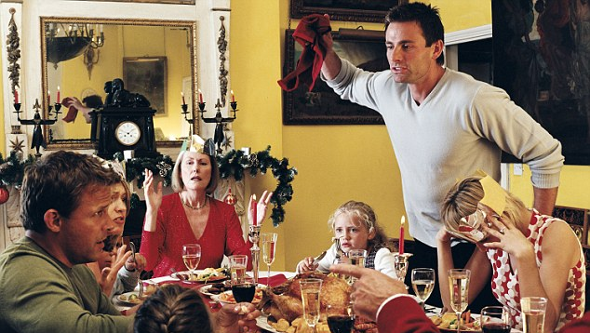

Slide 10
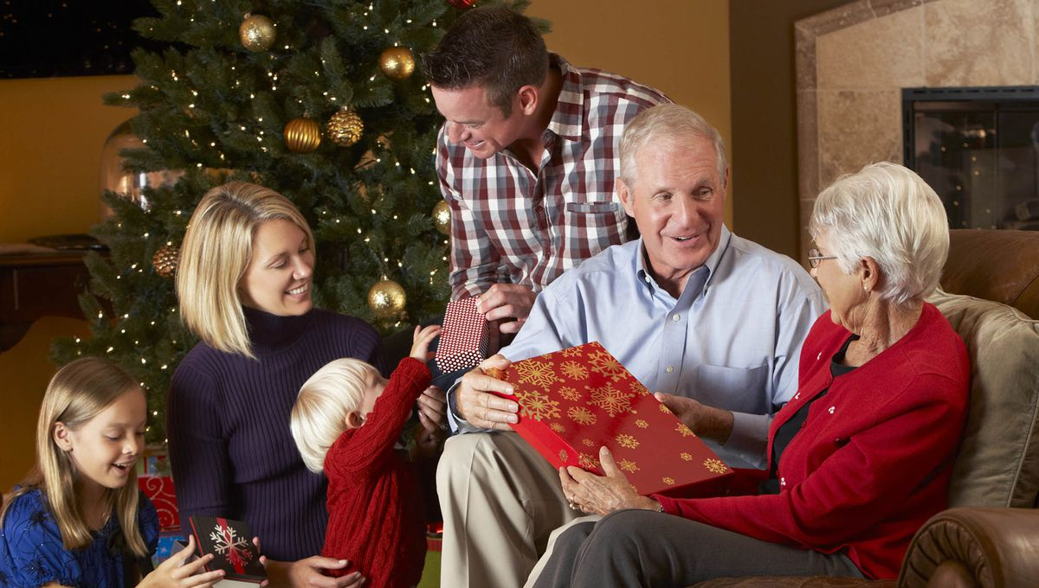

Slide 11
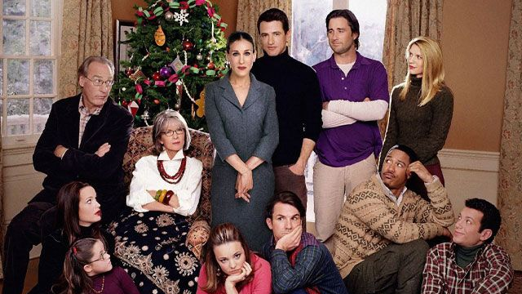

Slide 12
Prince of Peace
For to us a child is born, to us a son is given;
and the government shall be upon his shoulder,
and his name shall be called Wonderful Counselor, Mighty God, Everlasting Father, Prince of Peace.
Isaiah 9:6

Slide 13
²⁷ Peace I leave with you; my peace I give to you. Not as the world gives do I give to you. Let not your hearts be troubled, neither let them be afraid.
John 14:27
³³ I have said these things to you, that in me you may have peace. In the world you will have tribulation. But take heart; I have overcome the world.”
John 16:33

Slide 14
¹⁴ “Glory to God in the highest, and on earth peace among those with whom he is pleased!”
Luke 2:10-14

Slide 15
Hark the herald angels sing "Glory to the newborn King! Peace on earth and mercy mild God and sinners reconciled"

Slide 16
¹⁷ Therefore, if anyone is in Christ, he is a new creation. The old has passed away; behold, the new has come. ¹⁸ All this is from God, who through Christ reconciled us to himself …We implore you on behalf of Christ, be reconciled to God. ²¹ For our sake he made him to be sin who knew no sin, so that in him we might become the righteousness of God.
2 Cor 5:17-20

Slide 17
⁶ do not be anxious about anything, but in everything by prayer and supplication with thanksgiving let your requests be made known to God. ⁷ And the peace of God, which surpasses all understanding, will guard your hearts and your minds in Christ Jesus.
Phil 4:6-7

Slide 18
⁶ do not be anxious about anything, but in everything by prayer and supplication with thanksgiving let your requests be made known to God. ⁷ And the peace of God, which surpasses all understanding, will guard your hearts and your minds in Christ Jesus.
Phil 4:6-7

