Slide 3
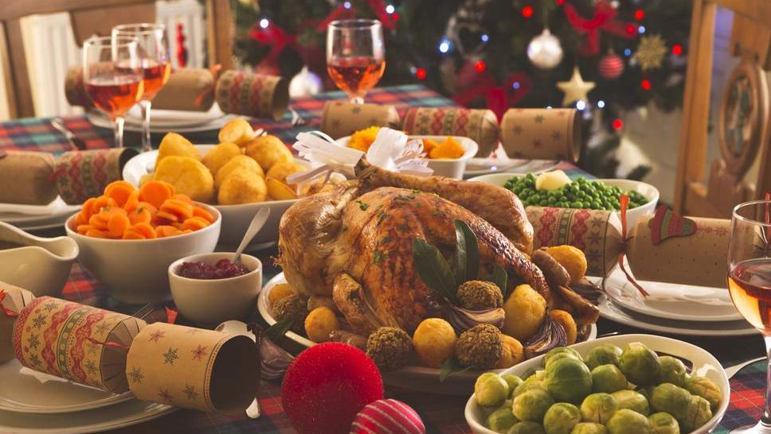

Slide 4
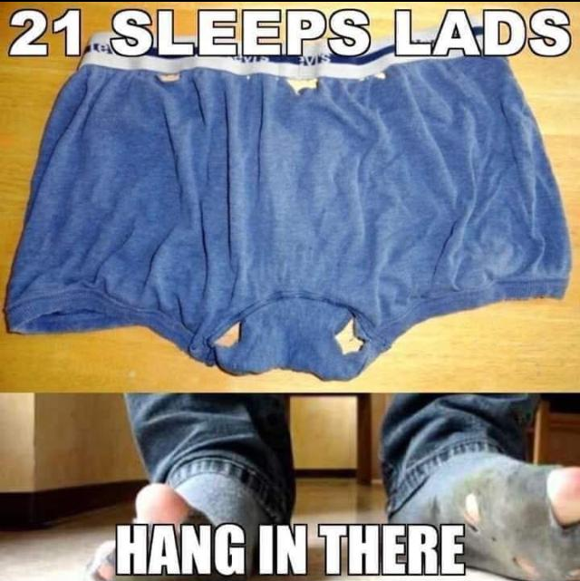

Slide 6
For to us a child is born,
to us a son is given,
and the government will be on his shoulders.
And he will be called
Wonderful Counselor, Mighty God,
Everlasting Father, Prince of Peace.
Isaiah 9v6-7

Slide 8
Christmas anticipation is thick in the air. Christmas music dominates the airwaves…Beautiful lights brighten the night. (But then) Christmas will be done. All the gifts will be unwrapped and worn or played with (or returned to the store). Trees and lights will come down and get tossed out or boxed up and put back in the attic. And it happens every year — a sense of letdown. Call me a scrooge, but I find this sensation rather predictable. Perhaps it’s because we will have overspent and under-slept and overeaten.
Matt Chandler

Slide 9
¹⁰ The thief comes only to steal and kill and destroy; I have come that they may have life, and have it to the full. ¹¹ “I am the good shepherd. The good shepherd lays down his life for the sheep.
John 10v10

Slide 10
¹⁰ The thief comes only to steal and kill and destroy; I have come that they may have life, and have it to the full. ¹¹ “I am the good shepherd. The good shepherd lays down his life for the sheep.
John 10v10

Slide 11
The Son of Man came to seek and to save the lost.
Luke 19:10
Even the Son of Man came not to be served but to serve, and to give his life as a ransom for many.
Mark 10:45

Slide 12
You know that he appeared in order to take away sins, and in him there is no sin. . . . The reason the Son of God appeared was to destroy the works of the devil.
1 John 3:5, 8

Slide 13
God so loved the world, that he gave his only Son, that whoever believes in him should not perish but have eternal life.
John 3:16

Slide 14
Joy to the world, the Lord has come
Let earth receive her King
Let every heart prepare Him room

