Slide 2
THE CHALLENGE OF ENCOUNTERING GOD IN WORSHIP
1 Corinthians 11v2-16

Slide 3
² Now I commend you because you remember me in everything and maintain the traditions even as I delivered them to you. ³ But I want you to understand that the head of every man is Christ, the head of a wife is her husband, and the head of Christ is God. ⁴ Every man who prays or prophesies with his head covered dishonours his head, ⁵ but every wife who prays or prophesies with her head uncovered dishonours her head, since it is the same as if her head were shaven.
1 Corinthians 11v2-5 ESV

Slide 4
⁶ For if a wife will not cover her head, then she should cut her hair short. But since it is disgraceful for a wife to cut off her hair or shave her head, let her cover her head. ⁷ For a man ought not to cover his head, since he is the image and glory of God, but woman is the glory of man. ⁸ For man was not made from woman, but woman from man.⁹ Neither was man created for woman, but woman for man. ¹⁰ That is why a wife ought to have a symbol of authority on her head, because of the angels.
1 Corinthians 11v6-10 ESV

Slide 5
¹¹ Nevertheless, in the Lord woman is not independent of man nor man of woman; ¹² for as woman was made from man, so man is now born of woman. And all things are from God. ¹³ Judge for yourselves: is it proper for a wife to pray to God with her head uncovered? ¹⁴ Does not nature itself teach you that if a man wears long hair it is a disgrace for him, ¹⁵ but if a woman has long hair, it is her glory? For her hair is given to her for a covering. ¹⁶ If anyone is inclined to be contentious, we have no such practice, nor do the churches of God.
1 Corinthians 11v11-16 ESV

Slide 6
Chapters (1) to (10)
New life in Christ
Transformed lives not clever arguments
The Church is God’s family
Relationships are vital to well-being
Live contrary to the prevailing culture

Slide 7
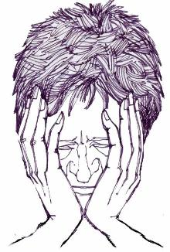
Chapter (11)
Meaning of crucial terms
Prevailing customs in the culture
Logic of Paul’s argument

Slide 8
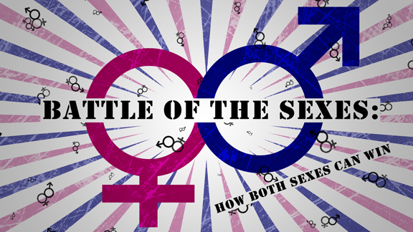

Slide 9
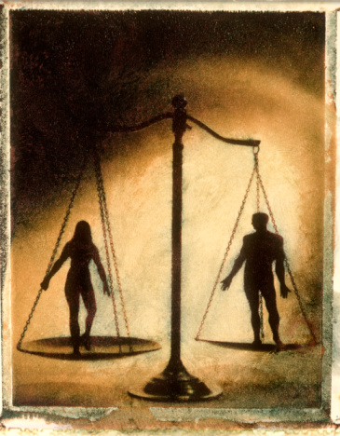
Men and women equal?

Slide 10
How the church should conduct itself when it gathers together to meet with and encounter God in worship.
(Word of correction)

Slide 11
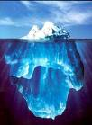
Romans (12 v 1,2)
Therefore, I urge you, brothers, in view of God’s mercy, to offer your bodies as living sacrifices, holy and pleasing to God – this is your spiritual worship.

Slide 12
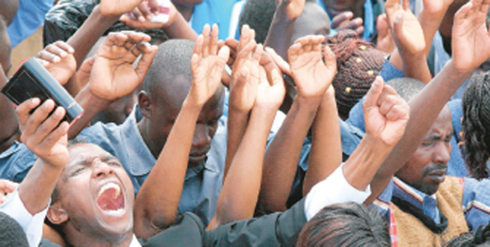
Every worship service should be a joyful celebration, a joyful rehearsal of what God has done for us through Jesus Christ.
(John Stott)

Slide 13
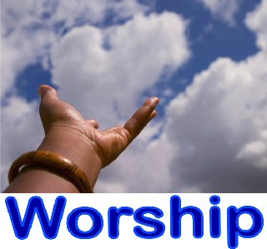
To illuminate our
INTELLECTS
To affect our
EMOTIONS
To engage our
WILLS
To heal our
BODIES and
MINDS

Slide 14
When we come together to worship, there needs to be clear evidence of godly order and spiritual authority.
Both sexes behave in ways that clearly
acknowledge they are of equal value,
dignity and status in God’s sight, but
with different roles, responsibilities and
functions before God.

Slide 15
Flow of divine power and authority in the church
God-ordained authority structure that permits the flow of life-changing power for the good of all God’s people.

Slide 16
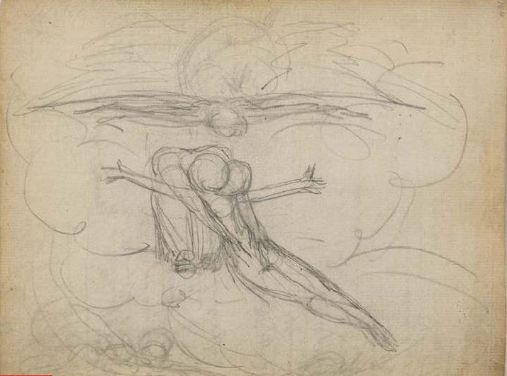
Authority and submission in male-female relationships are meant to reflect those that exist in the eternal Godhead.
THE TRINITY

Slide 17
³ Now I want you to realize that the head of every man is Christ, and the head of the woman is man, and the head of Christ is God.

Slide 18
What does Paul mean by the head of Christ is God?
HEAD (kephale)
Source (origin)
or
Possessing or
having authority

Slide 19
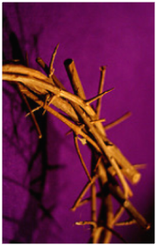
Christ submits to the Father’s
leadership & authority
John 8 v 28,29
When you have lifted up the Son of Man, then you will know that I am he, and that I do nothing on my own authority, but speak just as the Father taught me. And he who sent me is with me. He has not left me alone, for I always do the things that are pleasing to him.

Slide 20
THE TRINITY
The Father, Son and Holy Spirit each possess the divine nature equally, eternally, simultaneously and fully.
The Father, Son and Holy Spirit are not each one-third God, but each is fully God, equally God and this is true eternally and simultaneously.
In essence each member of the Godhead is identical, but in person each is distinct.

Slide 21
The three persons are never in conflict of purpose, never jealous over another’s position or specific work, never prideful over one’s position or work, and they are always sharing fully the delight in being the one God and accomplishing the unified purpose of God.

Slide 22
Here is unity of differentiation, where love abounds and where neither jealousy nor pride is known. Each divine person accepts his role, each in proper relation to the others, and each works together with the others for one unified common purpose.

Slide 23
The three persons love one another, support one another, assist one another, team with one another, honour one another, communicate with one another, and in everything respect and enjoy one another.

Slide 24
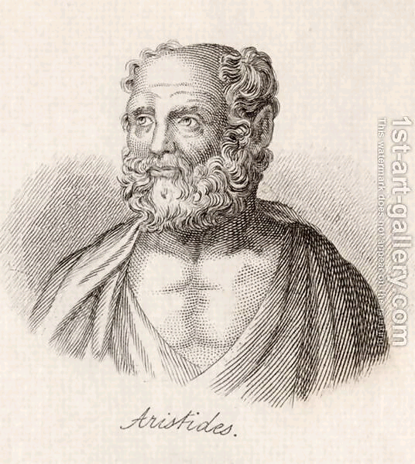
The head of every man is Christ
Image & glory of their Creator
Live under Christ’s authority
Pray & prophesy with head uncovered
Appearance demonstrates culturally
they are male

Slide 25
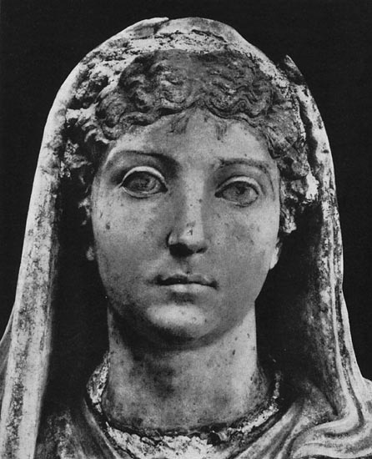
The head of the woman is man
Image of their Creator
Glory of man
Live under man’s authority

Slide 26
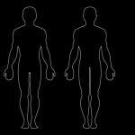
Man (aner) and Woman (gunaikos)
“man & woman” “husband & wife”
Women are only to be submitted to specific men who have legitimate God-given authority in a particular sphere and not to all of the men in general.

Slide 27
Authority and responsibility always go hand in hand

Slide 28
EXAMPLES
2 Corinthians 10 v 8
Ephesians Chapter (5)
Hebrews 13 v 17

Slide 29
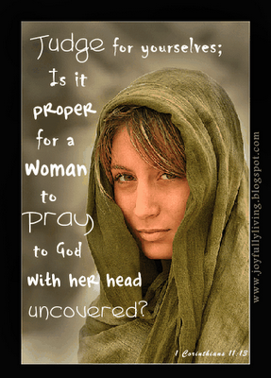
Express their submission to male leadership and authority by praying and prophesying with their head covered
Not to do so was a shameful act!

Slide 30
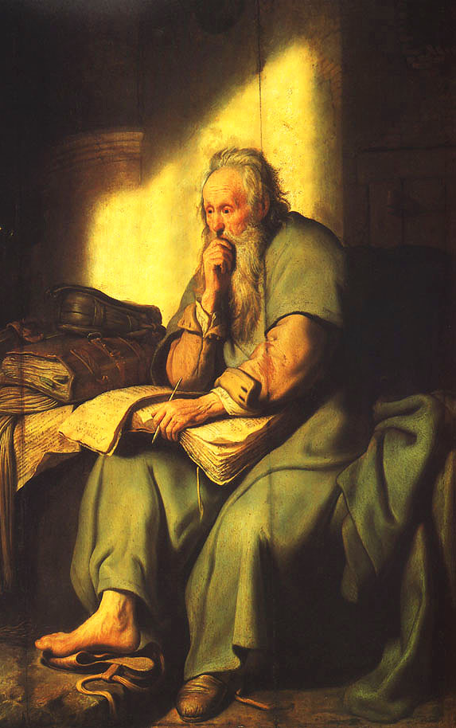
Not personal preference
Not because a misogynist
Not a concession to prevailing culture

Slide 31
Male headship was part of God’s original creation
⁸ For man did not come from woman, but woman from man; 9neither was man created for woman, but woman for man.
(Reference to Genesis (1) & (2))

Slide 32
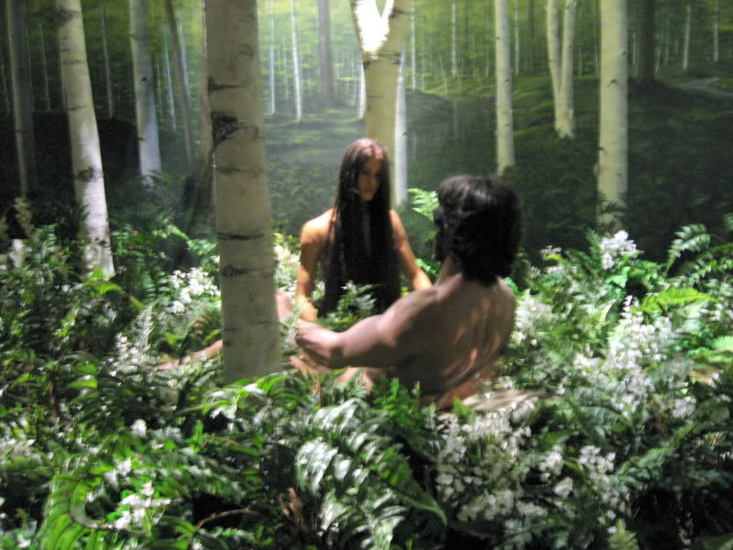
ADAM
Primary responsibility to lead the creation mandate
Leadership that served the spiritual, emotional and physical needs of his wife and family
Nurture godliness and release potential

Slide 33
EVE
It is not good for the man to be alone. I will make a helper suitable for him. (Genesis 2 v 18)
Partner in the global task
Sharing honour and rewards

Slide 34
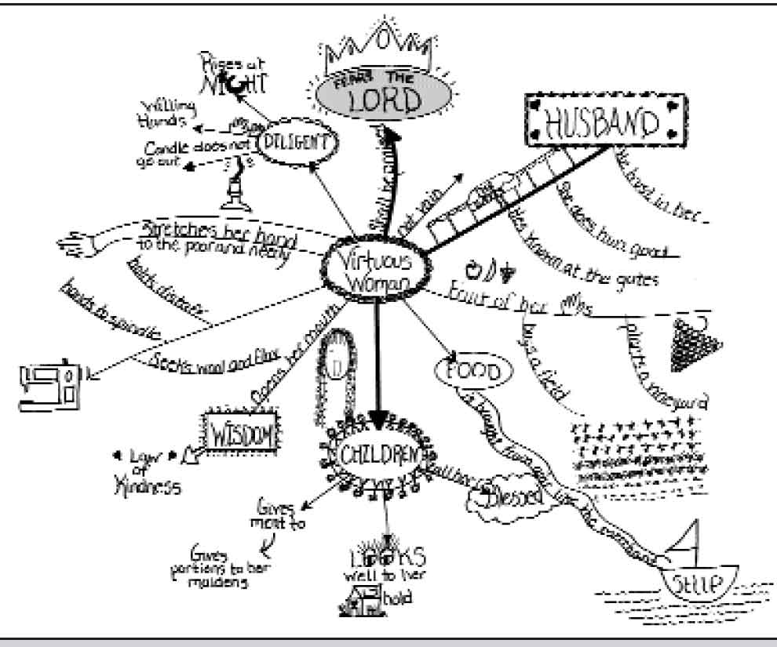
Proverbs 31
Legitimately carry a wide range of authority and initiative themselves in the domestic, economic and business sphere.

Slide 35
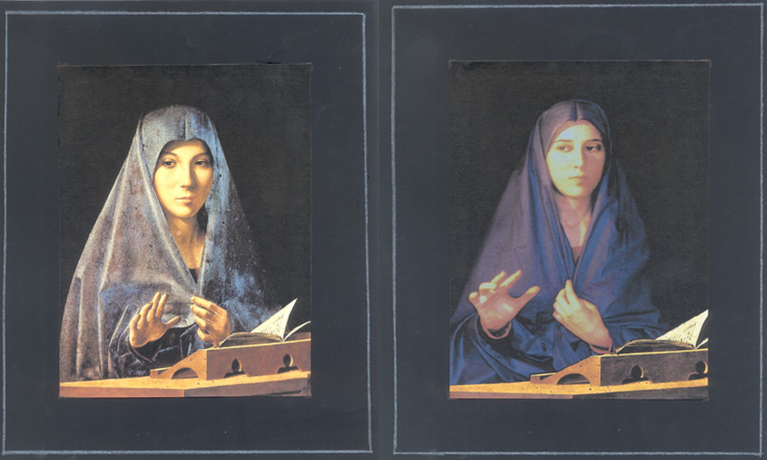
Sign of authority
Feature of her personal appearance that displayed her respect for herself as a woman, and for the men around her as men.
Under godly authority, could therefore exercise authority in praying and prophesying.

Slide 36
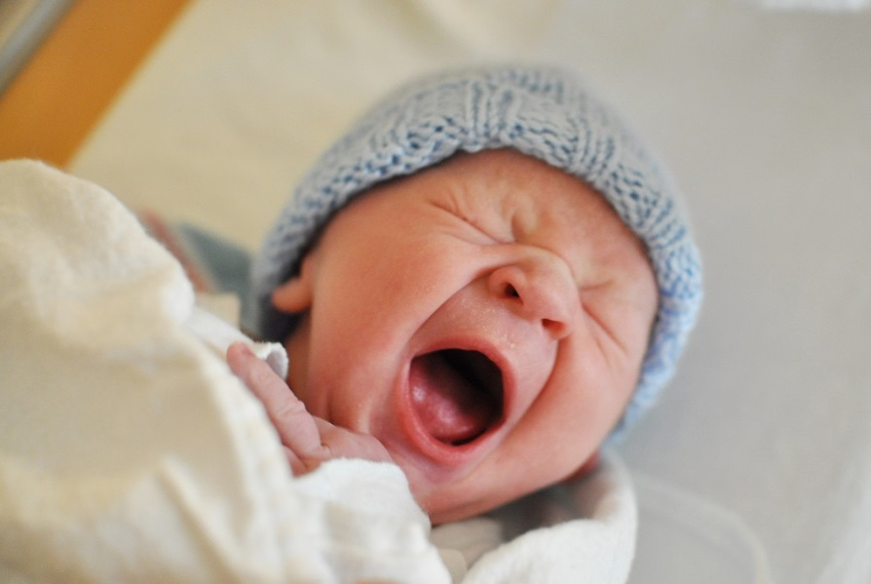
MUTUALLY INTERDEPENDENT
¹¹In the Lord, however, woman is not independent of man, nor is man independent of woman. ¹²For as woman came from man, so also man is born of woman. But everything comes from God.

Slide 37
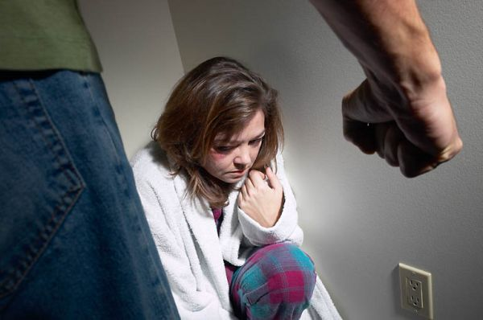
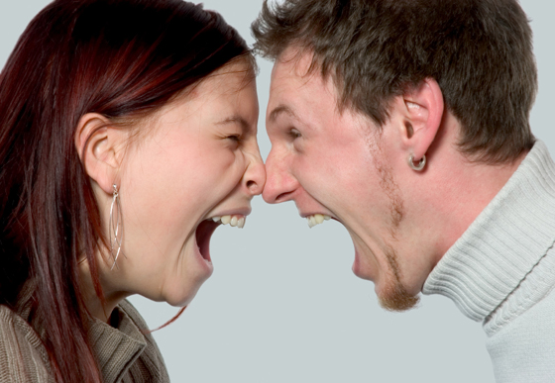
God’s intended order has been distorted & corrupted by sin.

Slide 38
God’s intention for women:
Prosper under the primary leadership of godly men
Released to exercise their God-given power and potential
Contribute to the church’s task of worship and witness
Be highly esteemed and honoured in the body of Christ

Slide 39
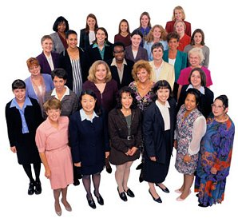
WOMAN
Delighted with the way God has made me?
Cheerfully submit myself to the godly authority of my husband and church leaders?
Fulfilling my God-ordained role of “helper”?

Slide 40
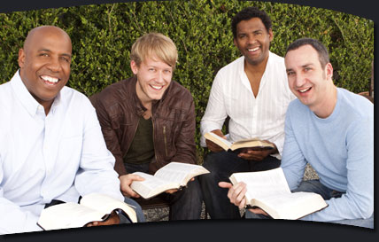
MAN
Accepted my role as primary leader of my home?
Primary concern the welfare of my wife and family?
Taking the lead and showing initiative in the spiritual welfare of my family?
Opting out or taking path of least resistance?

Slide 41
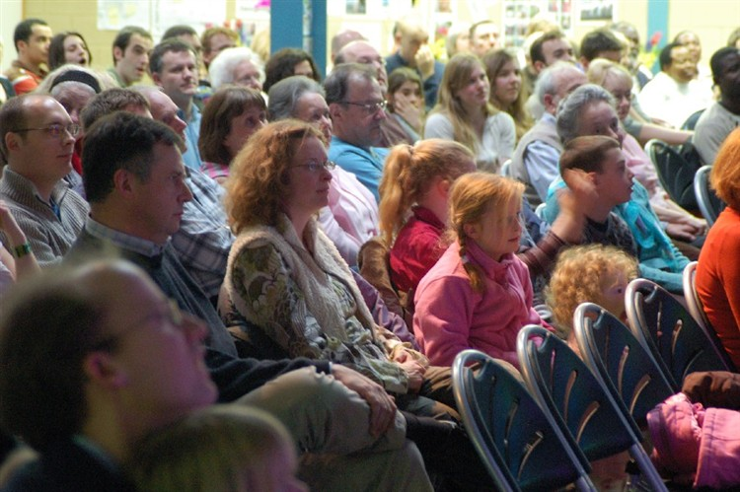
God’s intended order needs to be seen in the church!

Slide 42
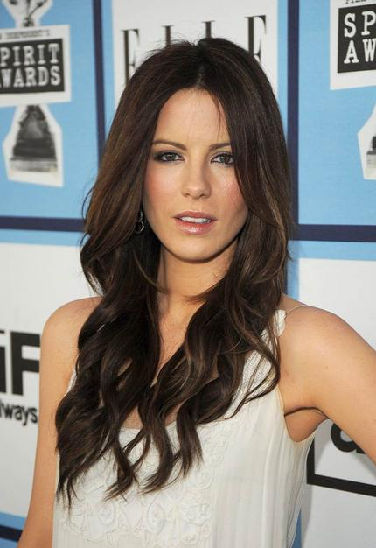
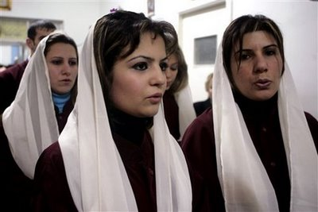
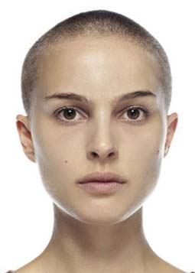
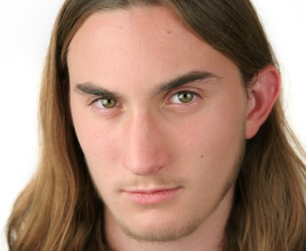
Does this mean?

Slide 43
The principle:
Godly order in the church expressed in a God-ordained authority structure that reflects God’s creation ordinance for men and women and facilitates the flow of spiritual authority and security in worship.

Slide 44
What matters:
Men look like men & women look like women!
Woman:
Cheerfully affirms God’s created order in male/female relationships
Man:
Upholds a woman’s dignity and honour
Embraces the duty to model servant leadership within home & church

Slide 45
MALE ELDERS:
Exercise God-given authority through servant leadership
Respected, obeyed & honoured
Held in high regard in love by all God’s people

Slide 46
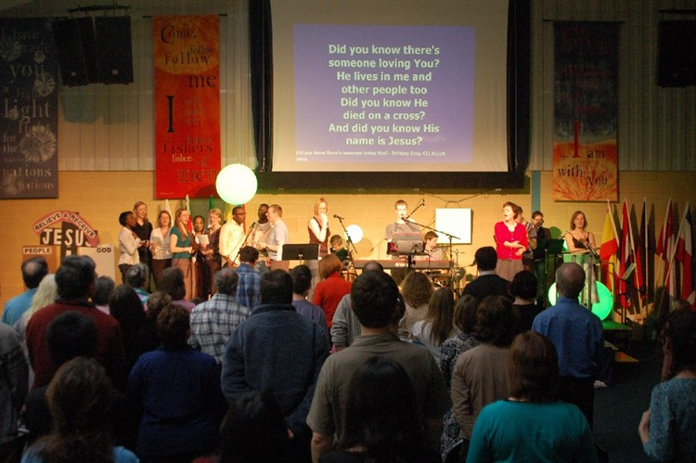
Men & women are released to become all they are meant to be in God’s kingdom!
Together, offer exuberant praise, thanksgiving and worship to the one true God. Be continually filled with his Spirit to become effective witnesses in the world.

Slide 47
The challenge of encountering God
in worship
THE END

