Slide 2
STAND FIRM IN THE FAITH
1 Corinthians 16:12-24

Slide 3
¹² Now concerning our brother Apollos, I strongly urged him to visit you with the other brothers, but it was not at all his will to come now. He will come when he has opportunity.
¹³ Be watchful, stand firm in the faith, act like men, be strong. ¹⁴ Let all that you do be done in love.
1 Corinthians 16:12-14 ESV

Slide 4
15 Now I urge you, brothers—you know that the household of Stephanas were the first converts in Achaia, and that they have devoted themselves to the service of the saints— 16 be subject to such as these, and to every fellow worker and labourer. 17 I rejoice at the coming of Stephanas and Fortunatus and Achaicus, because they have made up for your absence, 18 for they refreshed my spirit as well as yours. Give recognition to such people.
1 Corinthians 16:15-18 ESV

Slide 5
¹⁹ The churches of Asia send you greetings. Aquila and Prisca, together with the church in their house, send you hearty greetings in the Lord. ²⁰ All the brothers send you greetings. Greet one another with a holy kiss.
²¹ I, Paul, write this greeting with my own hand. ²² If anyone has no love for the Lord, let him be accursed. Our Lord, come! ²³ The grace of the Lord Jesus be with you. ²⁴ My love be with you all in Christ Jesus. Amen.
1 Corinthians 16:19-24 ESV

Slide 7
SUPPORT, REASSURANCE AND ACCOUNTABILITY
- Paul has encouraged, challenged, advised and admonished the church members
Apollos will do so in the future
It’s a continued, ongoing relationship between those in the wider church

Slide 8
Practical advice (and instructions!) from Paul

Slide 9
1 - ‘BE WATCHFUL’

Slide 10
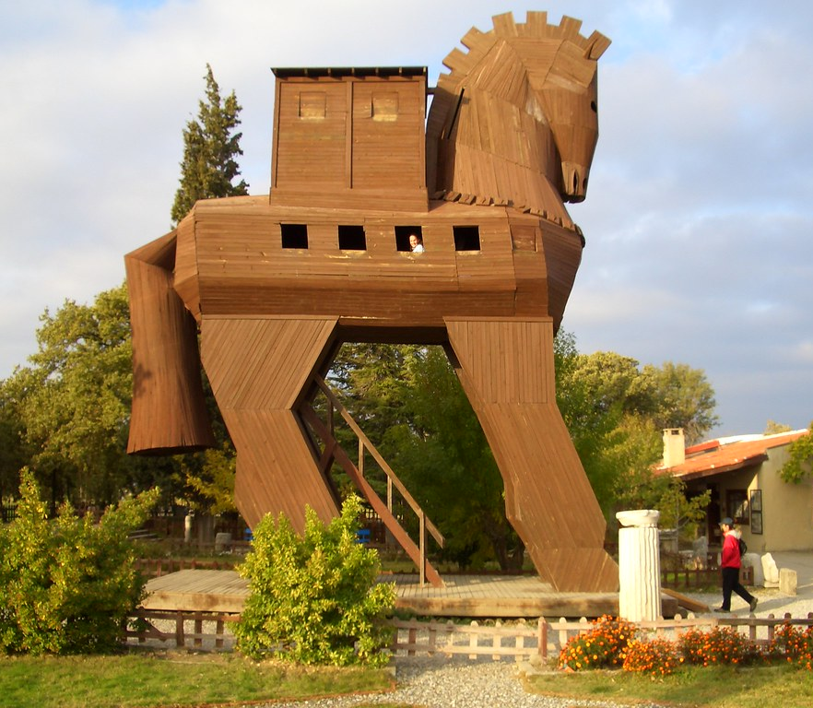
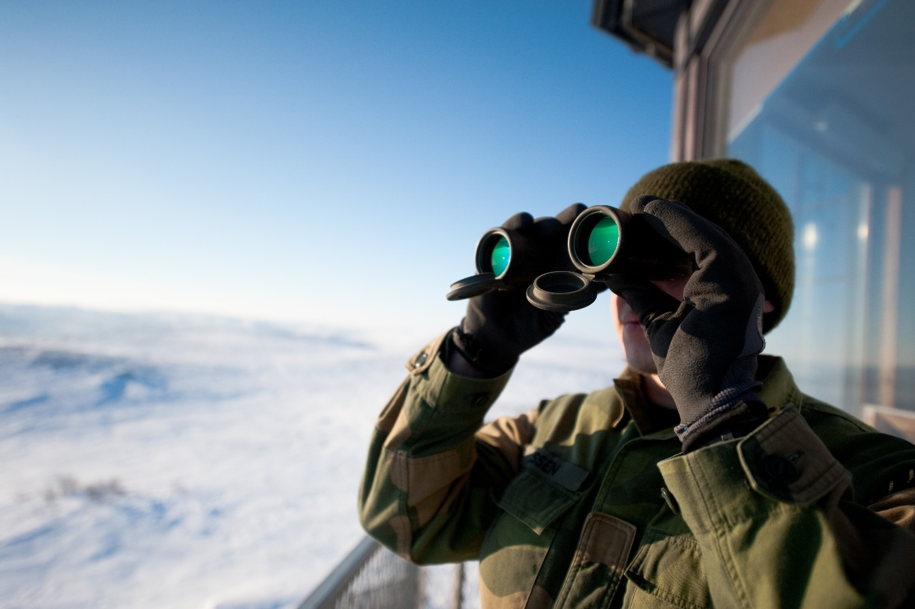

Slide 11
1 - ‘BE WATCHFUL’
- Individually, don’t get complacent
- In the church, look out for each other
- Don’t allow division between people

Slide 12
2 - ‘STAND FIRM IN THE FAITH’

Slide 13
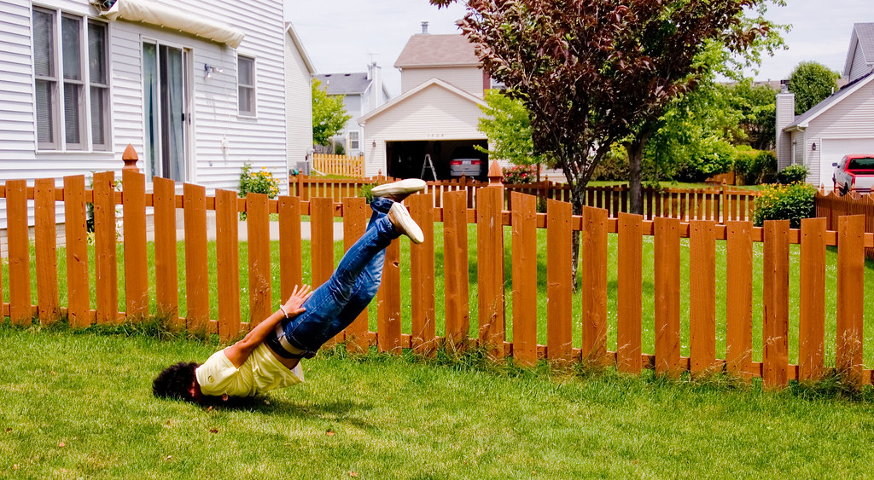

Slide 14
2 - ‘STAND FIRM IN THE FAITH’
- Doctrine, and faith in action.
Know your theology
Act it out in your whole life!
Hebrews 6: The certainty of God’s promise - ‘We have this as a sure and steadfast anchor of the soul’
What is our response to that certainty?

Slide 15
2 - ‘STAND FIRM IN THE FAITH’
James 1: ‘If any of you lacks wisdom, let him ask God, who gives generously to all without reproach, and it will be given him. 6 But let him ask in faith, with no doubting, for the one who doubts is like a wave of the sea that is driven and tossed by the wind. 7 For that person must not suppose that he will receive anything from the Lord; 8 he is a double-minded man, unstable in all his ways.

Slide 16
2 - ‘STAND FIRM IN THE FAITH’
Through hardship and suffering
For the benefit of friends, family and community
Against sin and temptation
For the long haul – run the race with endurance

Slide 17
‘3 - ACT LIKE MEN, 4 - BE STRONG’ ESV
‘3 - BE COURAGEOUS, 4 - BE STRONG’ NIV

Slide 18
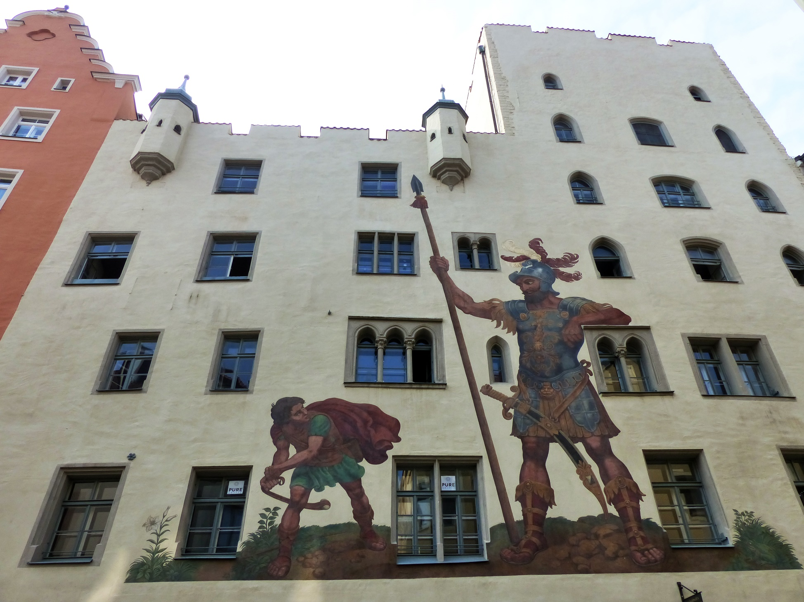

Slide 19
‘ACT LIKE MEN, BE STRONG’ ESV
‘Be courageous, be strong’ NIV
- Common phrase in OT – be bold and courageous
A reminder to those in Corinth of God’s faithfulness to his people in previous generations
Be like warriors ready for battle; don’t abdicate responsibility

Slide 20
‘ACT LIKE MEN, BE STRONG’ ESV
‘Be courageous, be strong’ NIV
Able to stand your ground when under attack
Not just ‘mighty’ - God’s call on men is also to be patient and sacrificial

Slide 21
‘ACT LIKE MEN, BE STRONG’ ESV
‘Be courageous, be strong’ NIV
Eph 6:10 – ‘Be strong in the Lord and in the strength of his might. 11 Put on the whole armour of God, that you may be able to stand against the schemes of the devil’
1 Cor 14:20 – ‘Brothers, do not be children in your thinking’

Slide 22
BE WATCHFUL
STAND FIRM IN THE FAITH
BE COURAGEOUS
BE STRONG
Military; brief;

Slide 23
‘LET ALL THAT YOU DO BE DONE IN LOVE’
A contrast to the punchy, direct actions before
Let all that you do… not restricted to certain tasks/situations
Passivity/inaction isn’t an option – Paul redirects poor practice, but doesn’t call a halt to everything
As Christ first loved us, we then love others. We depend on Him for strength, for courage, for the ability to love well

Slide 24
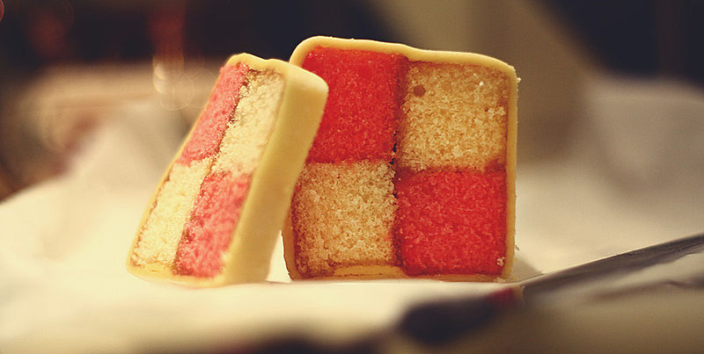

Slide 25
‘LET ALL THAT YOU DO BE DONE IN LOVE’
1 Corinthians 13 (ESV)
1 If I speak in the tongues of men and of angels, but have not love, I am a noisy gong or a clanging cymbal. 2 And if I have prophetic powers, and understand all mysteries and all knowledge, and if I have all faith, so as to remove mountains, but have not love, I am nothing. 3 If I give away all I have, and if I deliver up my body to be burned, but have not love, I gain nothing.

Slide 26
‘LET ALL THAT YOU DO BE DONE IN LOVE’
Colossians 3 (ESV)
13 Bear with each other and forgive one another if any of you has a grievance against someone. Forgive as the Lord forgave you.
14 And over all these virtues put on love, which binds them all together in perfect unity

Slide 28
PART OF SOMETHING BIGGER
15 Now I urge you, brothers—you know that the household of Stephanas were the first converts in Achaia, and that they have devoted themselves to the service of the saints— 16 be subject to such as these, and to every fellow worker and labourer. 17 I rejoice at the coming of Stephanas and Fortunatus and Achaicus, because they have made up for your absence, 18 for they refreshed my spirit as well as yours. Give recognition to such people.
1 Corinthians 16:15-18 ESV

Slide 29
PART OF SOMETHING BIGGER

Slide 30
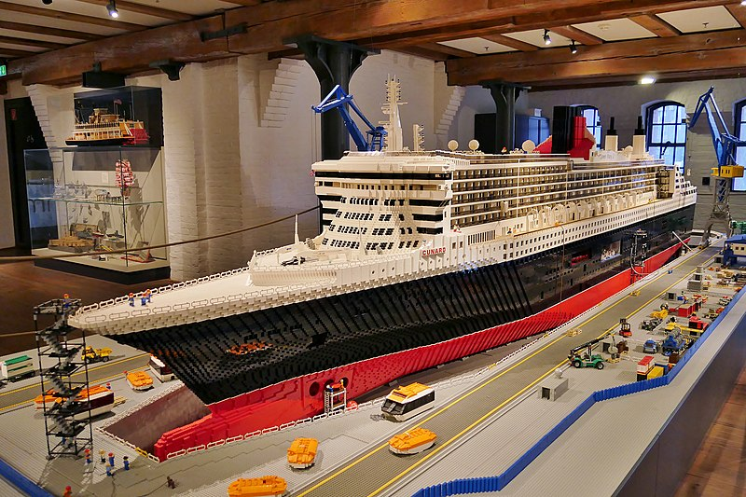
PART OF SOMETHING BIGGER

Slide 31
PART OF SOMETHING BIGGER

Slide 32
LOVE JESUS AND LOVE ONE ANOTHER
¹⁹ The churches of Asia send you greetings. Aquila and Prisca, together with the church in their house, send you hearty greetings in the Lord. ²⁰ All the brothers send you greetings. Greet one another with a holy kiss.
²¹ I, Paul, write this greeting with my own hand. ²² If anyone has no love for the Lord, let him be accursed. Our Lord, come! ²³ The grace of the Lord Jesus be with you. ²⁴ My love be with you all in Christ Jesus. Amen.
1 Corinthians 16:19-24 ESV

Slide 33
LOVE JESUS AND LOVE ONE ANOTHER
Example of Prisca and Acquila as people to emulate. Whatever their location – Rome, Corinth or Ephesus - they had people gather around them. They must’ve been good fun!
‘Greet each other with a Holy kiss’ - real sense of fellowship and affection
Paul could add further challenge or correction, but finishes with love

Slide 34
A FINAL WORD to the church in Corinth:
Personal responsibility
Be diligent about your faith: sticking to good doctrine, but also living out your faith. Understanding and action.
Unity and community
Fight for unity and against division. Not a collection of individuals, but members of a body, who support and encourage one another
Look to Jesus
Delight in Him, and depend on Him so that all you do may be done in love

Slide 35
STAND FIRM IN THE FAITH
Psalm 62
⁵ For God alone, O my soul, wait in silence, for my hope is from him. ⁶ He only is my rock and my salvation, my fortress; I shall not be shaken. ⁷ On God rests my salvation and my glory; my mighty rock, my refuge is God.

Slide 36
